Slide 1
EUI Comprehensive Emergency Plan
CFA AiFOS - Sicuring s.r.l. - Firenze - Certificati con RINA group - www.sicuring.it
Emergency phone: 055/4685.999, extension 2999
1

Slide 2

Contents
Emergency Plan – Emergency Management
Workers’ Rights – Responsibility and Involvement
Raising the Alarm – Initial Emergency Response
Evacuation Procedures – Emergency Officer’s Duties
Detecting Emergencies
Medical Emergencies
Flooding and Tornadoes
Earthquakes
Power Outages
Emergencies due to Fires
Evacuation
2

Slide 3
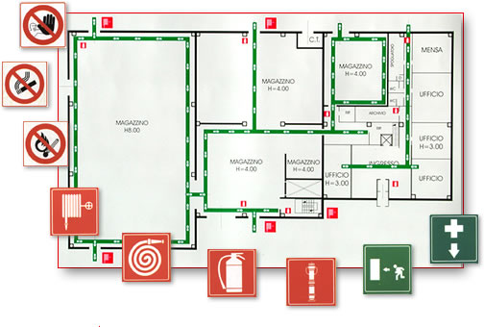
The Emergency Plan
3

Slide 4
The Emergency Plan
EMERGENCY: Any abnormal situation which presents a potential or actual risk.
EMERGENCY PLAN: Systematic procedures that clearly detail what needs to be done to respond to emergency situations.
4

Slide 5

The Emergency Plan
THE EMERGENCY OFFICER: The person who has been designated to coordinate the emergency response actions, in the event that the Staff Safety and Health Representative is an external consultant.
The Emergency Officer manages operations and is responsible for deciding to evacuate the premises. The Emergency Officer coordinates all actions, including liaising with external professional emergency services, and issues instructions to the Emergency Teams, managing the actions of the Area Contacts from the areas involved, helped in this by the workplace Emergency Team Coordinators.
5

Slide 6


The Emergency Plan
EMPLOYEES OF EXTERNAL COMPANIES: Staff employed by other companies working on the EUI premises in the performance of specific tasks and activities (e.g., the company providing cleaning services, heating and electricity maintenance technicians, canteen management and catering service, etc.).
VISITORS: Persons visiting the EUI, e.g. participants in conferences, researchers, etc.
6

Slide 7
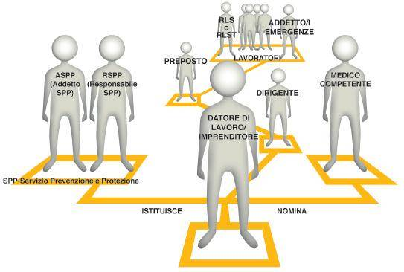
Emergency Management
7

Slide 8


Emergency Management
In compliance with existing obligations, the Employer shall:
a) Ensure that collaboration with the competent public services is properly organized, for the provision of first aid, rescue, fire fighting services and emergency management;
b) Designate, in advance, workers in charge of emergency management;
8

Slide 9
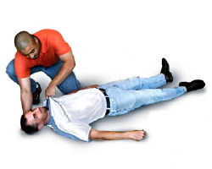
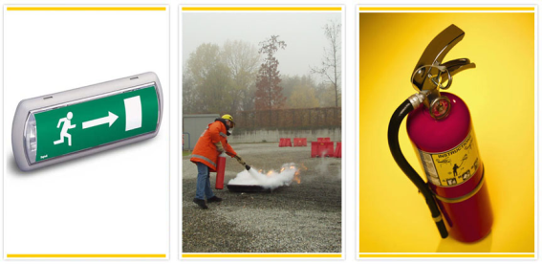
Emergency Management
c) Inform all workers who may be exposed to serious and imminent danger of all provisions implemented and of how they should behave;
9

Slide 10

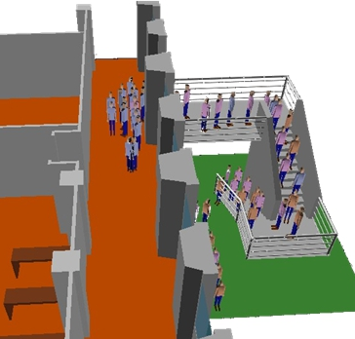

Emergency Management
d) Plan interventions, decide measures and give instructions, in the event of a serious and imminent danger which cannot be averted, so that workers can cease their activity, and go towards a safe place, immediately abandoning the workplace;
10

Slide 11
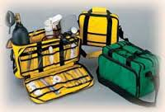
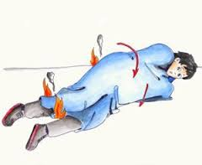
Emergency Management
e) Implement all necessary measures in order to enable any worker, in the event of a serious and imminent danger to his/her personal safety or to the safety of other persons, and in the event that such a worker is unable to contact the Officer in charge, to undertake any action aimed at averting the consequences of the danger, making the best use of his/her own knowledge and of available technical resources.
11

Slide 12

Emergency Management
In designating the workers serving as officers in charge of the Prevention and Protection Service, the Employer shall take into consideration the size and extent of the premises, as well as the specific risks which have been identified.
No worker, except for serious and duly justified motives, may refuse such a designation.
12

Slide 13
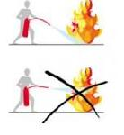




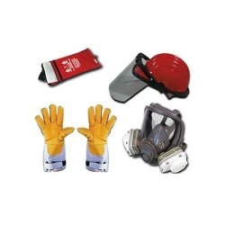




Emergency Management
Workers designated shall be provided with adequate training; their numbers shall be sufficient in relation to the size and specific risks of the premises and they shall be equipped with suitable equipment
13

Slide 14
Emergency Management
Except in the event of duly justified circumstances, the Employer shall not ask workers to resume their activities in a situation in which a serious and imminent danger persists.
14

Slide 15

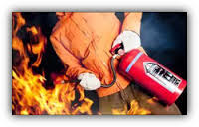
Workers’ Rights
In the event of serious and imminent danger, any worker who is unable to contact his immediate superior, competent for emergencies, and who acts independently to avoid the consequences of the imminent danger, shall not be subject to reprimands or punishments for his actions, except in the event that he is found guilty of severe negligence.
In the event of serious and imminent danger, any worker abandoning his/her workplace, or leaving a dangerous area, shall not be subject to reprimands or punishments and shall be protected from any harmful consequence.
15

Slide 16



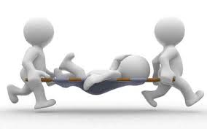
Responsibility and Involvement
All Workers:
In the event of an emergency, it is the duty of any worker to advise the staff members designated as members of the Emergency Team and their Coordinator and/or the Control Room.
Emergency Team Coordinator:
Extinguishes small fires
Provides first aid
In the event of evacuation, ensures that members of staff leave the premises in an orderly manner and according to plan
16

Slide 17



Raising the Alarm
Any person detecting an outbreak of fire or any other abnormality (presence of smoke, flooding, water leaks, explosion, structural collapse, leakage of flammable substances, etc.) shall immediately notify the Emergency Officer, providing the following information:
1. The nature of the emergency
2. Her/his exact position
3. The presence of injured persons
4. Her/his name
Memorize or keep with you the emergency phone number: 055/4685.999, extension 2999.
Take note of your building’s Porters’ Lodge phone number, which can be used alongside or instead of the emergency number in the event of danger: 055/4685.999, extension 2999.
17

Slide 18





Raising the Alarm
In the event of fire, it is preferable to use the existing fire alarms. Any person detecting a fire shall immediately notify the Emergency Officer, all persons who may be affected by further developments of the event detected, and the Emergency Team whose task it is to address the emergency.
18

Slide 19

Initial Emergency Response
Persons present may attempt to respond to the emergency, but only if they are capable of doing so and if this can be done without prejudice to their own safety and that of others.
In the case of fire, the Emergency Team Coordinator shall attempt to extinguish the fire with the extinguishers located on that floor, carefully following the instructions.
19

Slide 20



Evacuation Procedures
In the event that the Emergency Officer issues the order to evacuate the premises, all personnel present shall proceed towards the Emergency Exits, as indicated on the emergency signs.
20

Slide 21


Evacuation Procedures
IN AN EVACUATION ALL PERSONS SHALL ABIDE BY THE FOLLOWING RULES:
leave the premises without delay, in an orderly and calm manner, without creating undue alarm or confusion, and without hindering rescue workers;
do not take with you umbrellas, or any kind of heavy or large bags and packages;
do not go back inside for any reason whatsoever;
do not obstruct the entrances to the building.
21

Slide 22

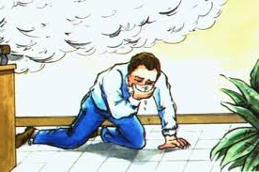
Evacuation Procedures
IN THE PRESENCE OF SMOKE OR FLAMES:
You are advised, if possible, to soak a handkerchief in water and tie it over your nose and mouth, so as to protect your airways from smoke as much as possible.
If available, use woolen clothes to protect your head, face and hands.
22

Slide 23

Emergency Officer’s Duties
In the event of fire or of any other danger, emergency actions shall be coordinated by a single person, who must be given as much information as possible on the event: this person shall take all operational decisions.
23

Slide 24


Emergency Officer’s Duties
In the event of fire or any other kind of danger:
the Emergency Officer shall go to the location in order to evaluate the severity of the situation.
The Officer, or another person delegated by him, shall:
order evacuation of premises, if necessary
order the Control Room to alert external emergency services (Fire Department, Medical Emergency Services, etc.)
immediately order that external companies interrupt the provision of services, ensuring that their equipment is secured appropriately and order the immediate evacuation of all persons, caring especially for persons with disabilities, even of a temporary nature, and visitors ;
turn off all heating and air conditioning systems;
24
turn off the supply of electricity and gas; ensure that no one is blocked in the lifts or closed in the bathrooms.

Slide 25




Detecting Emergencies
On the EUI premises the types of emergencies that can be foreseen are the following:
Medical Emergencies (injuries, accidents, acute illnesses), affecting employees and any other person on the premises for conferences, etc.
Emergencies due to flooding or other water leaks, and earthquakes.
Emergencies due to fires and explosions.
25

Slide 26
Medical Emergencies
If an employee is involved in an accident or is suddenly affected by an acute illness, any person present shall immediately notify the Emergency Officer.
Stay with the injured or ill person until the arrival of the emergency team.
With the exception of cases in which the victim’s life is in imminent danger, do not attempt to help: do not move him/her and do not give him/her anything to drink.
In the person has fallen, do not move him/her.
26

Slide 27



Medical Emergencies
Refrain from asking the victim banal or inquisitive questions such as:
- How did the accident happen?
- Whose fault was it? etc.
Talk to the victim as little as possible, in order not to increase the victim’s stress, thereby worsening his/her physical and psychological shock. Only use reassuring, calming words and tones.
After the intervention of the medical emergency and rescue services, remain at the location to help, if needed, in reconstructing the event.
27

Slide 28

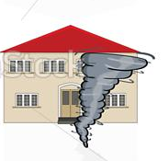
Flooding and Tornadoes
There are many possible causes of accidents and damage, such as those caused by water and wind: from simple water leaks to flooding, from a strong wind to a tornado.
These are phenomena for which operational emergency procedures must be envisaged.
28

Slide 29

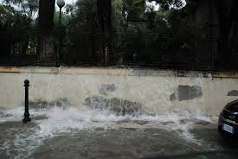
Water Leaks and Flooding
Floods are increasingly frequent and water leaks can also have
serious consequences.
IN THESE CASES:
Stay calm and do not walk on the wet area to avoid slipping,
Immediately notify:
Your immediate superior
The Emergency Officer
Provide information on the nature, the exact location and especially the extent of the water leak or the characteristics of the flood, including its cause if you know it.
29

Slide 30





Flooding
Report any danger that is a threat to valuable assets, documents, etc.
Use extreme caution in the presence of electric appliances or plugs near the flooded area. In the event of imminent danger, evacuate the area.
If you are sure you have identified the cause of the leak and believe that you are capable of remedying the situation (for example, by closing a valve handwheel, or clearing an obstructed drain), act accordingly. But always proceed with caution.
Remain on the spot, without interfering with the emergency services, so as to collaborate on recovery of valuables, documents, etc.
30

Slide 31

Earthquakes
In the event of an earthquake, find out as much as possible about the severity of the event:
Keep calm and take shelter under a table or in a doorway.
If this does not put your life or that of others in jeopardy, evacuate the premises.
31

Slide 32






Power Outages
In the event of a power outage:
Stay calm.
Help any person who shows signs of being distressed or of panicking.
Show those present the emergency exits and escape routes, trying to guide them calmly in the right direction, along the routes lit by the emergency lights.
32

Slide 33


Power Outages
If you are in a completely dark area, take some time waiting to see whether the electricity supply is restored. After a little while, use your memory to try and visualize the room and any obstacles in it. If possible, use the light on your cell phone. Then move, with the utmost caution, towards the exit or towards another area provided with emergency lighting.
If you are given the order to evacuate, go straight to the emergency exits.
33

Slide 34





Emergencies due to Fires
In the event of a fire, behave as follows:
Stay calm
Press the fire alarm button
Immediately notify:
Your immediate superior
The Emergency Officer
34

Slide 35
Emergencies due to Fires
Move as far away as possible from the fire any flammable substance and unplug electric appliances: this will reduce the risk of fire propagation.
If the outbreak of fire is small, and if you feel capable of trying to extinguish it, use the fire extinguisher to put it out.
In no way put your physical safety at risk.
35

Slide 36




Emergencies due to Fires
Do everything you can to stop the fire from spreading in such a way that it gets between you and your escape route.
If you are not capable of extinguishing the fire, evacuate the area.
Close all doors and windows behind you, before you leave the area and head for the emergency exits
36

Slide 37


Emergencies due to Fires
Do not break windows or open them until the fire has been properly extinguished, since the oxygen in the air would further fuel the flames.
Use caution in opening doors. Before opening a door, touch it to feel whether it is hot. If it is hot, or if smoke is coming through it, look for another safety exit; if you have no alternatives and must open it, only do so with the utmost caution.
37

Slide 38
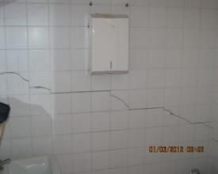
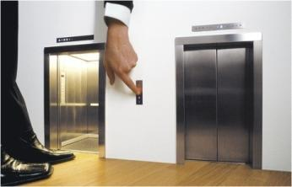

Emergencies due to Fires
Check carefully for the presence of cracks. Horizontal cracks are much more dangerous than vertical ones, since they indicate that the walls are straining outwards.
38
Do not use lifts.

Slide 39


Emergencies due to Fires
no
no
no
Do not try to carry with you to safety any personal object which may slow you down or get in the way as you evacuate the premises.
39

Slide 40


Emergencies due to Fires
Do not return to the area you have evacuated until you are authorized to do so by the Officer in charge of the Emergency Team.
40
no

Slide 41



Evacuation
Help any person(s) needing assistance and reassure them.
Help people with disabilities, if they are in need
and not being helped by the rescue teams.
Take with you only your car and house keys, and only if they are close at hand. Do not take any heavy or large items with you.
41

Slide 42

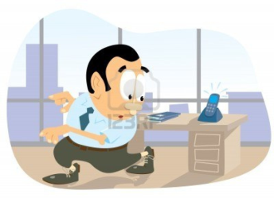

Evacuation
In the event that an evacuation order is issued, behave as follows:
Stay calm.
Stop doing whatever you were doing.
Move away quickly.
42

Slide 43
Evacuation
The Area Contact or the person who has been designated shall ensure that all employees and external collaborators have left the premises.
Each employee shall also ensure that all the other people present are evacuating the premises.
As you leave the premises always check, quickly, that no one is in cloakrooms, storage rooms, archives, bathrooms or in the lifts.
43

Slide 44


Evacuation
As you leave, close all doors behind you. Closed doors can slow down the spread of fire and of smoke. Only if you have been given specific instructions to do so, leave the doors and windows open, to ward off the risk of explosions.
44

Slide 45

Evacuation
Make your way towards the emergency exits, without running, without inducing panic.
Do not push other people. Hold on tightly to the railings when you go downstairs, to avoid falling should anyone push you.
45

Slide 46

Evacuation
When you have reached the outside of the building, make your way immediately to the Assembly Point and check that all your colleagues are there with you!!!!!
46

