Slide 1
Research Data Collections & Services EUI Library 29 August 2024

Slide 2
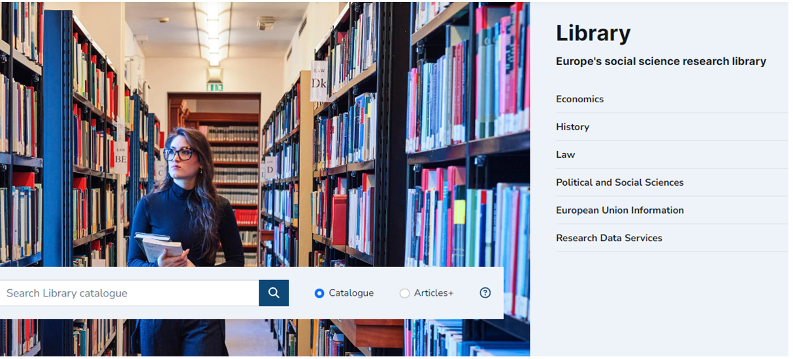

Slide 4
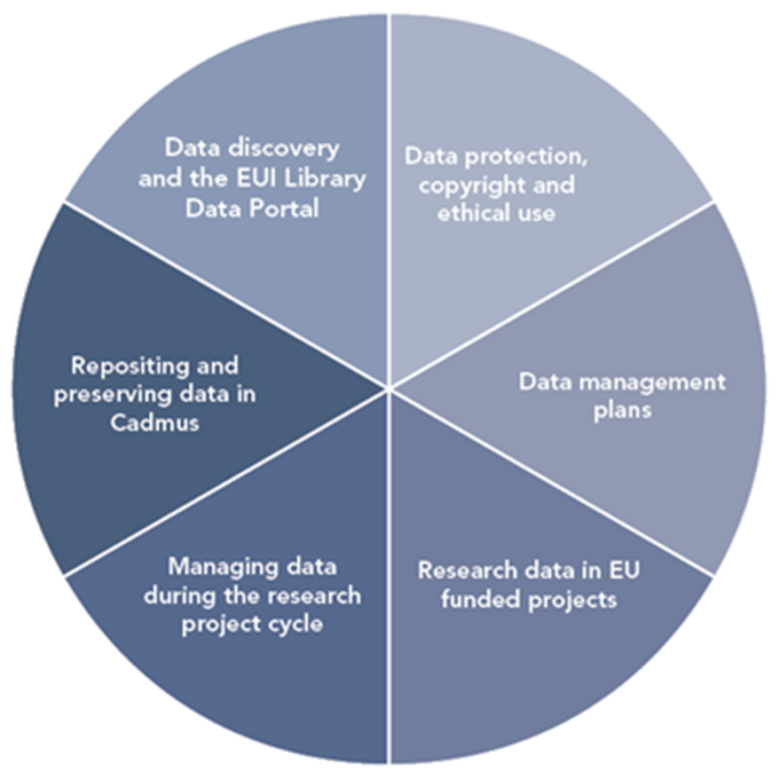
Research Data Lifecycle

Slide 5
Data discovery and generation
Data use
Data preservation and sharing

Slide 6
Data discovery and generation

Slide 7
Inputs, use, outputs
Discovery | Elaboration | Output
● Topic ● Level of analysis / granularity ● Temporal coverage / frequency ● Geographical coverage ● Methodology / variables | ● Sub-setting ● Combining ● Customising selections | ● Exporting ● Saving ● Preserving ● Sharing

Slide 8
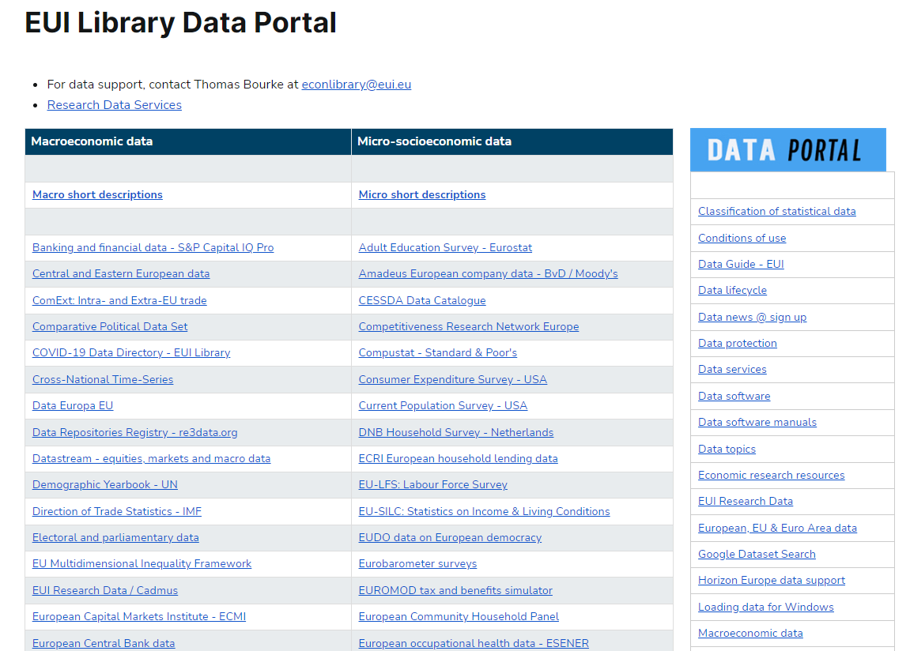

Slide 9
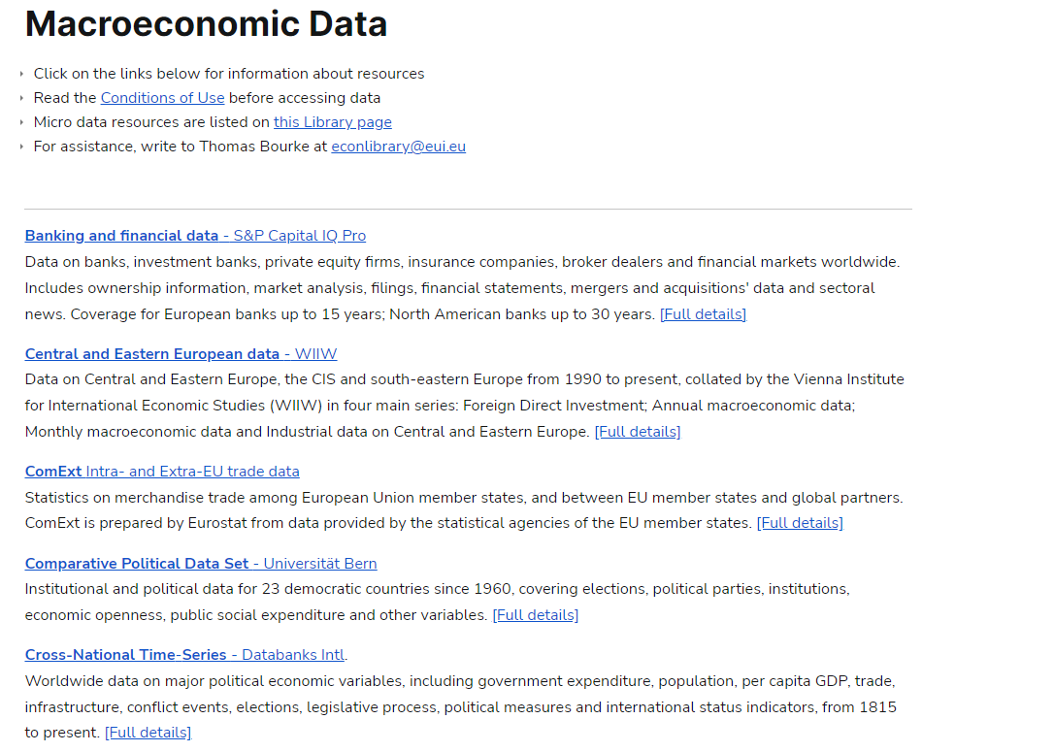

Slide 10
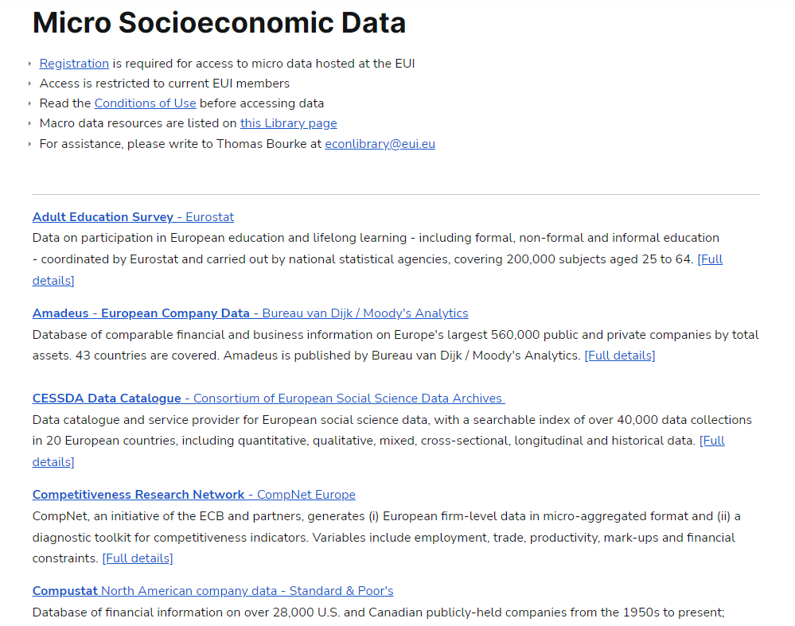

Slide 11
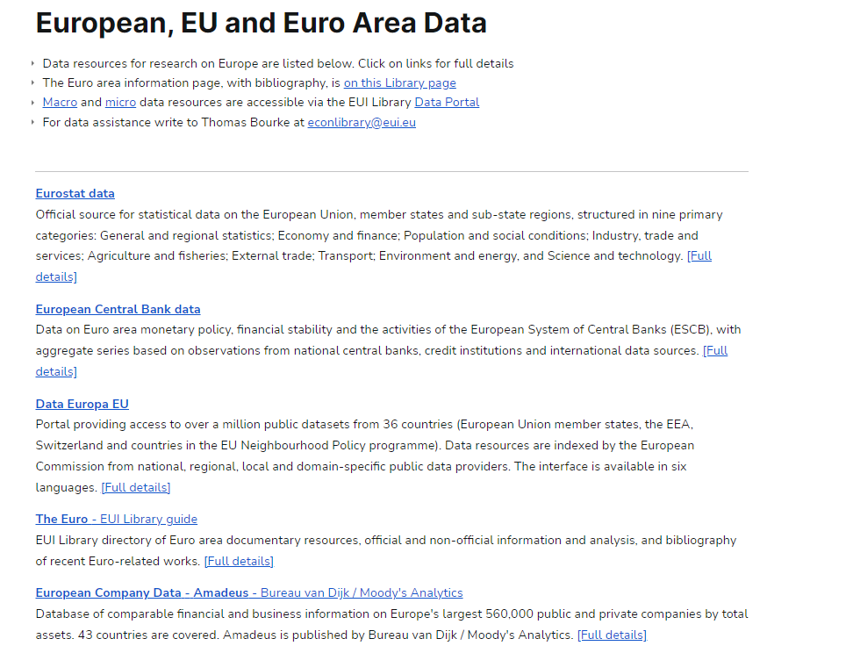

Slide 12
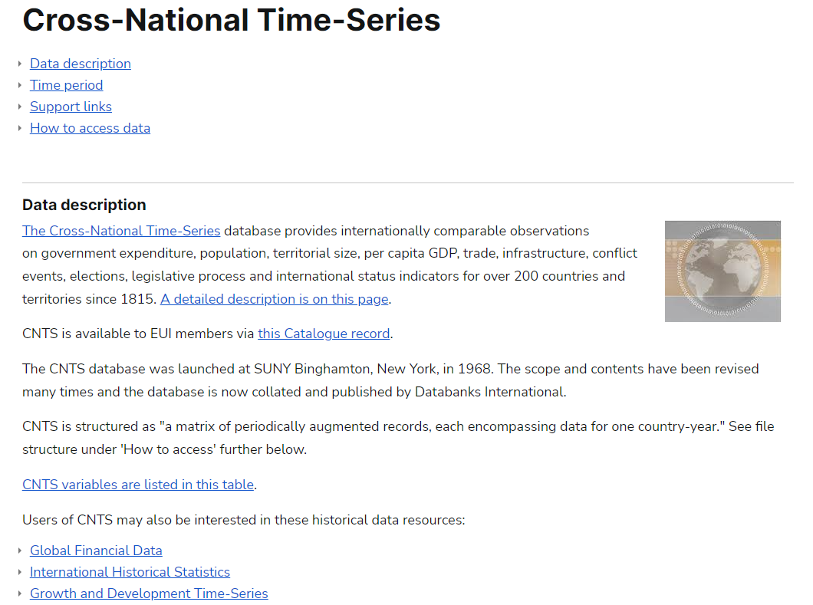

Slide 13
Examples
East / Central European data (WIIW)
Cross-National Time-Series (Databanks Intl.)
International Country Risk Guide (ICRG)
Compustat (S&P)
OECD iLibrary
Datastream (Refinitiv)
Amadeus (Moody’s Analytics)

Slide 14
Micro socio-economic data Library restricted server
Special terms and conditions of access and use
Registration required
Library restricted server K:/

Slide 15
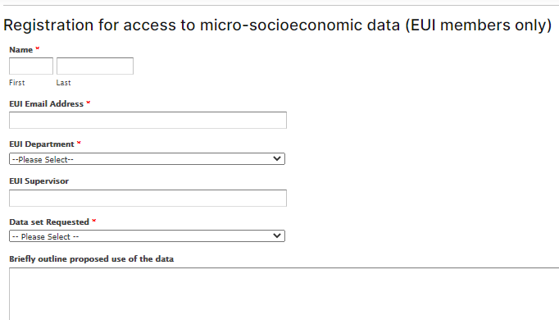

Slide 16
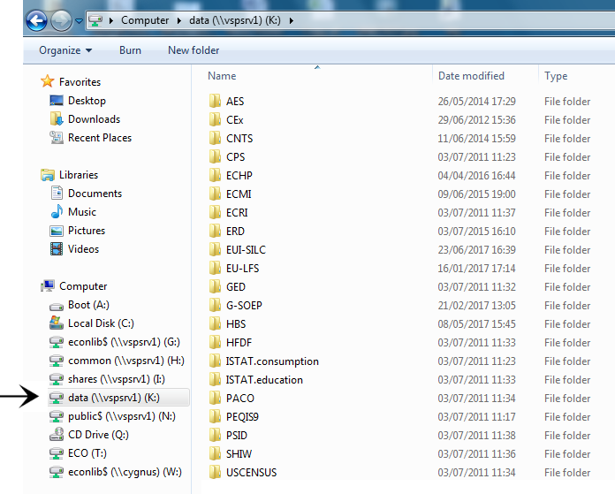
Restricted server K

Slide 17
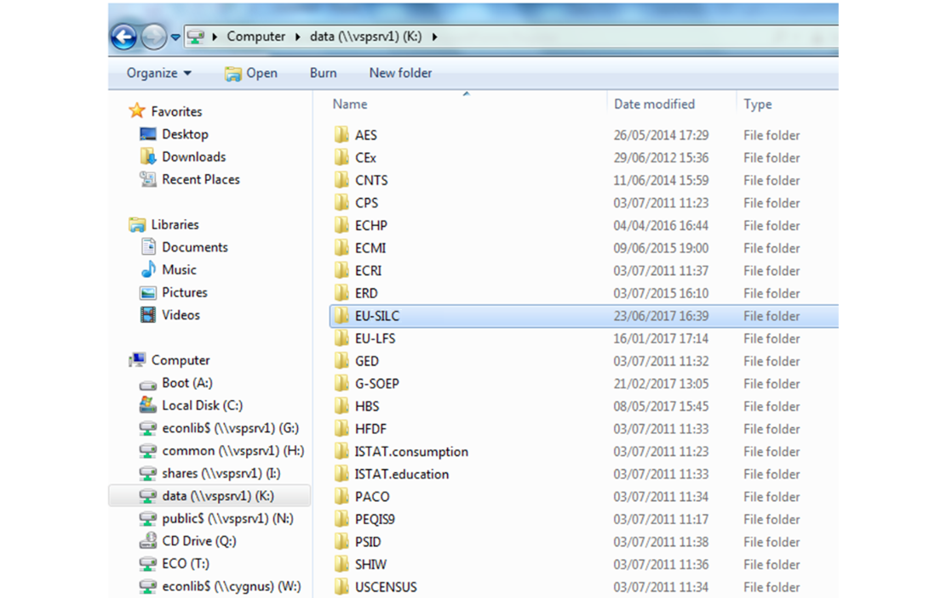
EU-SILC

Slide 18
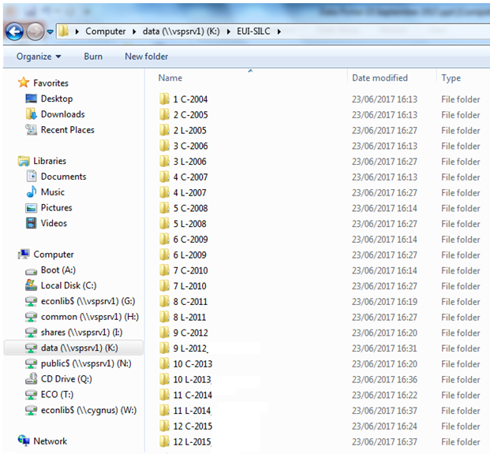

Slide 19
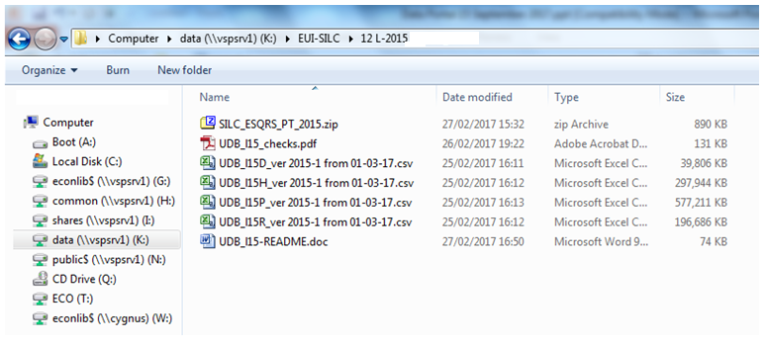

Slide 20
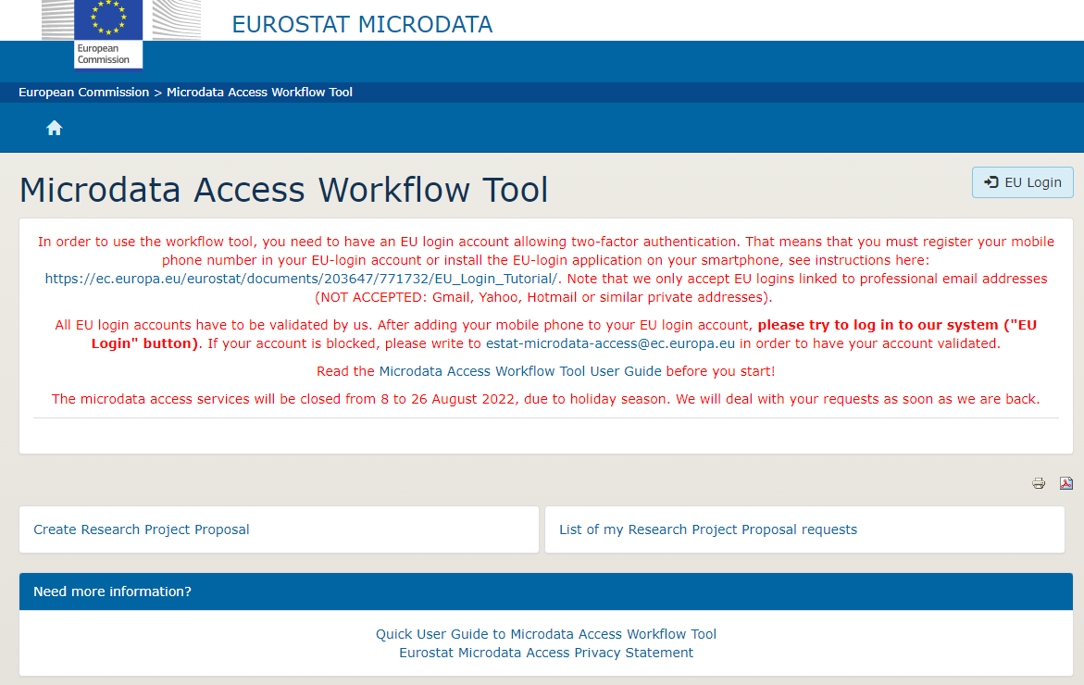
Eurostat micro data application

Slide 21
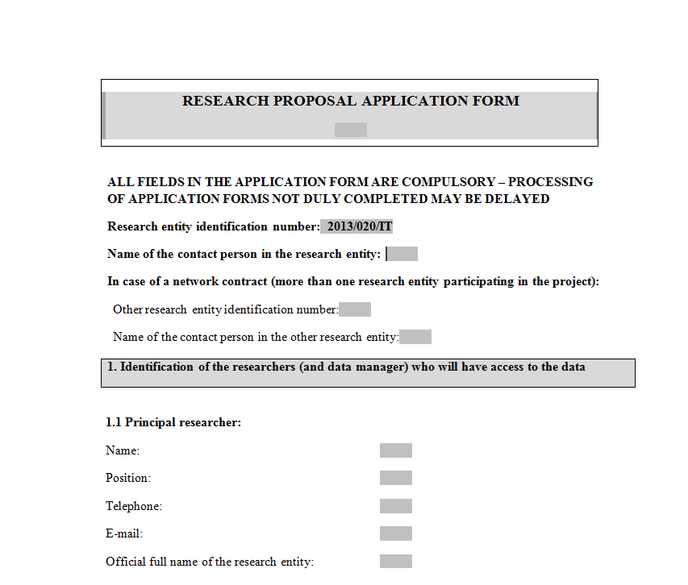

Slide 22
Data archives

Slide 24
Research Data Lifecycle

Slide 25
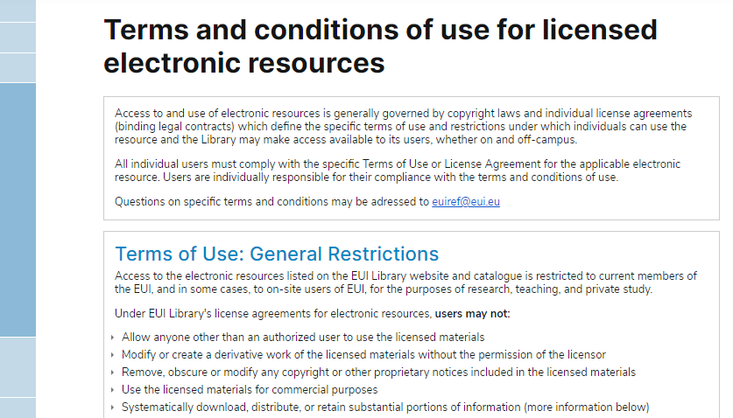

Slide 26
Data Protection: Collecting, generating and processing data
Special terms and conditions apply when collecting and processing micro-socioeconomic and qualitative data – reflecting the sensitive nature of data observations about persons, families and households
Persons, families and households cannot be identifiable in any dataset.

Slide 27
Anonymisation
Remove personal data identifiers (names, postcodes, workplaces, telephone numbers &c.)
Aggregate, or reduce, the precision of variables, eg: year of birth rather than birth date
Use a general level of geo-coding
Generalise meanings/categories; reduce the precision of variables
Remove the upper or lower ranges of observations
Timing of anonymisation:
At time of data collection
During elaboration (data processing)
Public version of data can be created.

Slide 28
Pseudonymisation
Provide justification for why data are not anonymised (eg. follow-up wave of survey)
Replace personal identifiers (such as names) with unique identifiers (codes)
Store/encrypt pseudonyms separately
Pseudonymised data can be anonymised by destroying code files and decryption key
Data should be deleted at end of retention period.

Slide 29
Structure, folders, files, variables, format and versioning
The structure of the research dataset should be carefully considered at the start of the project.
Dataset design varies by discipline, methodology, types of data and variables, medium of data, units of analysis, relationship between data elements, and whether or not the dataset is part of a series.
Clear and consistent metadata for folders, files, variables and versioning helps make research data findable, accessible, interoperable and re-usable; FAIR data principles.
File names should be standardised, eg: date, version
Variables (age, country &c.) should be clearly tagged, avoiding special characters and spaces
Temporary identifiers should be removed from the schema
Different file versions should be systematically named, using a standardised date system (YYYY-MM-DD) or version numbering.

Slide 30
Documentation and codebooks
Clear and accurate documentation should be provided about the purpose and context of the research project, and about the research data outputs
The sources of the data should be clearly indicated
Elaboration of pre-existing data
Data generation (surveys, interviews, experiments)
Documentation should include a description of folders, files, variables, versioning, and – where applicable – information about problematic values, missing observations and weightings
Codebooks, questionnaires and data dictionaries should be included. A concise note on methodology should be included
Good documentation makes datasets findable, accessible, interoperable and re-usable (FAIR data principles).

Slide 31
Security during research projects

Slide 32
Backup during research projects
The EUI ICT Service advises that the personal G:\ network drive or OneDrive should be used to store work-related data. These are backed up centrally.
When collaborating with other EUI scholars, a shared drive (eg. S:\) or SharePoint can be used. Consult with ICT staff.
[EUI members also have a personal C:\ drive for storing non-work related data (photos &c.). Note that the C:\ drive is not backed up centrally.]

Slide 33
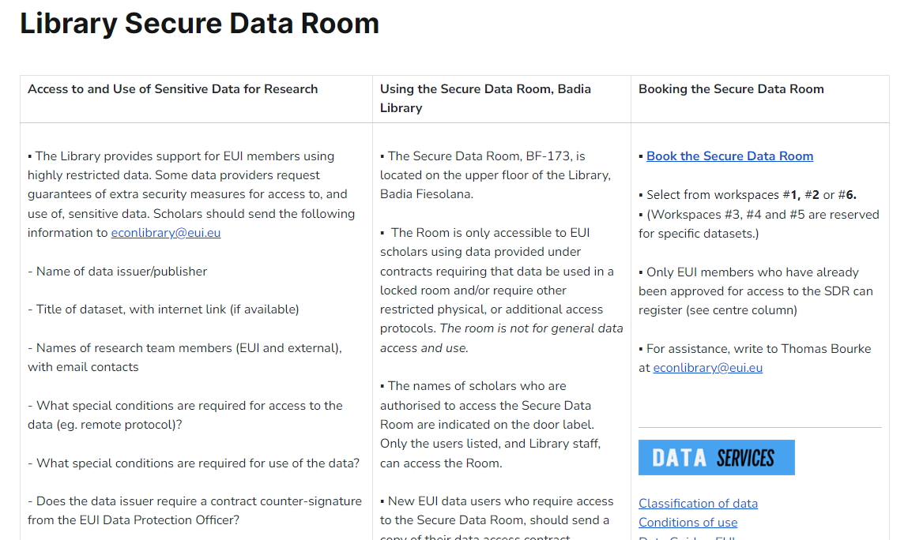

Slide 34
EUI Standard Infrastructure & Protocol Description
Library & ICT staff can provide a standard description of EUI infrastructure and access protocols, when required by data issuers
Write to econlibrary@eui.eu

Slide 35
Data deletion
At the end of a research project, it may be necessary to permanently delete data used in the elaboration phase.
Many micro-socioeconomic data providers (eg. Eurostat) require deletion for work-files and non-aggregate outputs.
EUI members can use software such as Disk Wipe which performs byte-by-byte deletion of data
If the data provider requires a compliance statement, the name of the software used, the location of the device, the name of the drive and the time of deletion should be recorded.

Slide 37
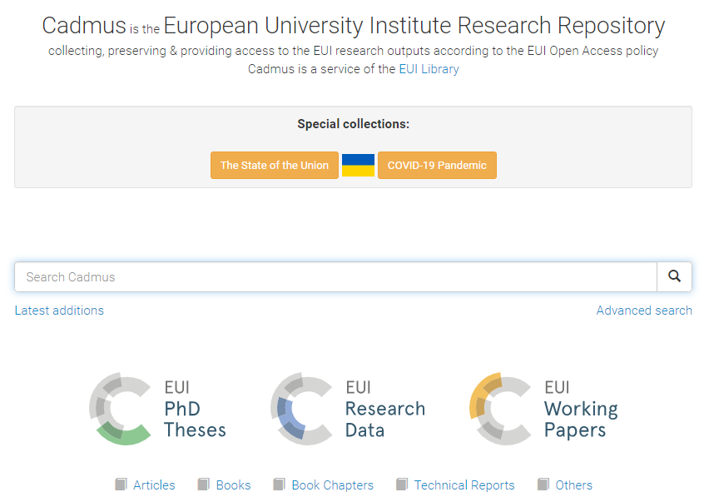

Slide 38
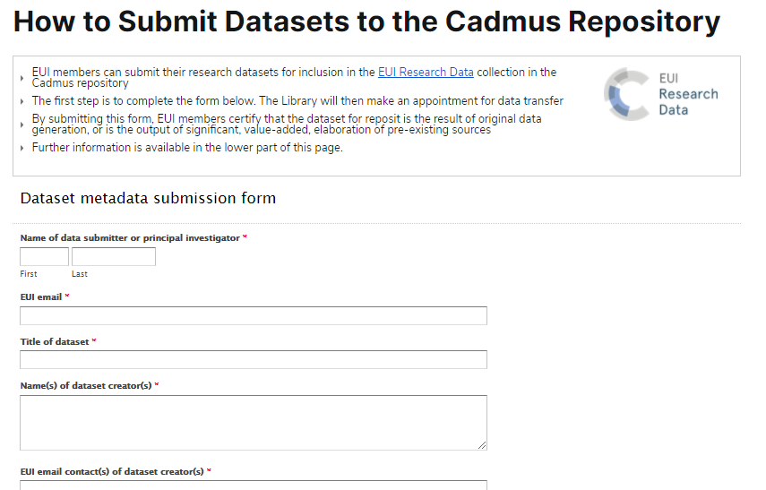

Slide 39
Preparing data for reposit
Check that there are no data protection violations
Check that there are no database copyright violations
Library staff can advise
Create a DATA folder and a DOCS folder
The DOCS folder should contain precise documentation about the methodology, context and discipline of the research project. Where applicable, codebooks should also be presented for reposit.
Data should be submitted in the original file format version.
Large datasets should be submitted in a compressed archival format (eg. .zip, .tgz).
Subsets should be accommodated within the DATA folder - not submitted as multiple repository entries.
The uploading of datasets and documentation is done by Library staff, after the submission of the online submission form.

Slide 40
Metadata
Title, names of creator(s), affiliation(s)
Description – ‘data abstract’
Source(s)
Creation date
Spatial / temporal coverage
Format
Location of data
Access status and embargo
Licence
Funding Statement
Related publications

Slide 41
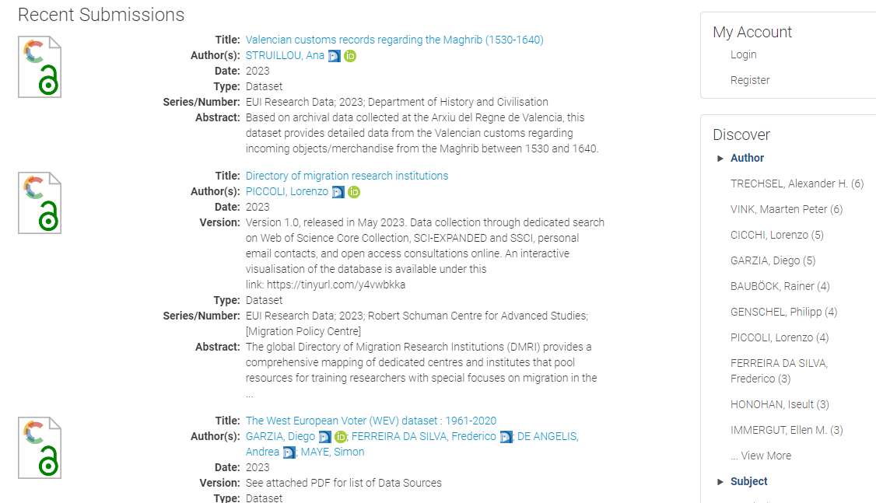

Slide 42
Dataset outputs as original work
EUI Library dataset submission form:
The scholar(s) submitting the dataset for reposit must be the creator(s) of the dataset
The dataset must be the output of original data generation; or must be the output of significant, value-added, elaboration of pre-existing sources
The source(s) of the data must be indicated. If the dataset is the output of original data collection and elaboration, details must be provided. If the dataset is derived from pre-existing sources, those sources must be clearly indicated (data creator, institutional source, publisher).

Slide 43
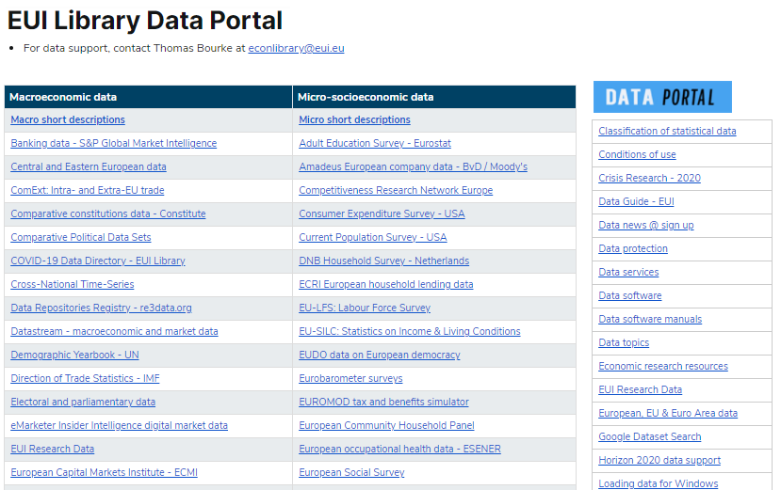

Slide 44
Data Management Plans
Overview and context of research project
How data are collected and generated
What data-related resources are required
How data are used, elaborated and organised during the research project
How data are secured, and how data subjects are protected
How data, code and ancillary elements are described and documented
What kind of data outputs are generated
How data are stored and secured, and how long data will be retained
How dataset authorship and credit are assigned
How data are preserved
How data outputs can be shared.

Slide 45
EUI data guidelines and standards
EUI Library ‘Research Data Guide’(11th ed) 2023
EUI ‘code of Ethics in Academic Research’ 2021

Slide 46
FAIR data principles
Research data management is underpinned by the FAIR Guiding Principles, to make data:
Findable
Accessible
Interoperable
Reusable.

Slide 47
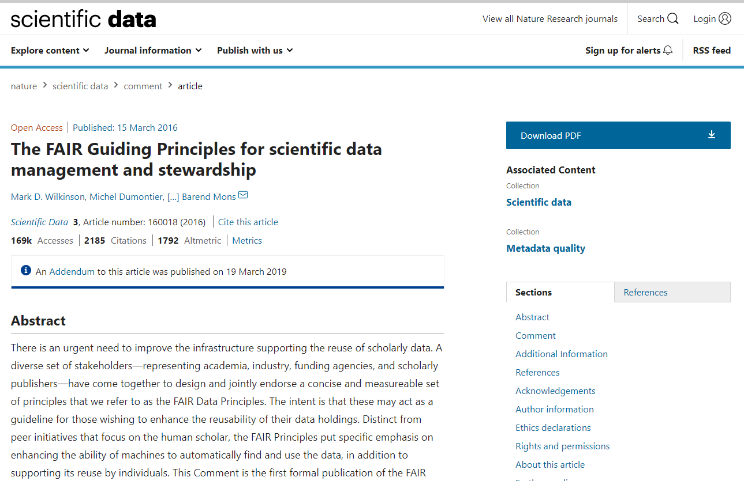

Slide 48
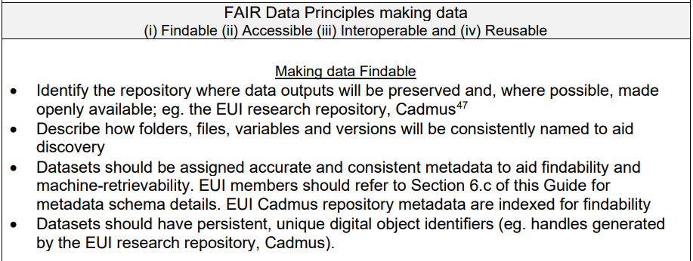

Slide 51
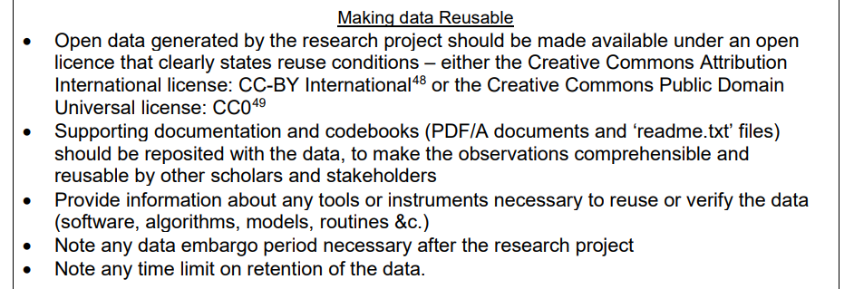

Slide 52
2021-2027
“As open as possible,
as closed as necessary.”

Slide 54
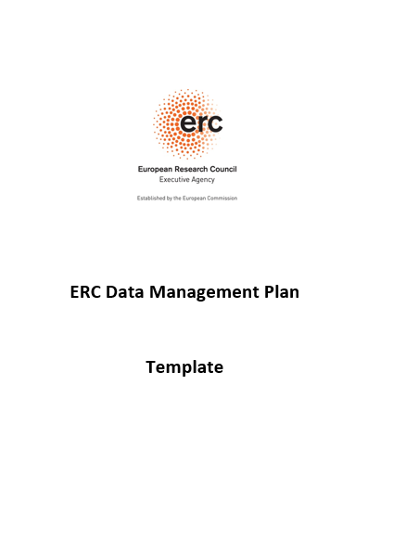

Slide 55
Data Management Plans
Online tool (with prompts for preparing a DMP)
Generates document in Word, PDF &c.
If science funder provides template:
- Cut/paste text to template

Slide 56
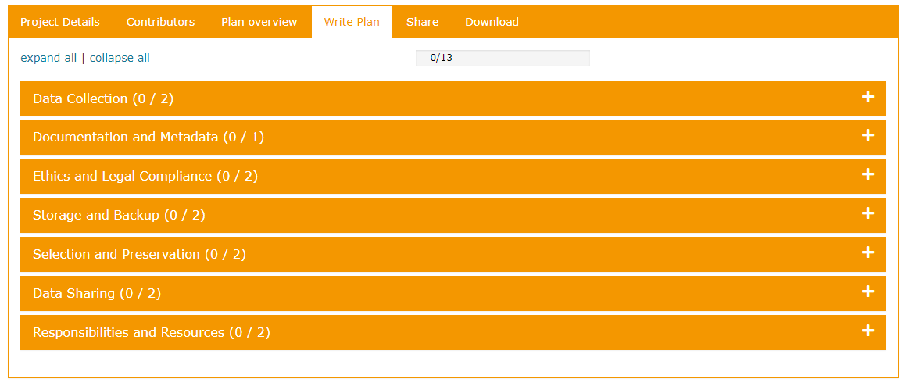
DMPonline tool
Create account > Organisation: ‘Other’
‘Write plan’

Slide 57
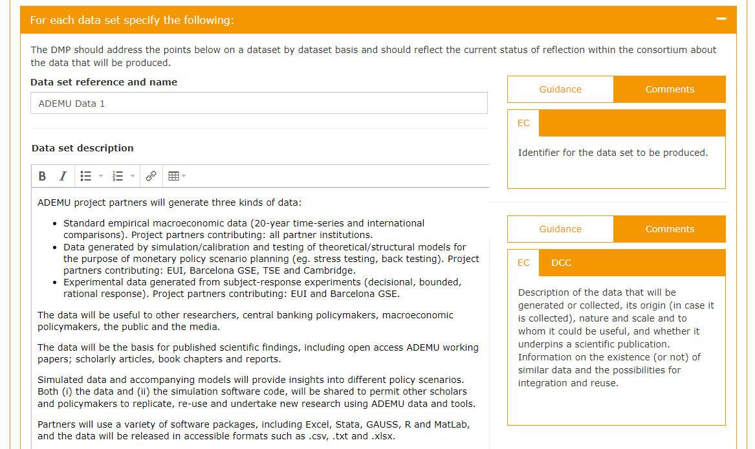

Slide 58
EUI support

Slide 59
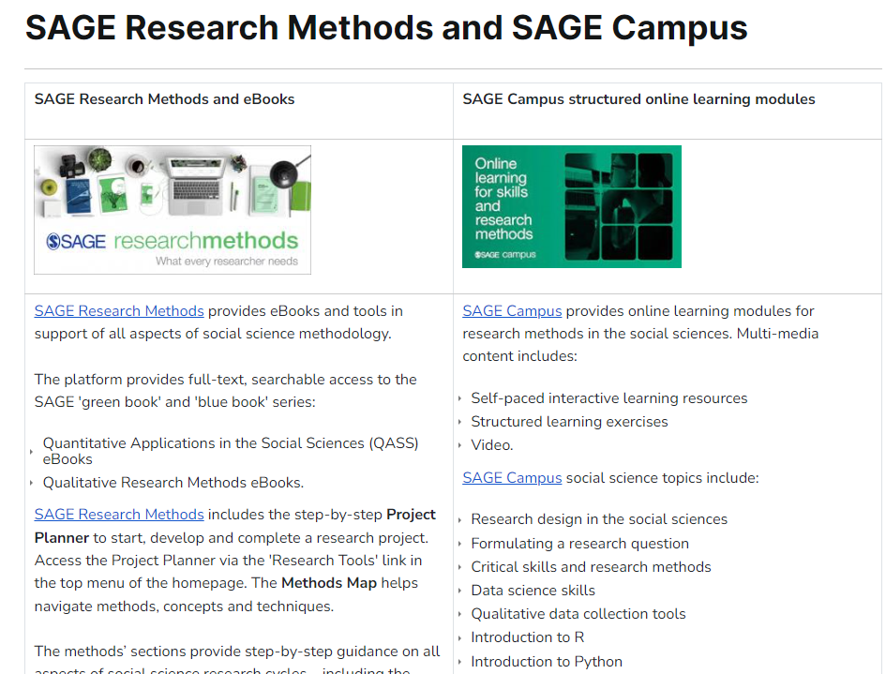

Slide 60
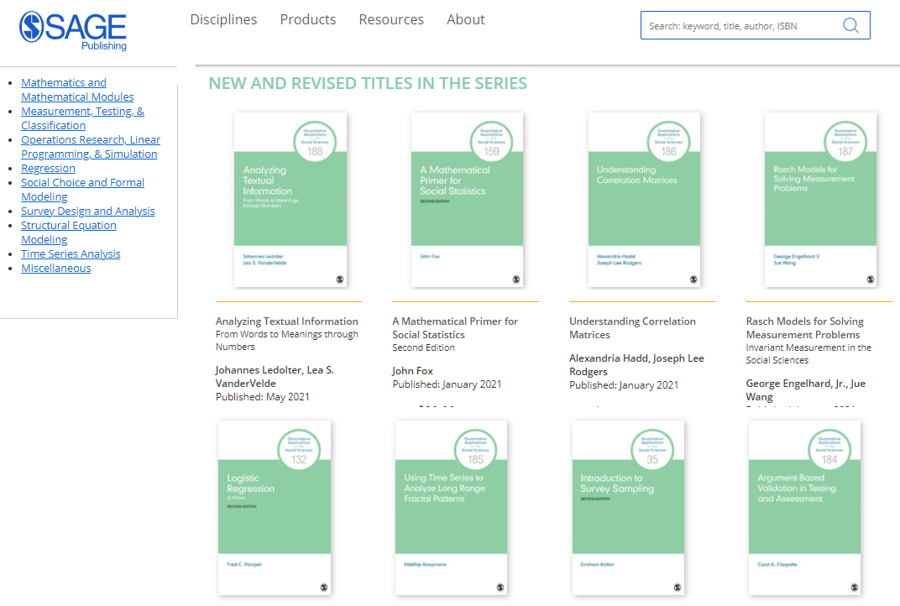

Slide 62
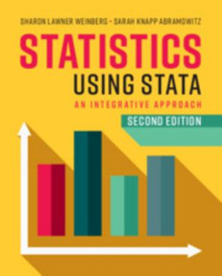
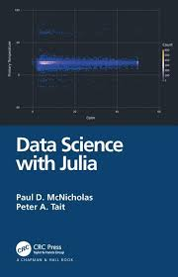
Manuals

Slide 63
Data Manuals
First floor: 001-005
Social science data methods: 300.182
Statistical & data science: 519.5
eBooks / manuals via Catalogue

Slide 64
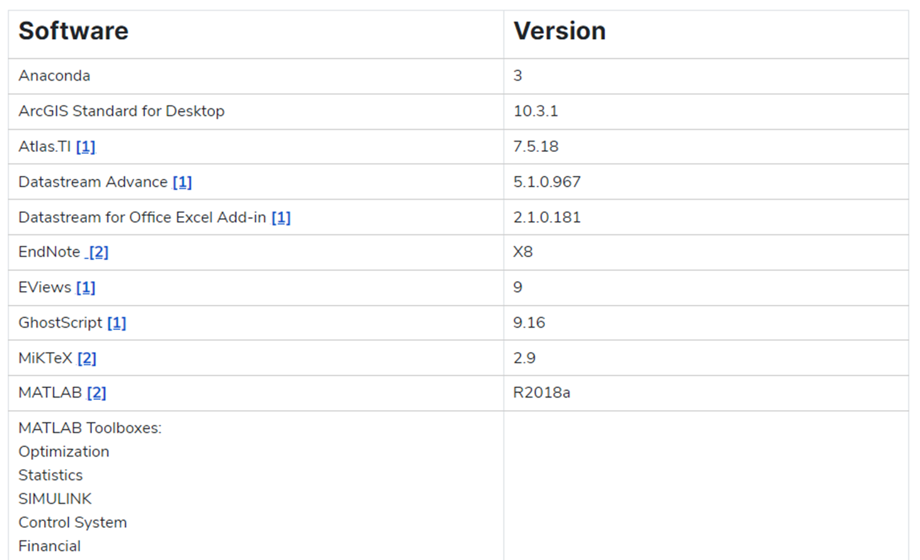
Research software - ICT

Slide 65
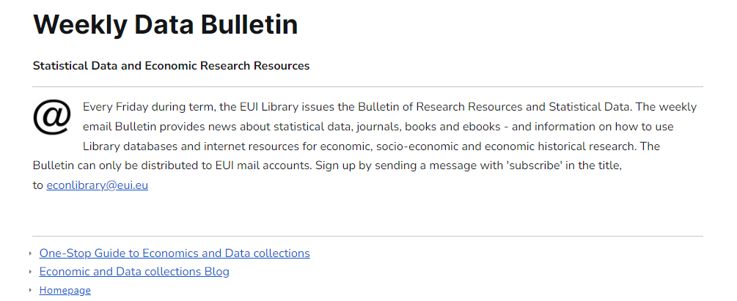

Slide 66
Research data support
Research Data Services homepage
Departmental Information Desk, VLF (2nd floor, VLF-026)
Monday, Wednesday & Friday afternoons
Badia Library Information Office (1st floor, BF-085)
econlibrary@eui.eu

Slide 67
Research Data Collections & Services EUI Library 29 August 2023

