Slide 1
Library Collections and Services for Economic Research 28 August 2024

Slide 2
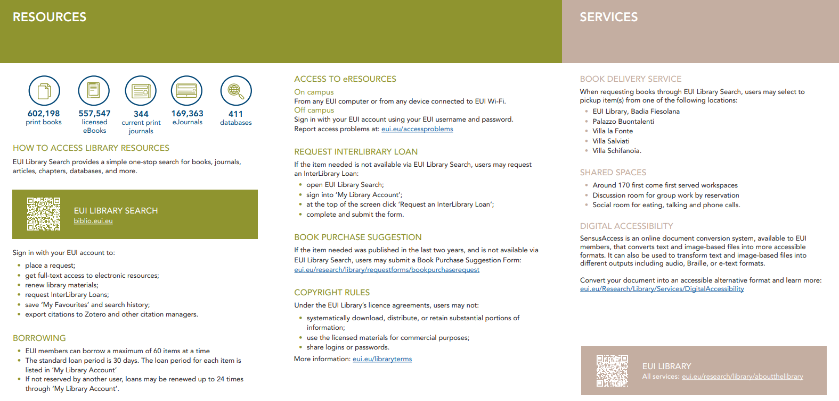
General information leaflet

Slide 3
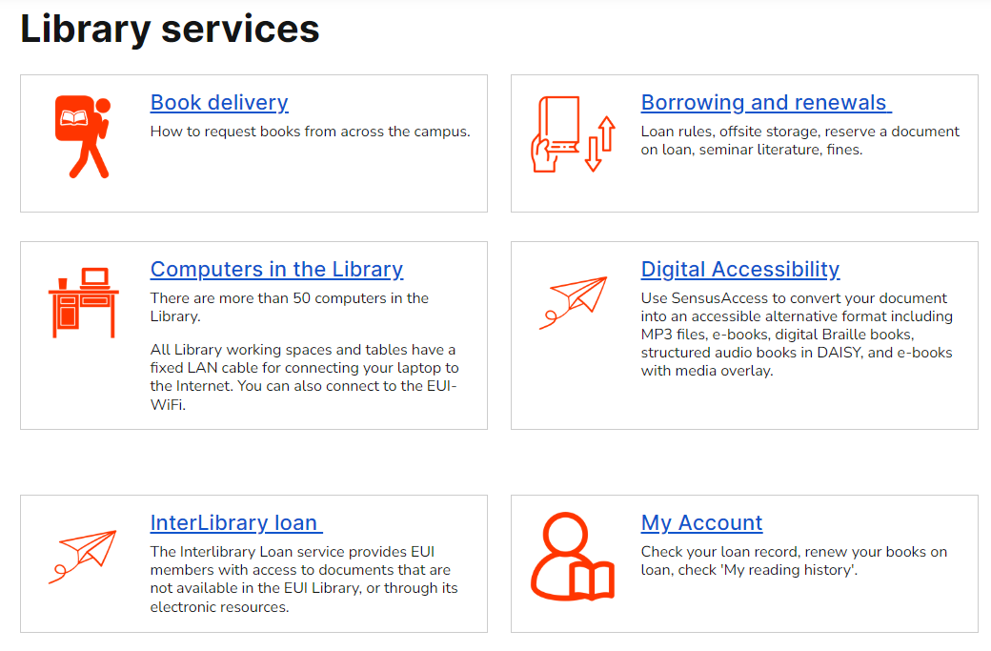

Slide 4
Library opening hours
BADIA FIESOLANA
Monday–Friday 08.30-22.15
Saturday 09.00-22.15
VILLA LA FONTE
Monday-Sunday 24 hrs.
Porters lodge 08:00-19:00 weekdays
* Consult web site for summer variation

Slide 5
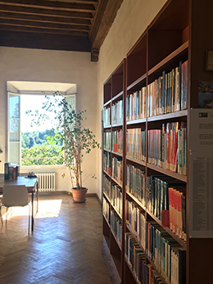

Slide 6
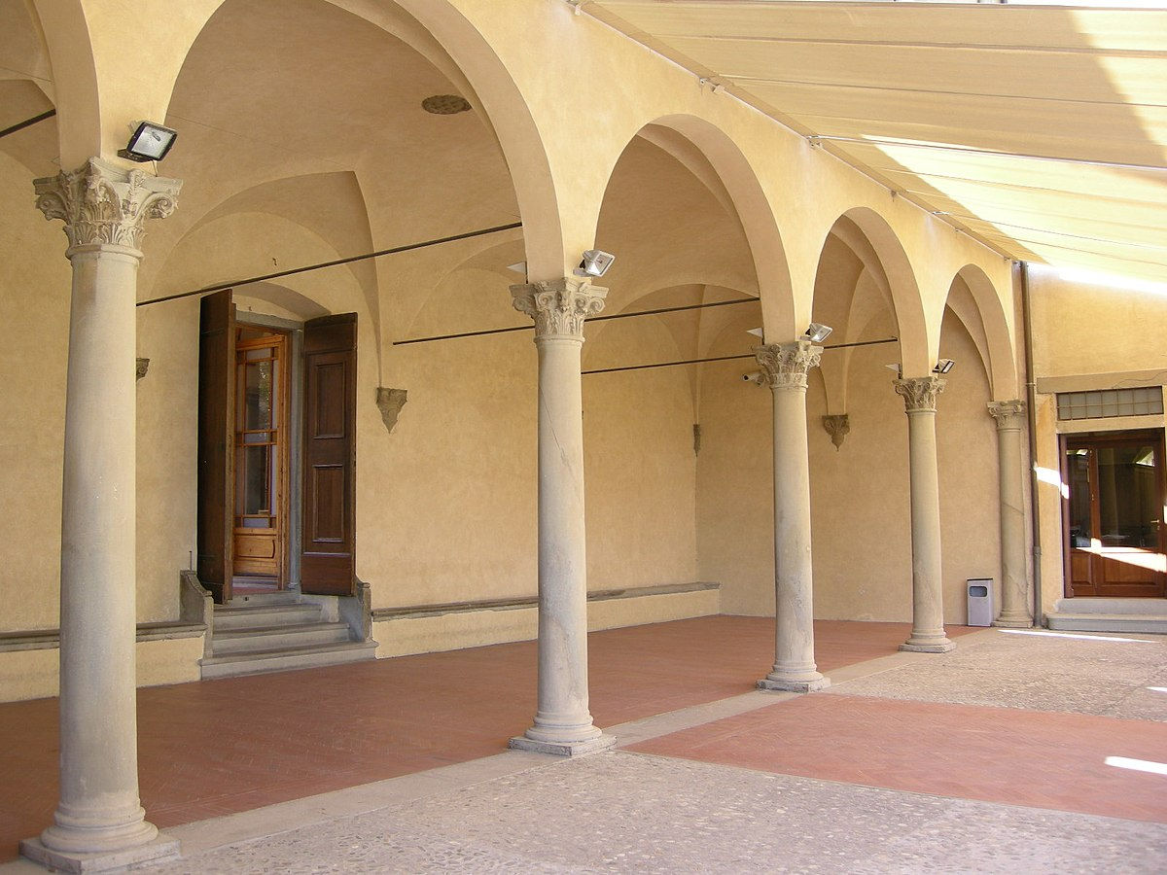
Today’s Library Tours
Badia Fiesolana
Lower loggia entrance to Library
Tour I 16:00
Tour II 16:30

Slide 7
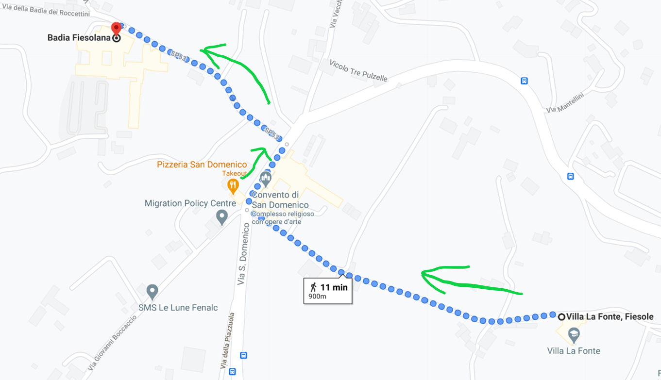

Slide 8
Research support
econlibrary@eui.eu
Departmental Information Desk, VLF - 2nd floor, VLF-026
Monday, Wednesday & Friday afternoons
Badia Library Information Office (1st floor, BF-085)
Weekday mornings and Tuesday & Thursday afternoons
Economics Collection homepage

Slide 9
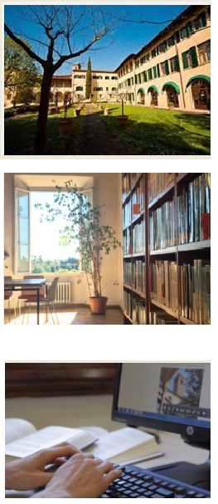
Badia Library
Departmental Library (VLF)
Desktop Library

Slide 10
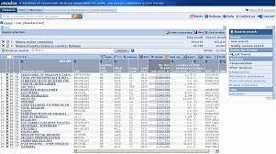
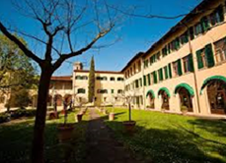
Economics & Data Collections
Full-text electronic journals
Books, ebooks & manuals
Data Portal
Reference collection
Departmental collection (VLF)
Full-text working papers

Slide 11
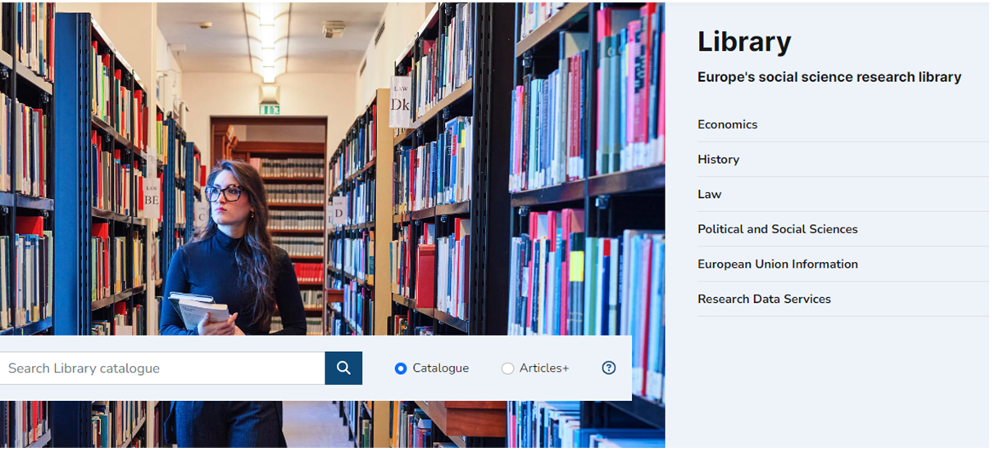

Slide 12
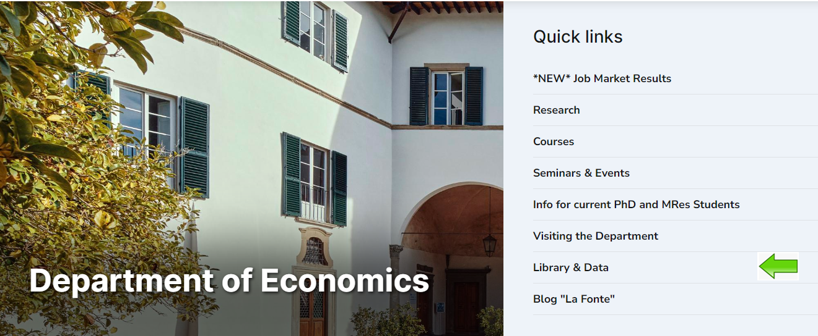

Slide 13
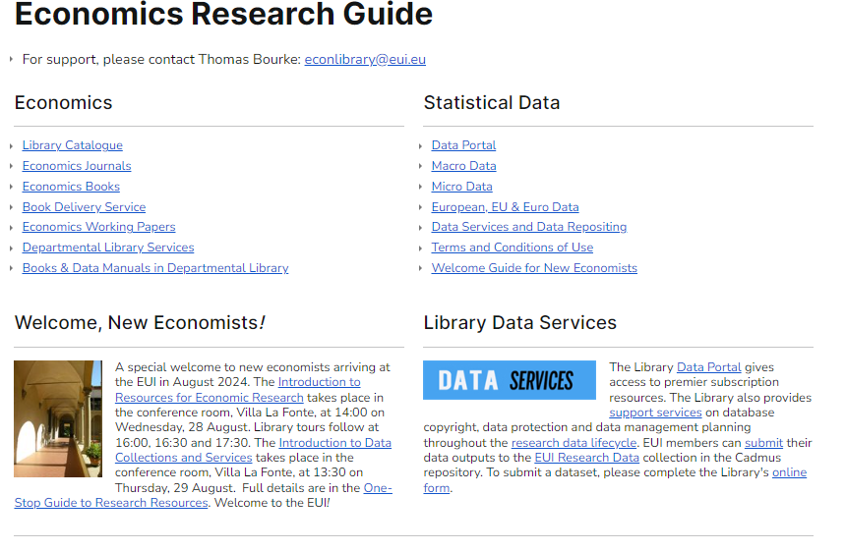

Slide 14
The Catalogue
Title / author / keyword
Book shelfmarks (Badia & VLF)
Full-text ebooks
Full-text ejournals
Book delivery: 30-day loan
Patron account
Placing holds
Renewing book loans

Slide 15
Classification
001 Data manuals and data science 330 Economics: general works 331 Labour economics 332 Financial economics 333 Environmental, land and energy economics 335 Socialism and related systems 336 Public Finance 337 International economics 338.5 Microeconomics 339 Macroeconomics 381 Domestic trade 382 International trade 384 Communications and telecommunications 510 Mathematics 519 Probabilities and applied mathematics

Slide 16
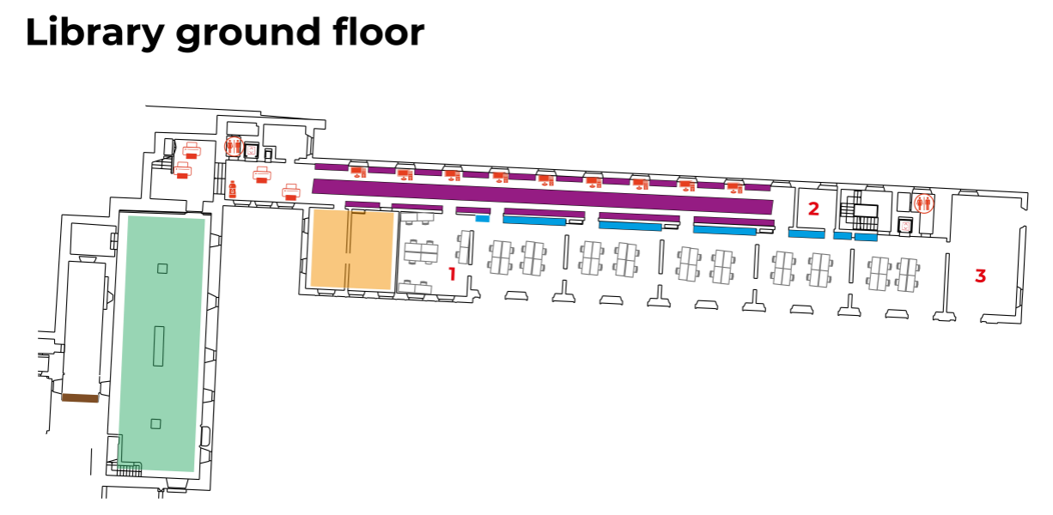

Slide 17
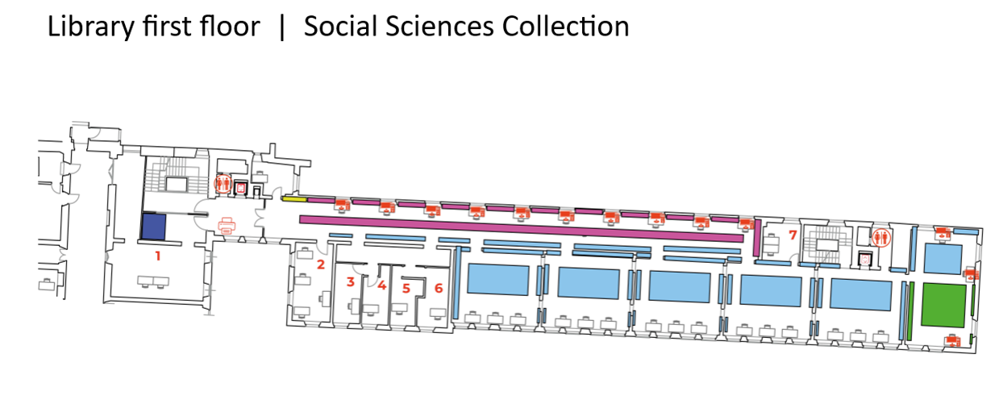

Slide 18
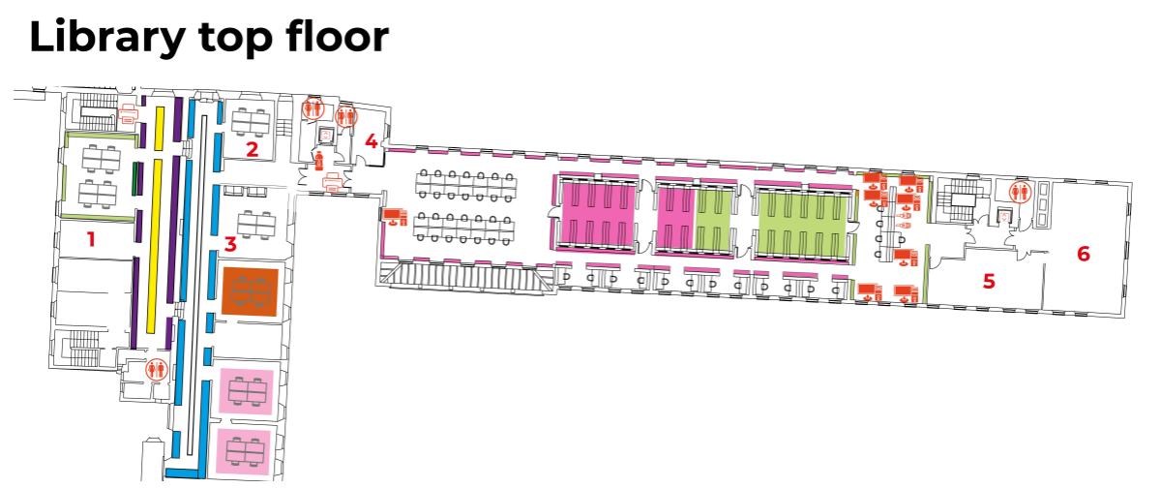

Slide 19
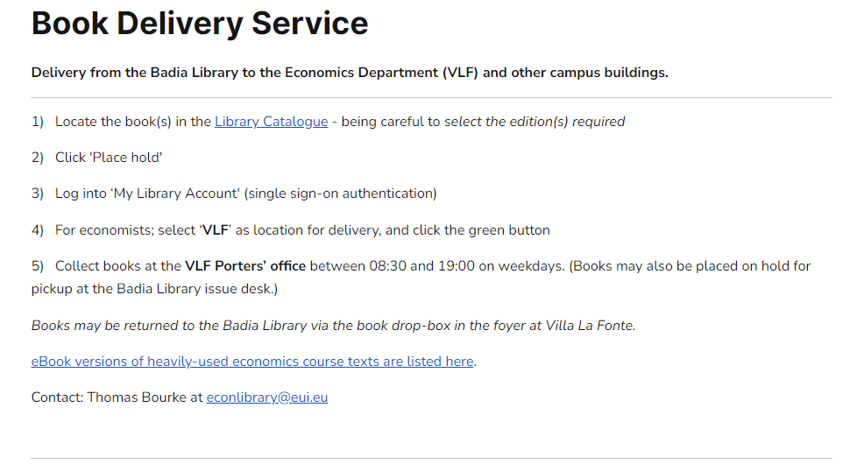

Slide 20
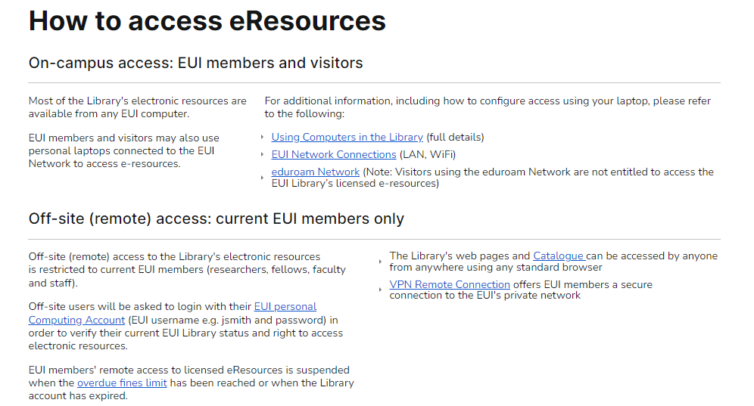

Slide 21
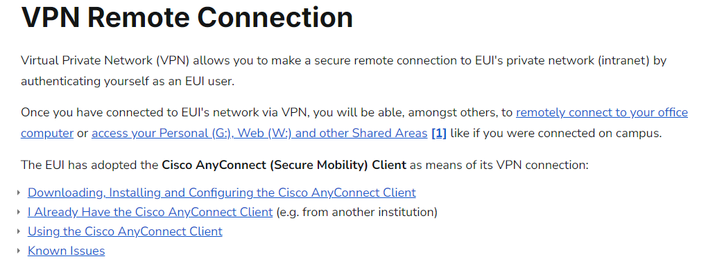
ICT Support

Slide 23
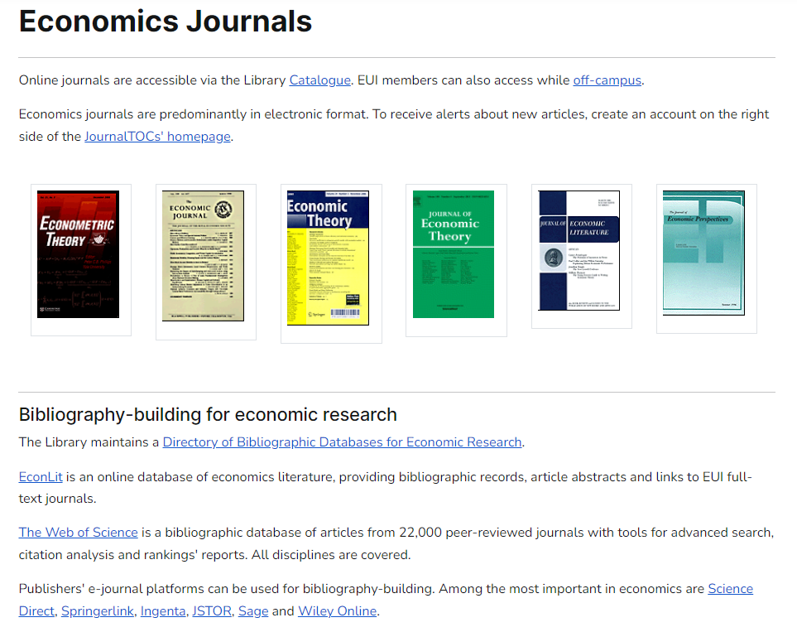

Slide 24
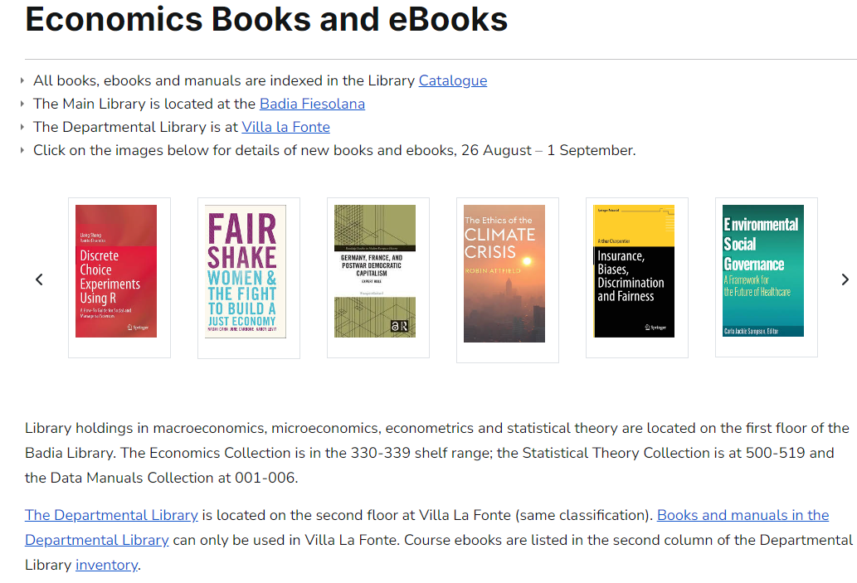

Slide 25
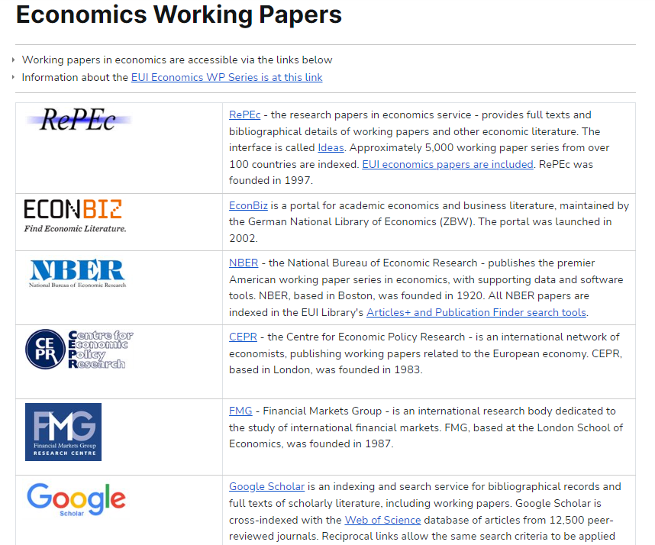

Slide 26
450 course monographs and data manuals
All books and manuals must be on shelf at the start of the working day (including weekends)
No overnight or weekend loans
Books cannot be taken out of the Departmental complex
Auto check-out / check-in
Multiple copies at Badia Library for 30-day loan.

Slide 27
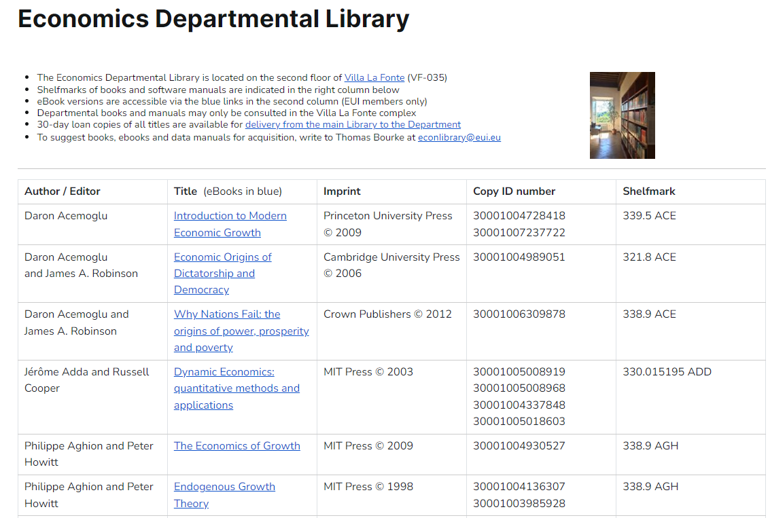

Slide 28
Suggestions Welcome
New books / ebooks / editions in any language
New journals
New data manuals
Extra copies for Departmental Library (VLF)
Older books not in Collection
econlibrary@eui.eu

Slide 29
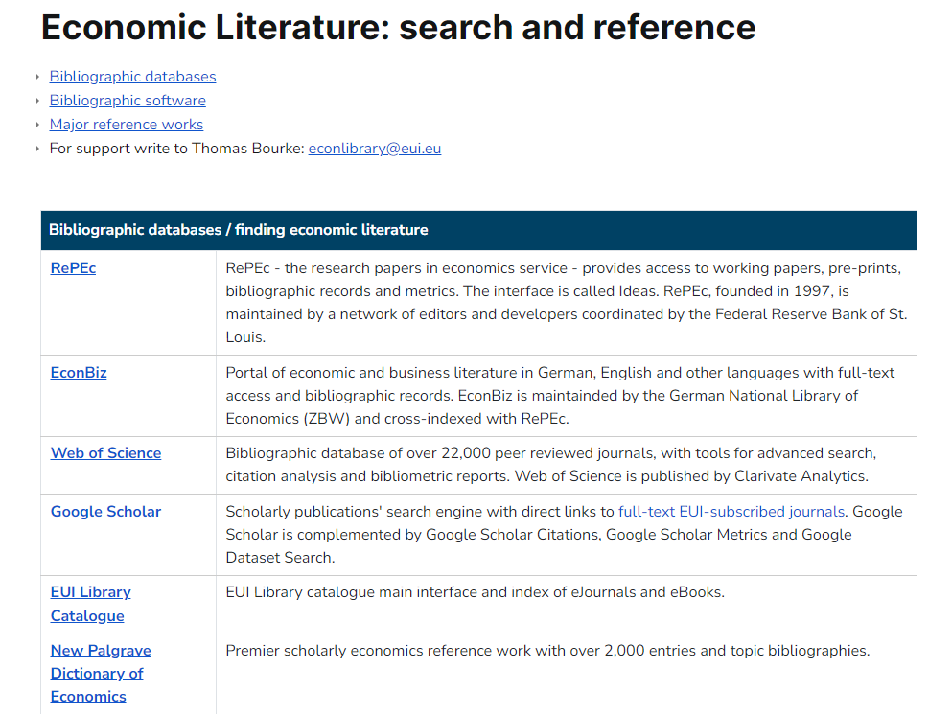

Slide 30
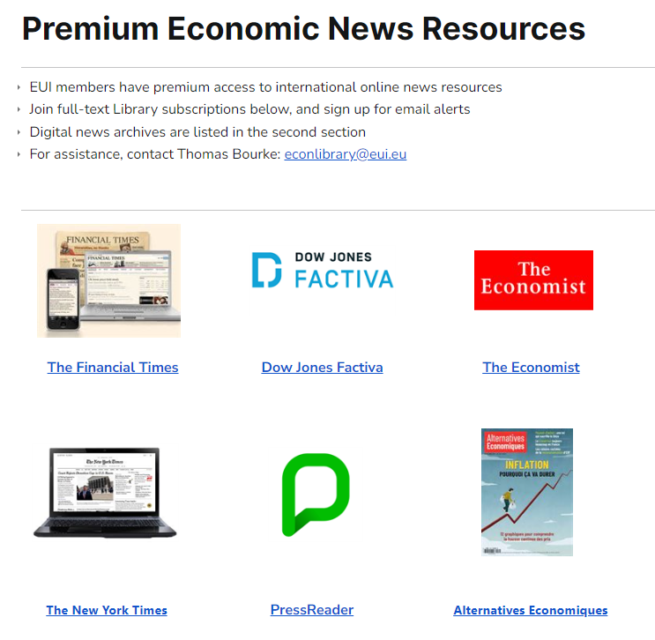

Slide 32
Introduction to Library Data Resources
Thursday, 29 August 13:30 Conference room, VLF

Slide 35
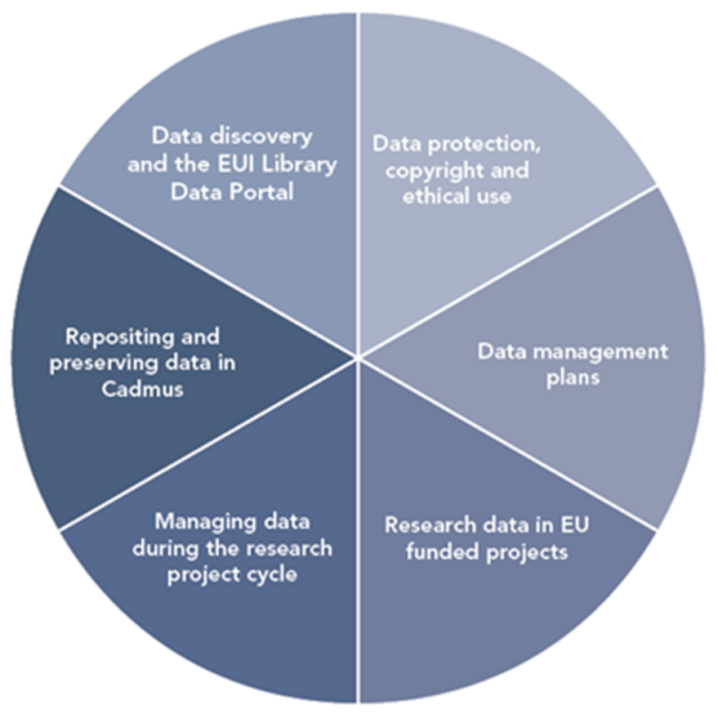
Research Data Lifecycle

Slide 36
Data discovery and generation
Data use
Data preservation and sharing

Slide 37
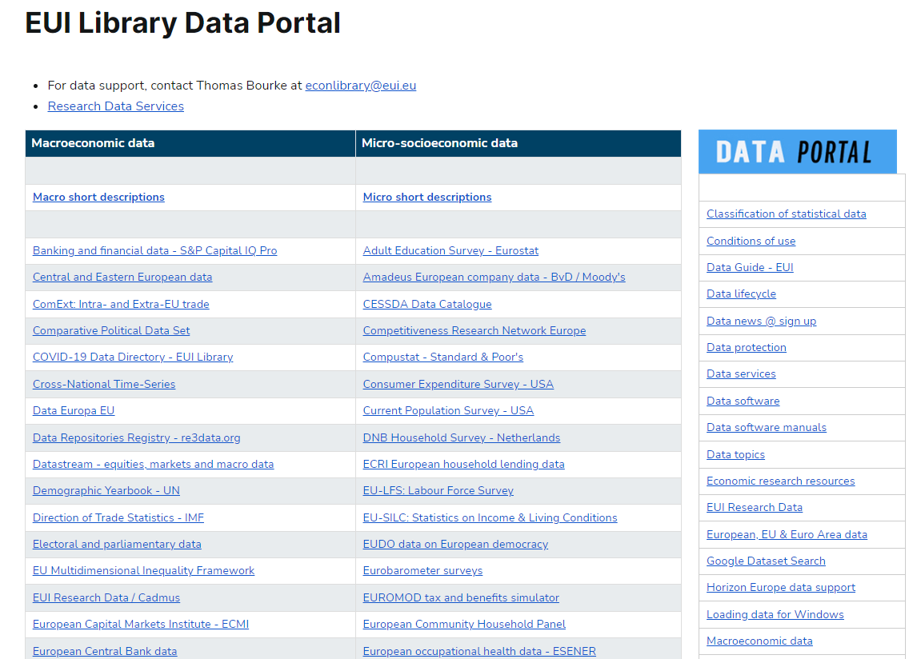

Slide 38
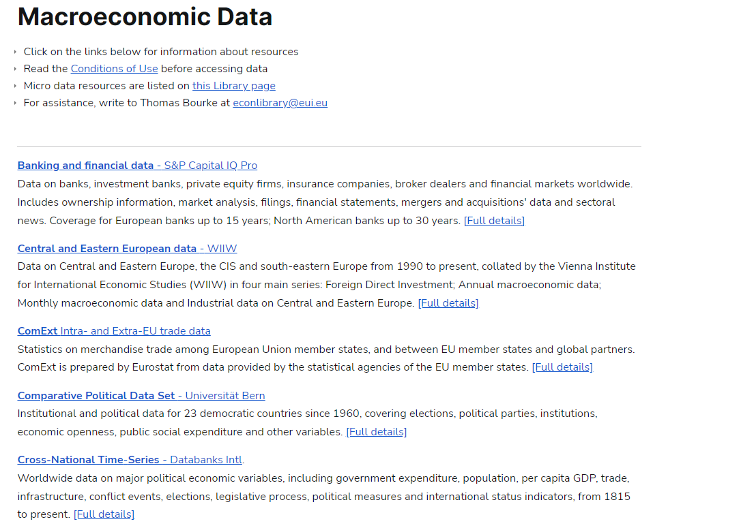

Slide 39
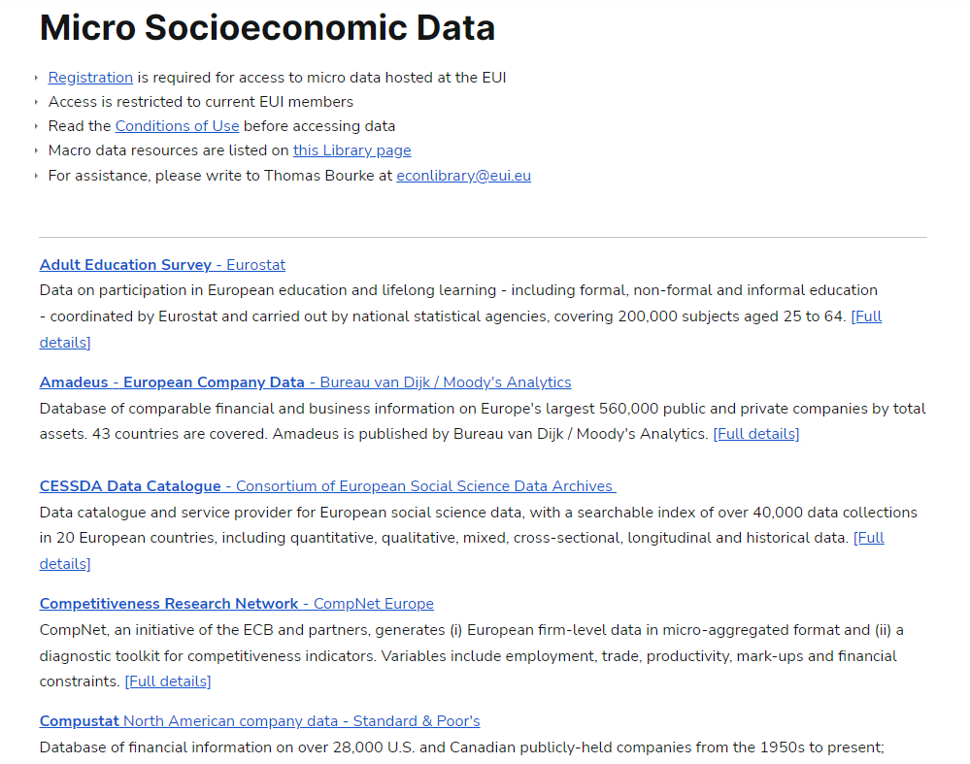

Slide 40
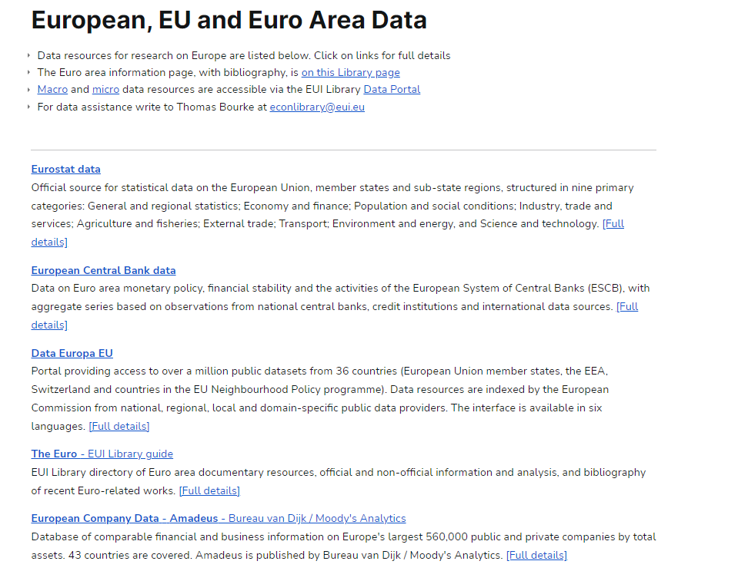

Slide 41
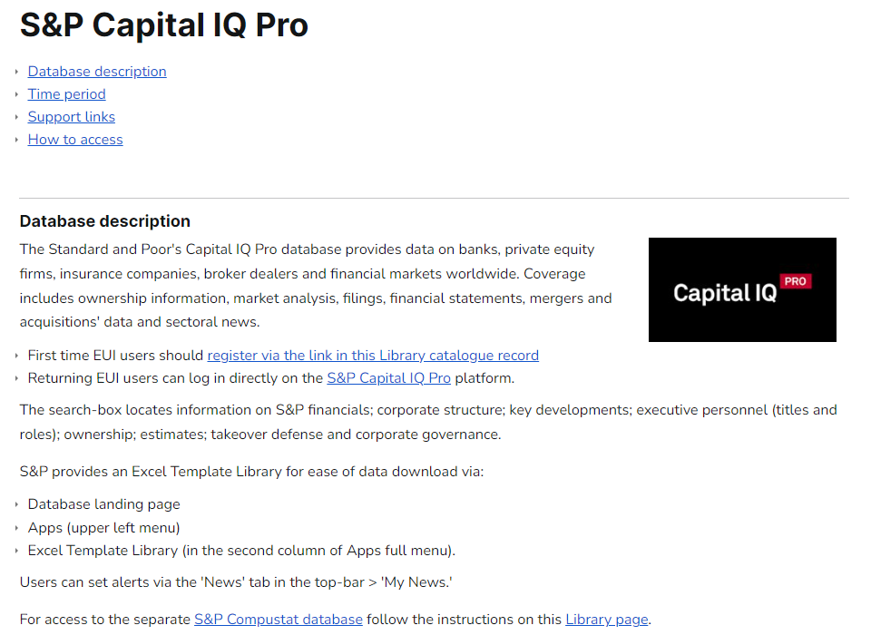

Slide 42
Examples
East / Central European data (WIIW)
Cross-National Time-Series (Databanks Intl.)
International Country Risk Guide (ICRG)
Compustat (S&P)
OECD iLibrary
Datastream (Refinitiv)
Amadeus (Moody’s Analytics)

Slide 43
Micro socio-economic data Library restricted server
Special terms and conditions of access and use
Registration required
Library restricted server K:/

Slide 44
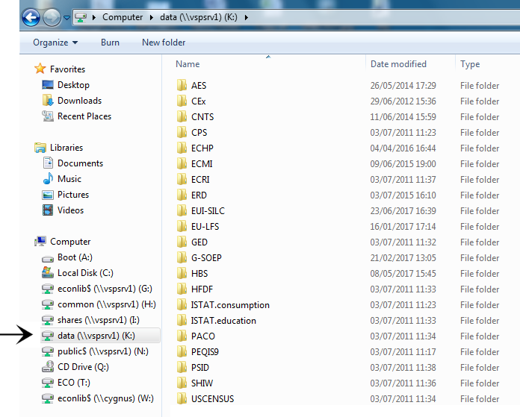
Restricted server K

Slide 45
Data archives

Slide 47
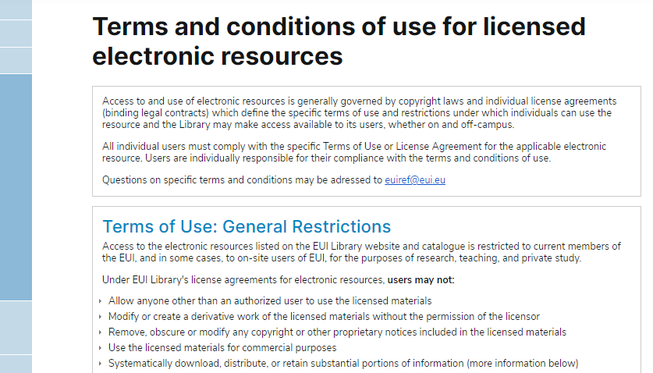

Slide 48
Data Protection: Collecting, generating and processing data
Special terms and conditions apply when collecting and processing micro-socioeconomic and qualitative data – reflecting the sensitive nature of data observations about persons, families and households
Persons, families and households cannot be identifiable in any dataset.

Slide 49
Structure, folders, files, variables, format and versioning
The structure of the research dataset should be carefully considered at the start of the project.
Dataset design varies by discipline, methodology, types of data and variables, medium of data, units of analysis, relationship between data elements, and whether or not the dataset is part of a series.
Clear and consistent metadata for folders, files, variables and versioning helps make research data findable, accessible, interoperable and re-usable; FAIR data principles.
File names should be standardised, eg: date, version
Variables (age, country &c.) should be clearly tagged, avoiding special characters and spaces
Temporary identifiers should be removed from the schema
Different file versions should be systematically named, using a standardised date system (YYYY-MM-DD) or version numbering.

Slide 50
Documentation and codebooks
Clear and accurate documentation should be provided about the purpose and context of the research project, and about the research data outputs
The sources of the data should be clearly indicated
Elaboration of pre-existing data
Data generation (surveys, interviews, experiments)
Documentation should include a description of folders, files, variables, versioning, and – where applicable – information about problematic values, missing observations and weightings
Codebooks, questionnaires and data dictionaries should be included. A concise note on methodology should be included
Good documentation makes datasets findable, accessible, interoperable and re-usable (FAIR data principles).

Slide 51
Security during research projects

Slide 52
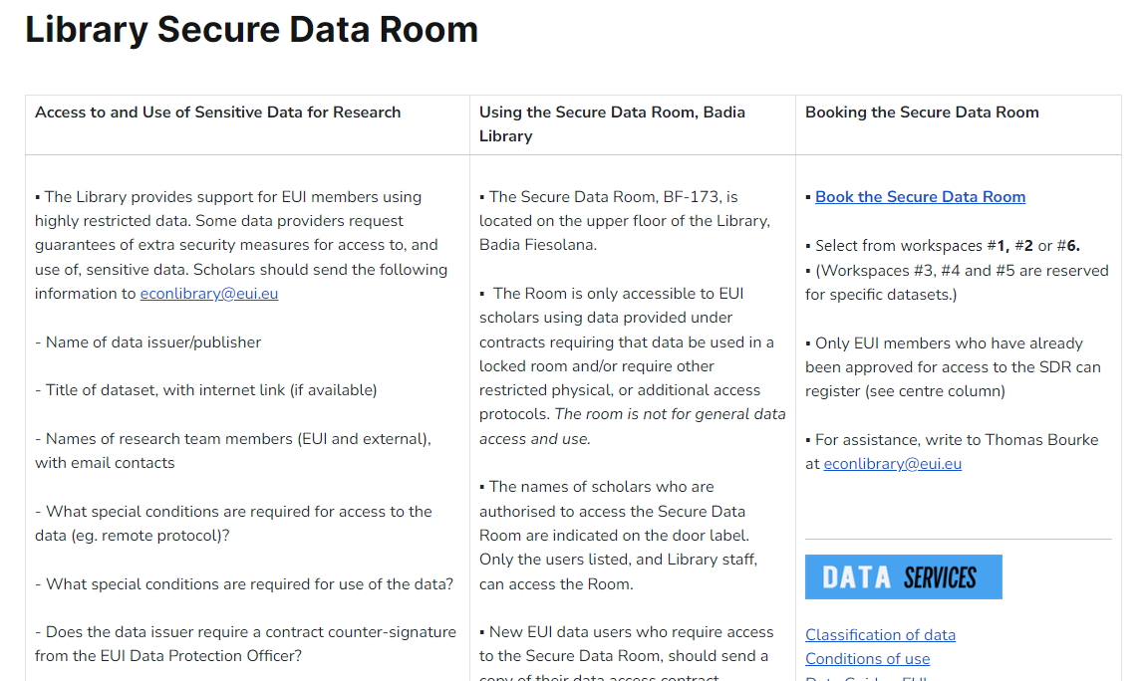

Slide 54
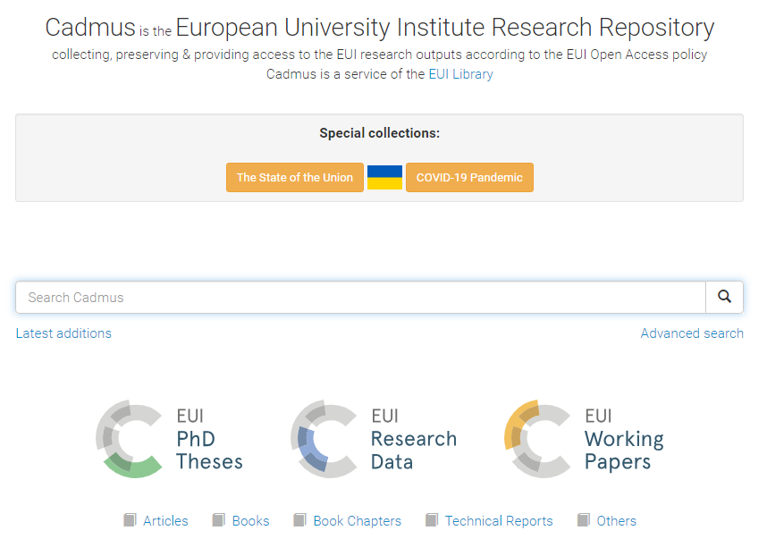

Slide 55
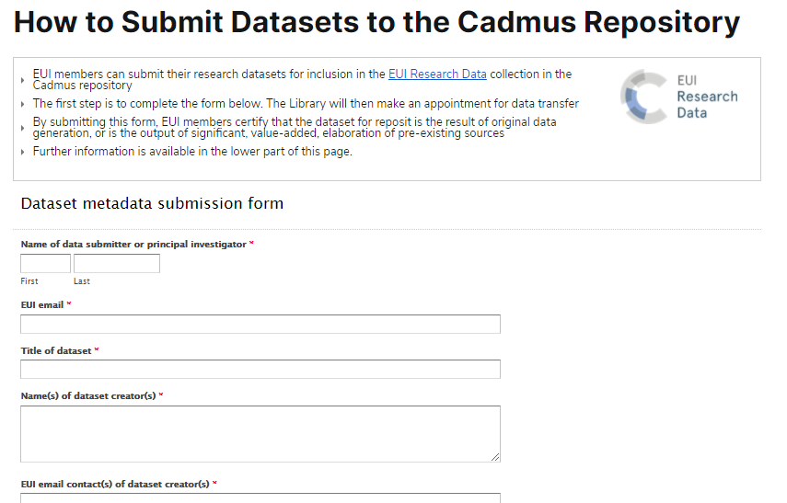

Slide 56
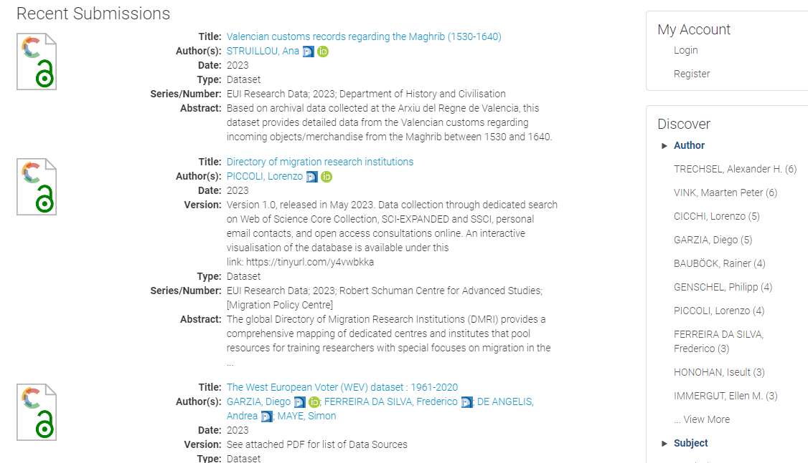

Slide 57
Data Management Plans
Overview and context of research project
How data are collected and generated
What data-related resources are required
How data are used, elaborated and organised during the research project
How data are secured, and how data subjects are protected
How data, code and ancillary elements are described and documented
What kind of data outputs are generated
How data are stored and secured, and how long data will be retained
How dataset authorship and credit are assigned
How data are preserved
How data outputs can be shared.

Slide 58
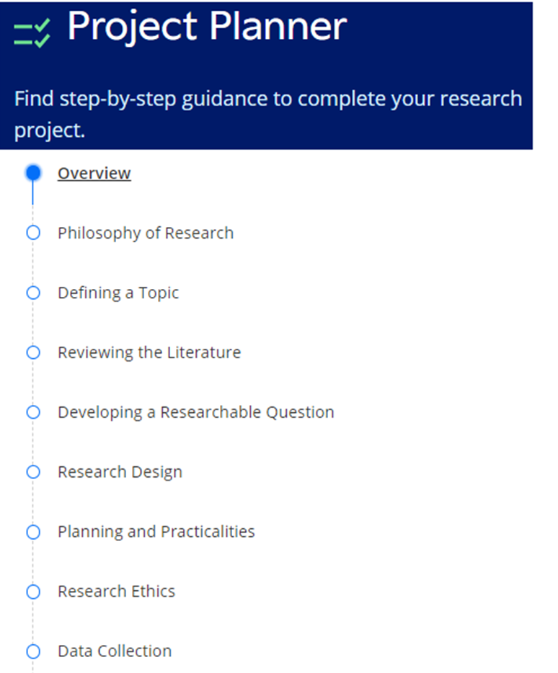

Slide 59
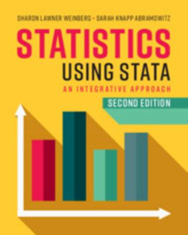
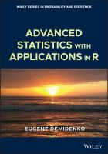
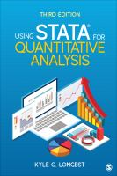
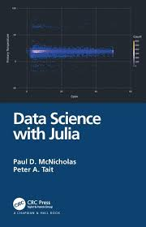
Manuals

Slide 60
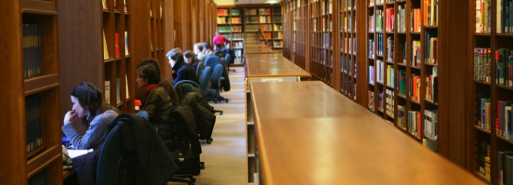
Data and statistical science
Data science & software manuals: 001-005
Data methods for Social science: 300.72
Statistical science 519.5
eBooks / eManuals via Catalogue Online

Slide 61
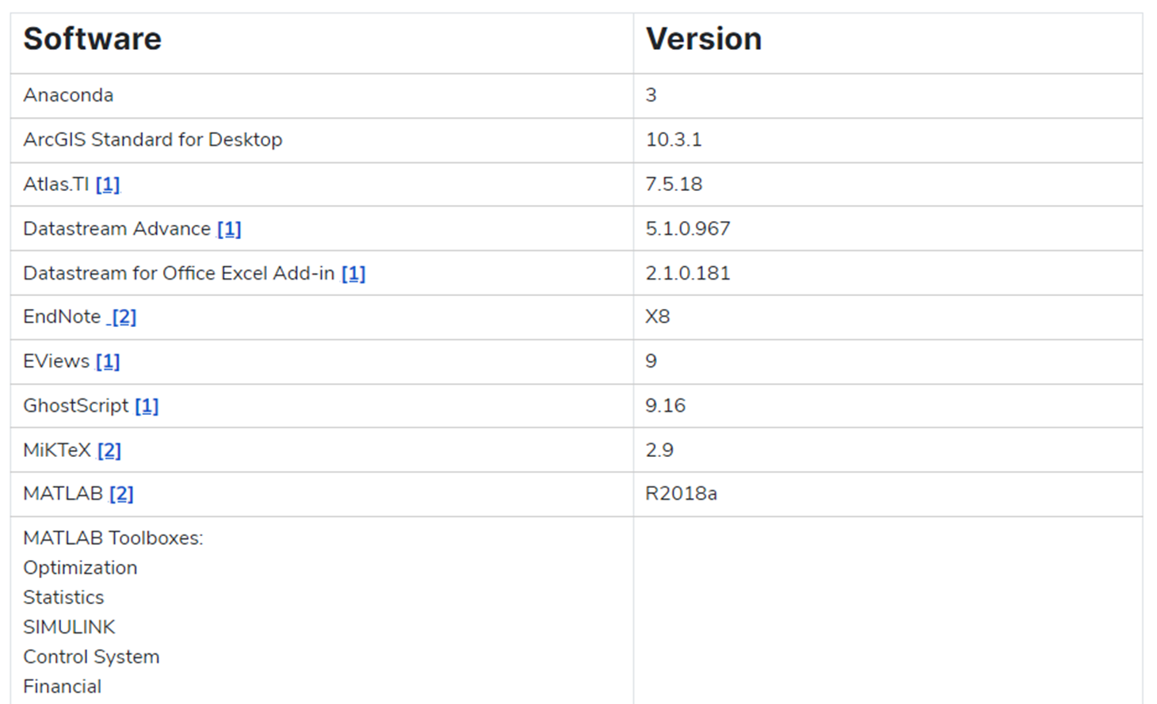
Research software - ICT

Slide 62
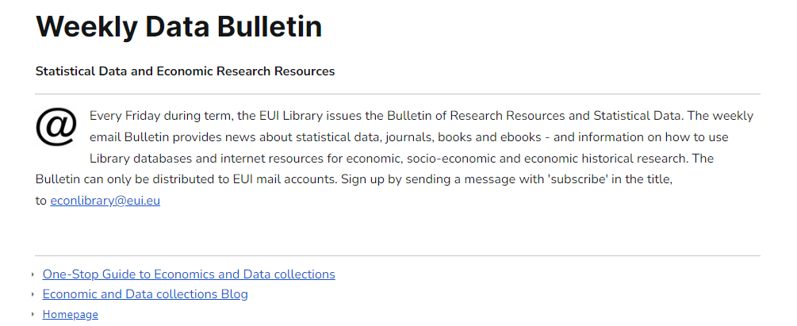

Slide 63
Introduction to Library Data Resources
Thursday, 29 August 13:30 Conference room, VLF

Slide 64
Research support
Research Data Services homepage
Departmental Information Desk, VLF (2nd floor, VLF-026)
Monday, Wednesday & Friday afternoons
Badia Library Information Office (1st floor, BF-085)
econlibrary@eui.eu

Slide 65
Today’s Library Tours
Badia Fiesolana
Lower loggia entrance to Library
Tour I 16:00
Tour II 16:30

Slide 68
Library Collections and Services for Economic Research 28 August 2024

