Slide 1
EUI Library News Resources
Thomas.Bourke@EUI.eu
Elena.Brizioli@EUI.eu
Federica.Signoriello@EUI.eu
13 November 2024

Slide 2
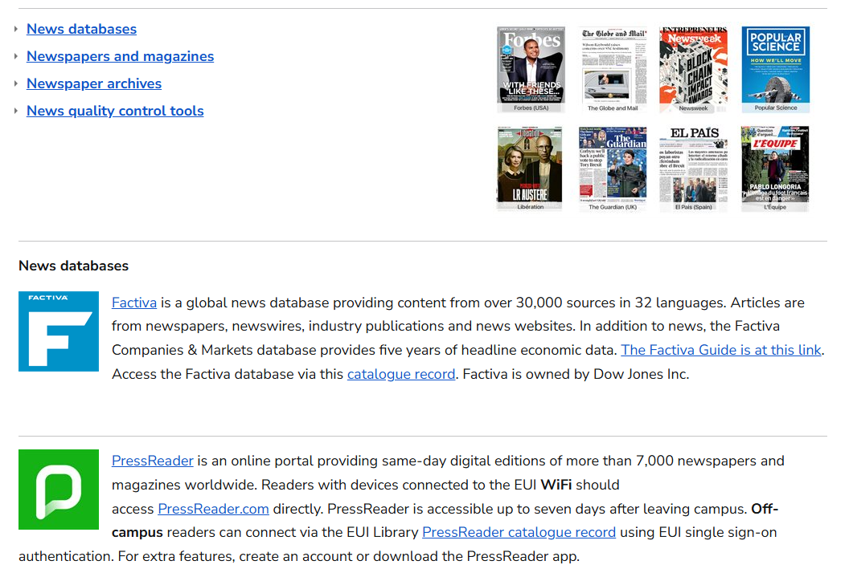

Slide 3
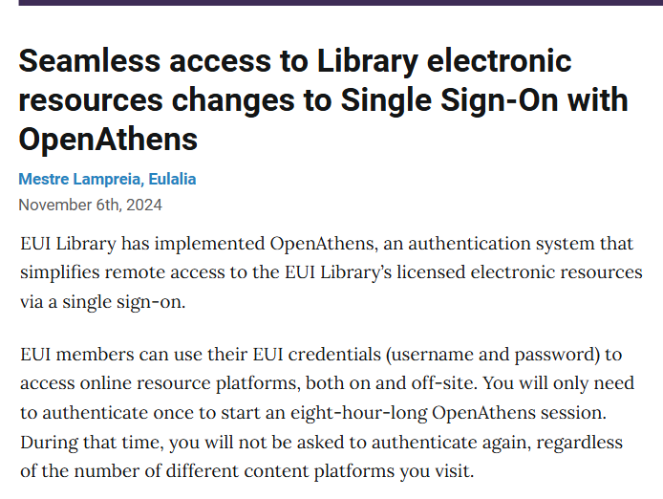

Slide 4
On-campus
For most resources, no authentication required.
Off-campus
Use EUI credentials, username and password, to access online resources, when off-campus
Links from the Catalogue will prompt login
Most publishers allow direct access to subscribed contents via OpenAthens authentication
When asked to select institutional affiliation; select ‘European University Institute’ from the list of institutions.

Slide 5
Categories
Newspapers / gazettes / magazines
Wire services
Online versions of analogue newspapers
Newspaper websites / news websites
Versioning and retrieval

Slide 6
Modes of access
Publishers’ platforms / Mobile app
Aggregate databases
Microform / CD-rom
Paper

Slide 7
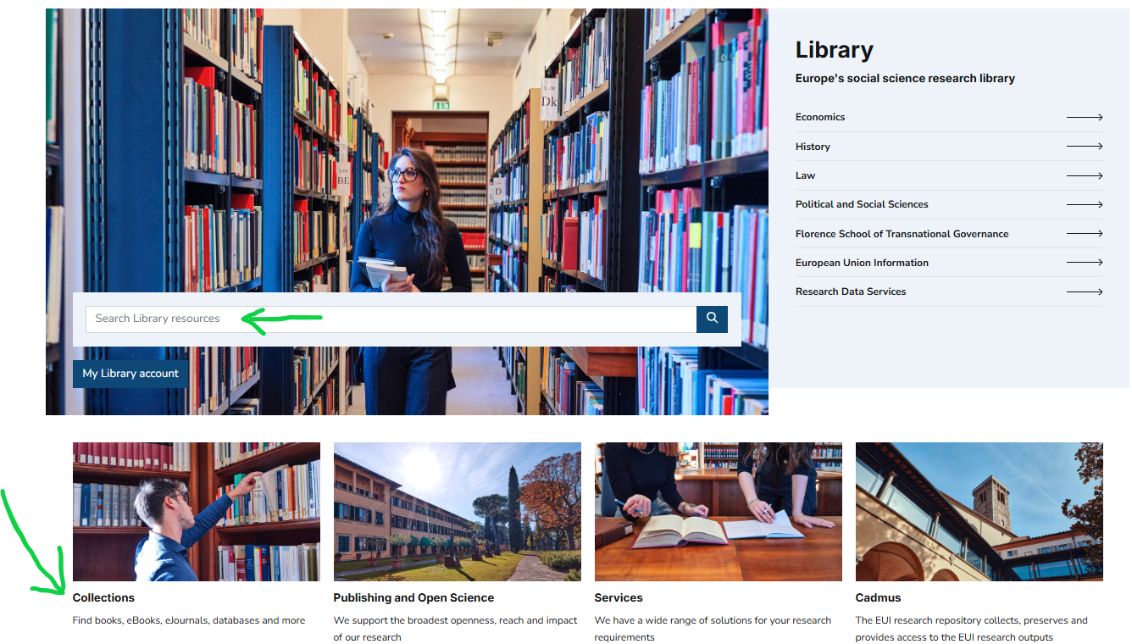

Slide 8
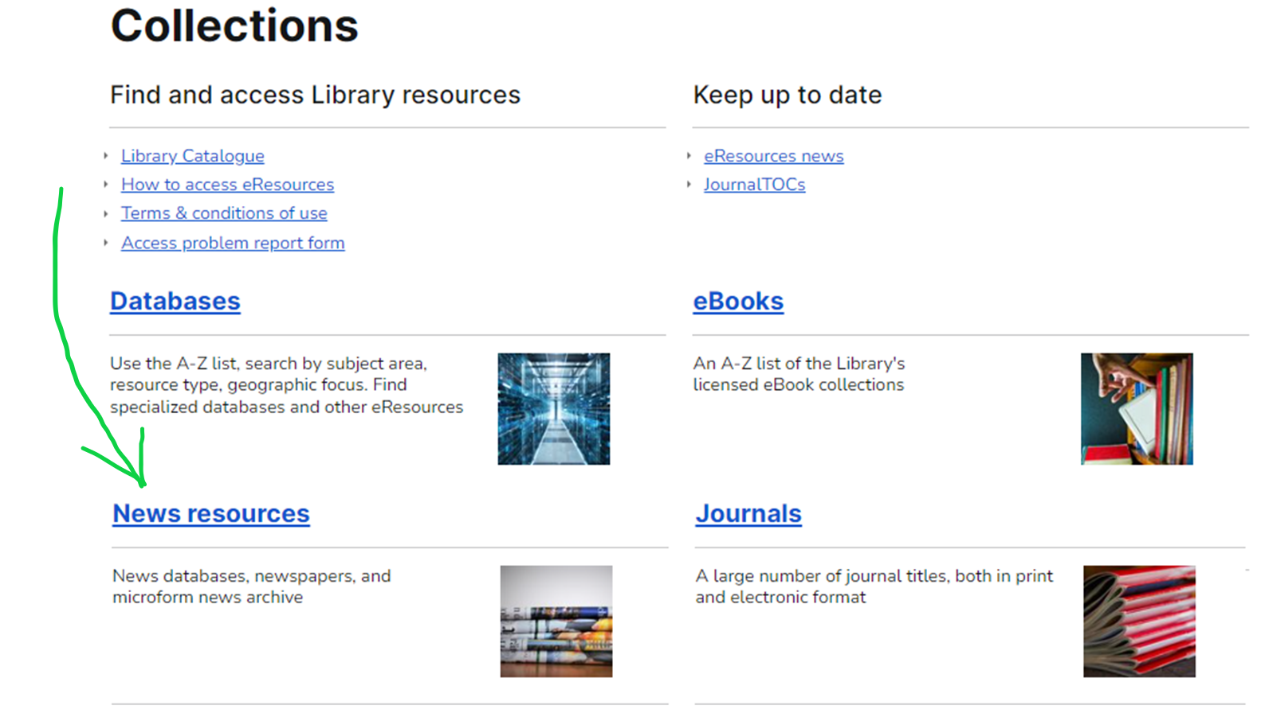

Slide 9
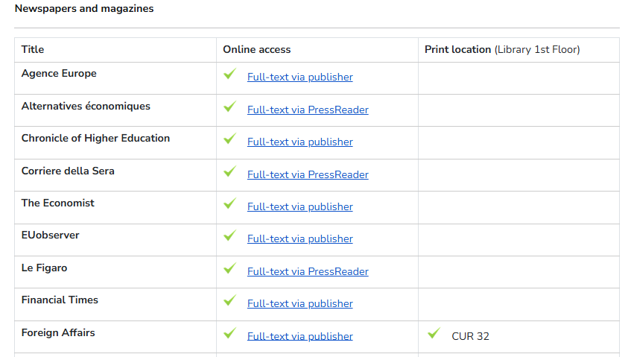

Slide 10
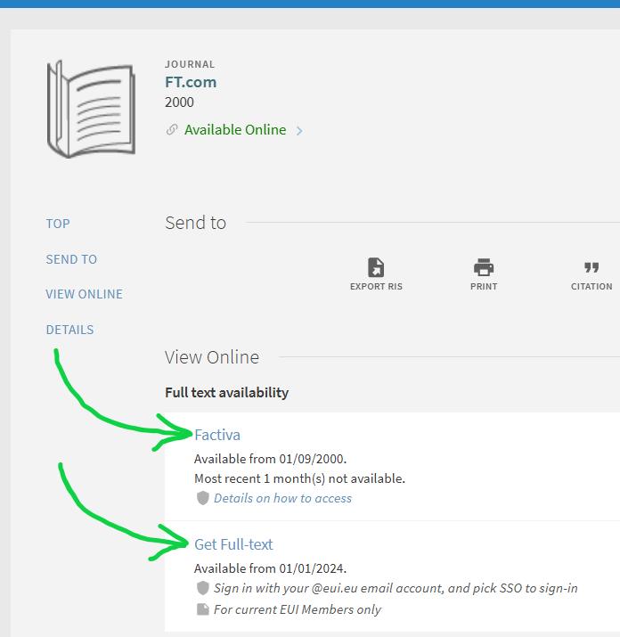
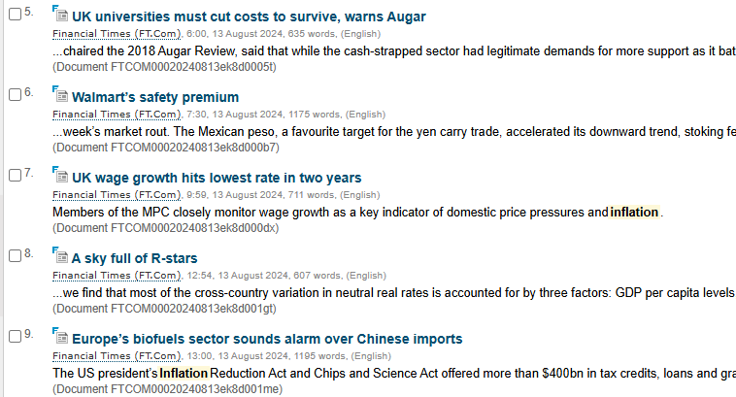
Multiple modes of access

Slide 11
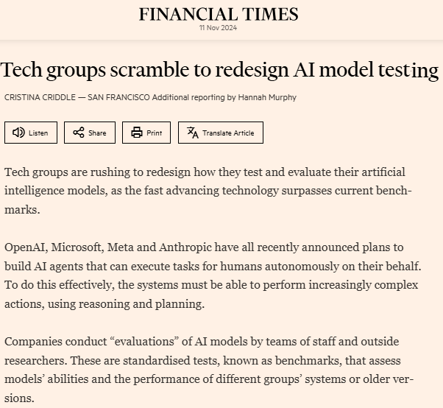
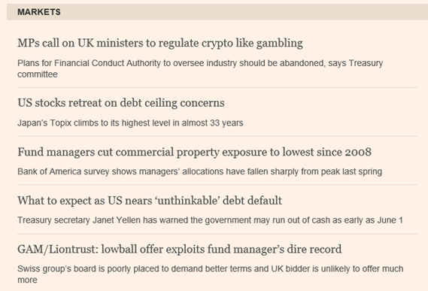

Slide 12
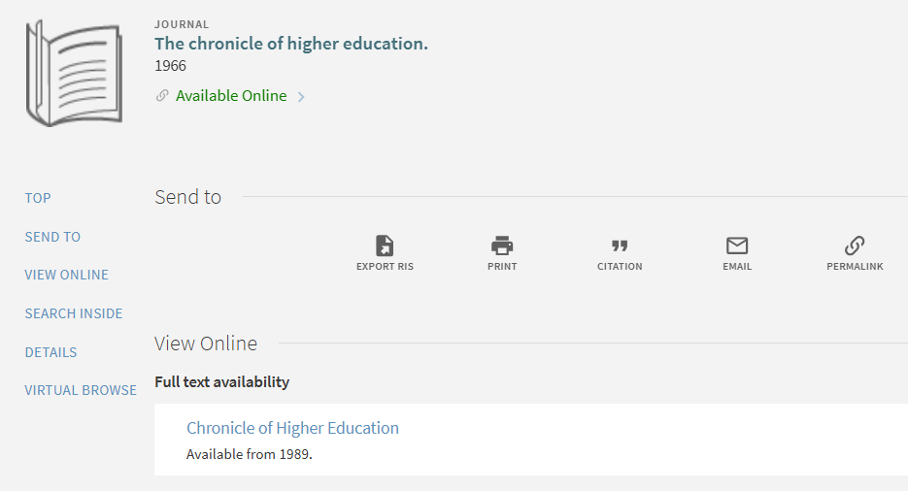
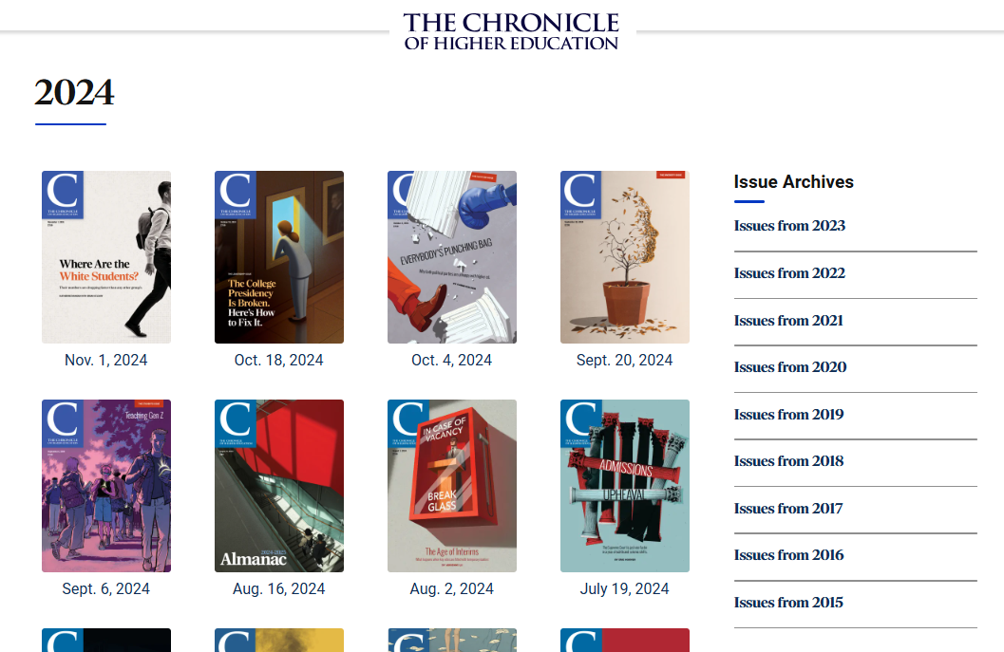

Slide 13
Newsletters and alerts

Slide 14
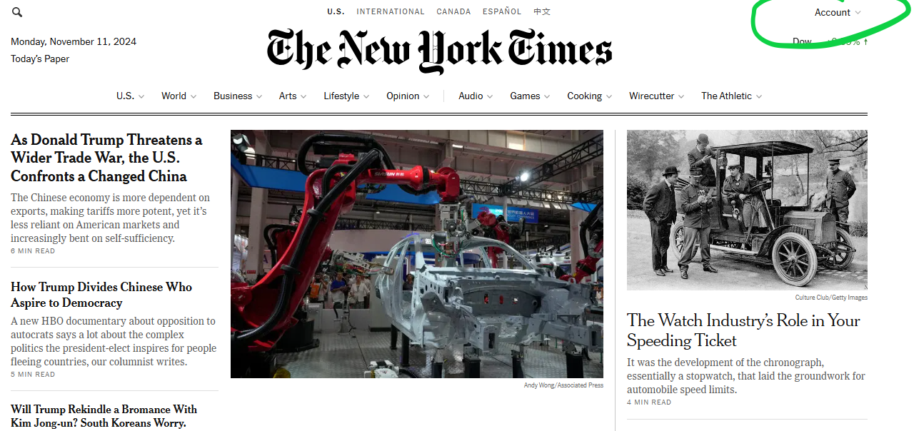

Slide 15
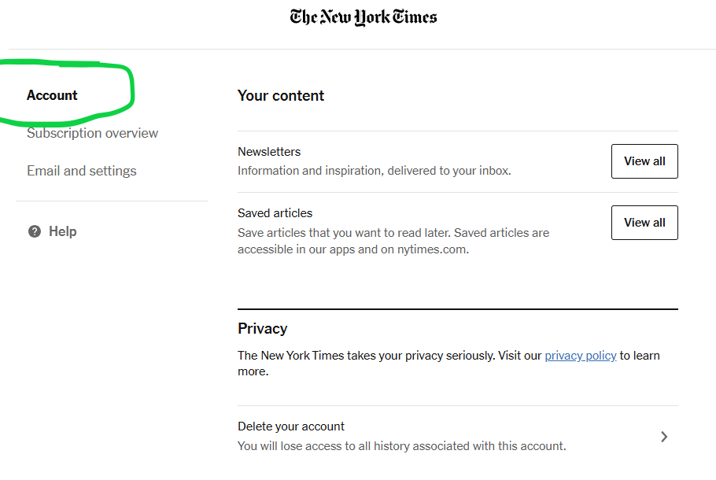

Slide 17
Terms and Conditions: access and use
Premium (paid) resources are for current EUI members only
No sharing of passwords / access
Personal / research use only
No commercial use

Slide 18
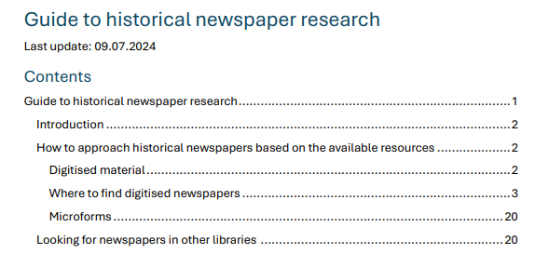

Slide 19
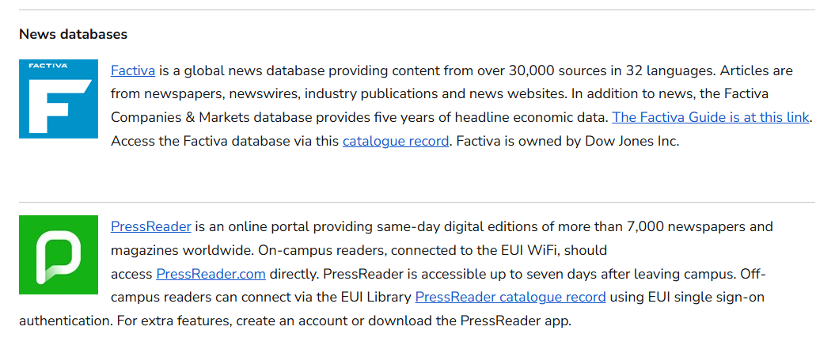

Slide 20
News databases
PressReader | Factiva
Approx. 7,000 international news sources | Approx. 30,000 international news sources
General newspapers and magazines | Newspapers, newswires, news releases
Page images/layout and text | Text only
90-day coverage (varie) | 35-year coverage (varie)
Basic search | Advanced search
Via mobile app, desktop, laptop | Via desktop, laptop

Slide 22
Available Apps
PressReader
FT
NYTimes
Economist

Slide 23
Access PressReader via the Catalogue link
Create an account associated with your @eui.eu email
Download the App on your phone or tablet
The first login to the App must be done on Campus (connected to the EUI wi-fi). This way your account is linked to the EUI subscription
The so-called radiant access is granted for 7 days from the moment you have disconnected from the EUI wi-fi
After 7 days you can still access the content via the link provided in the Catalogue
Your account will be reactivated once back to the EUI or accessing the resource via Catalogue link
Quick Start Guide: https://care.pressreader.com/hc/en-us/articles/202547739-Quick-Start-Guide

Slide 24
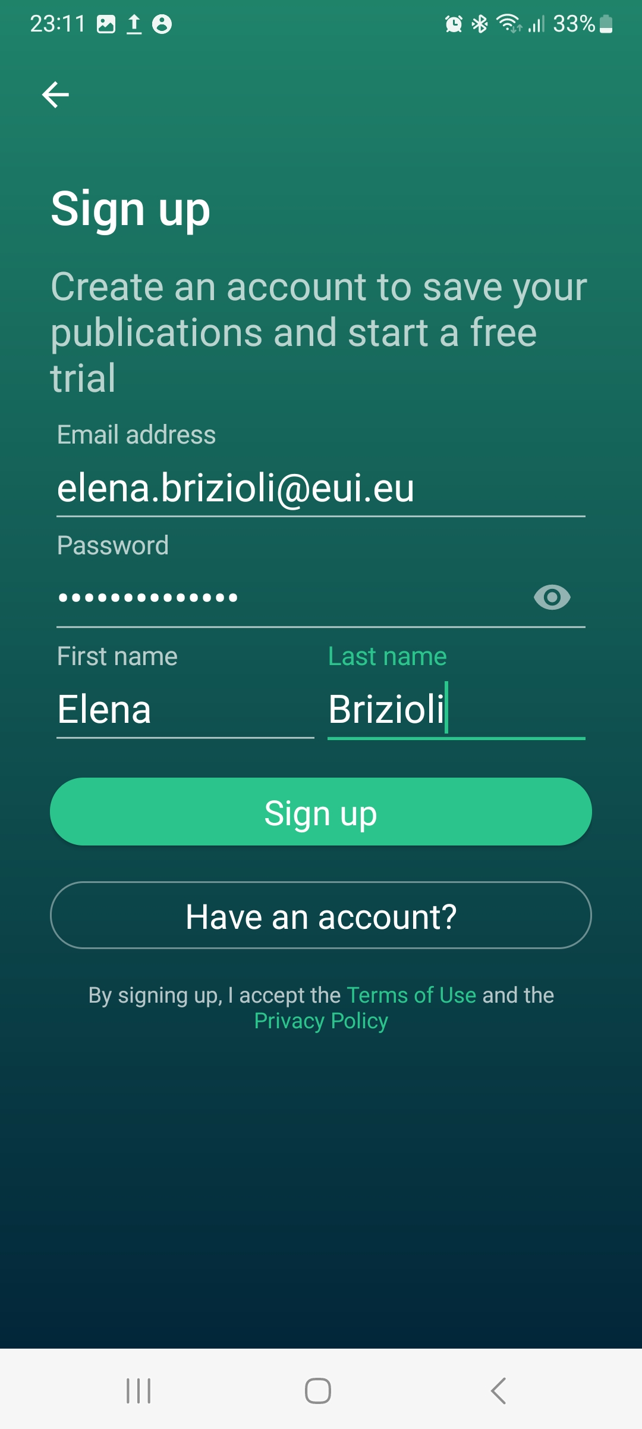
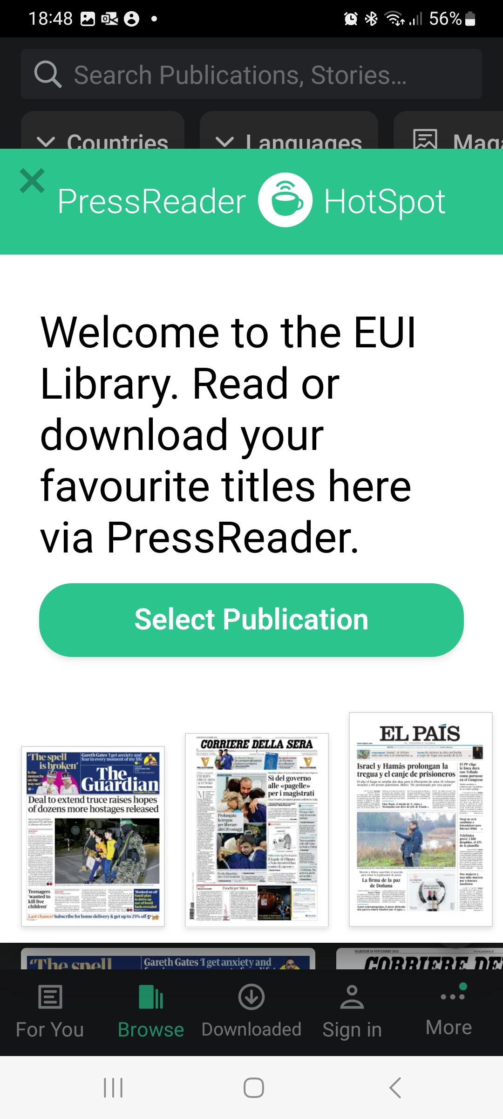
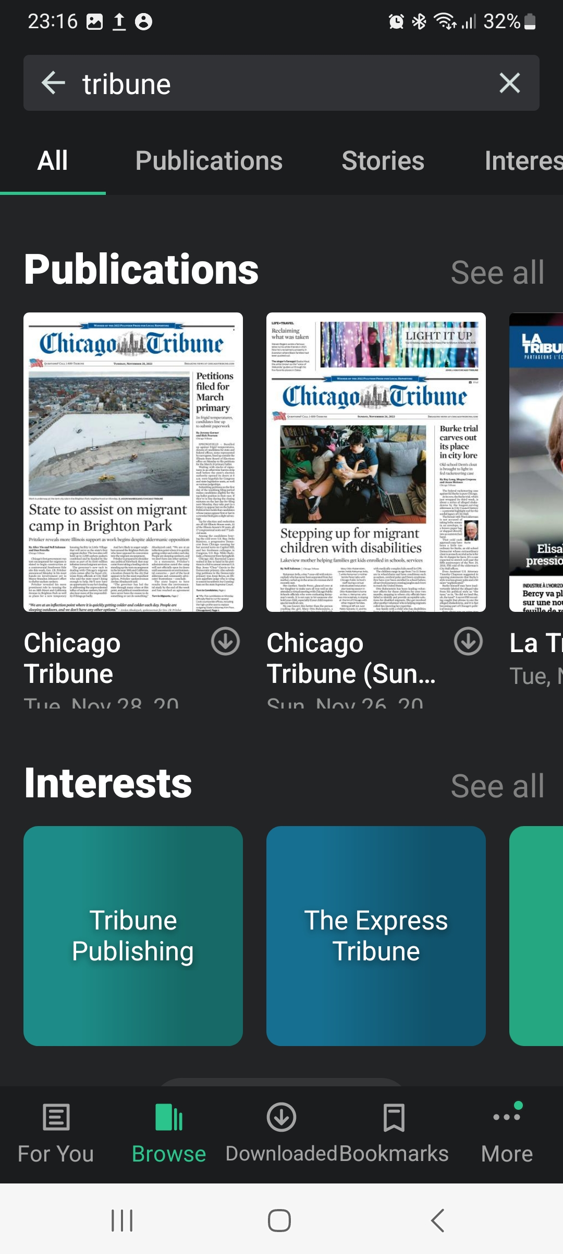
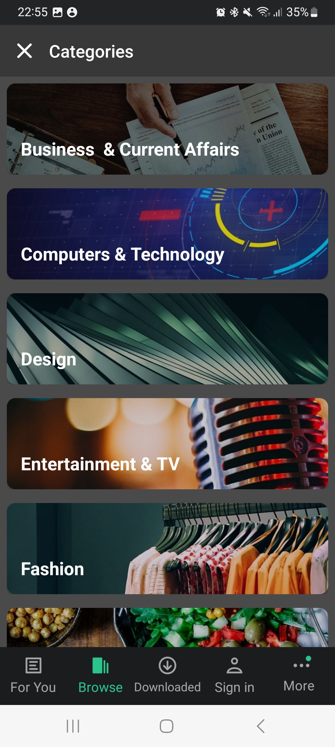
Main features
Notes:
Once downloaded the App, sign in, you will enter the EUI PressReader room
Search the Title you are interested in
Browse by Category
Browse by publications type, language…Country

Slide 25
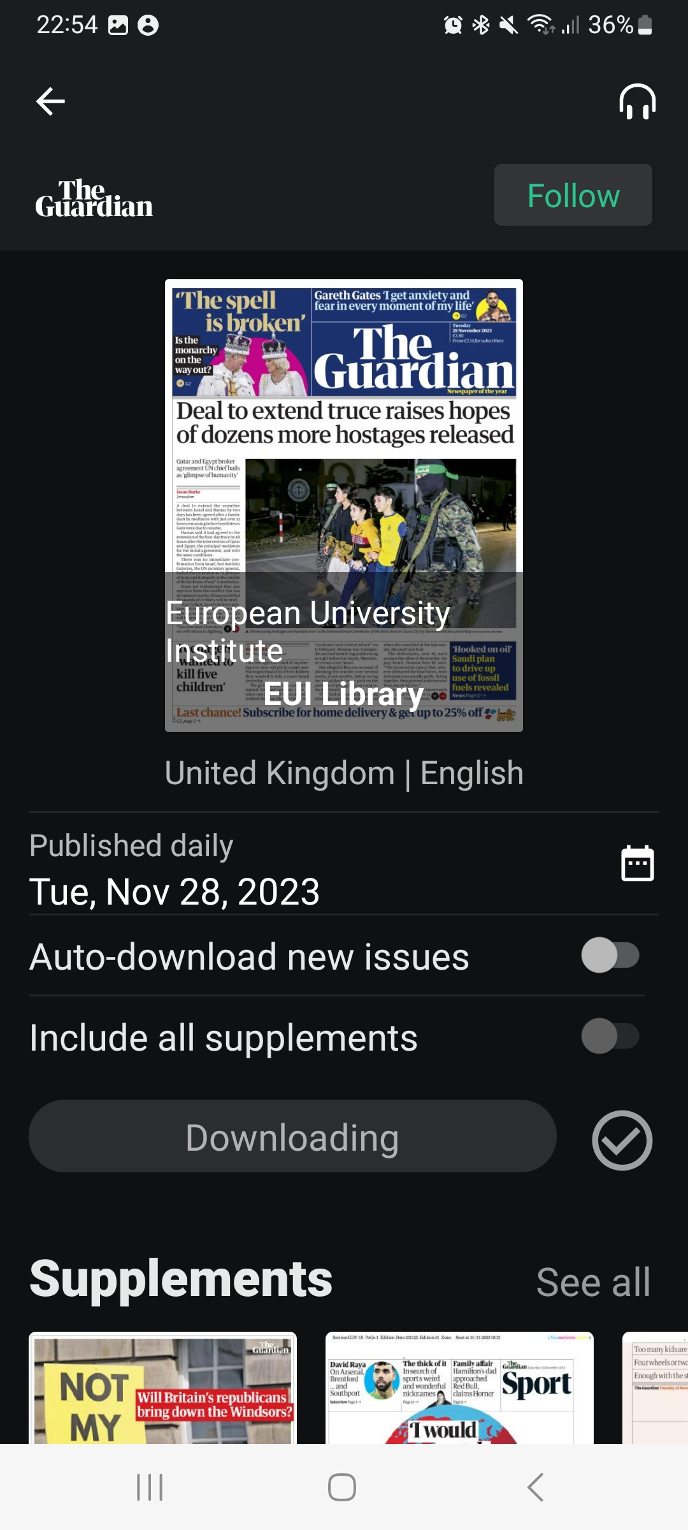
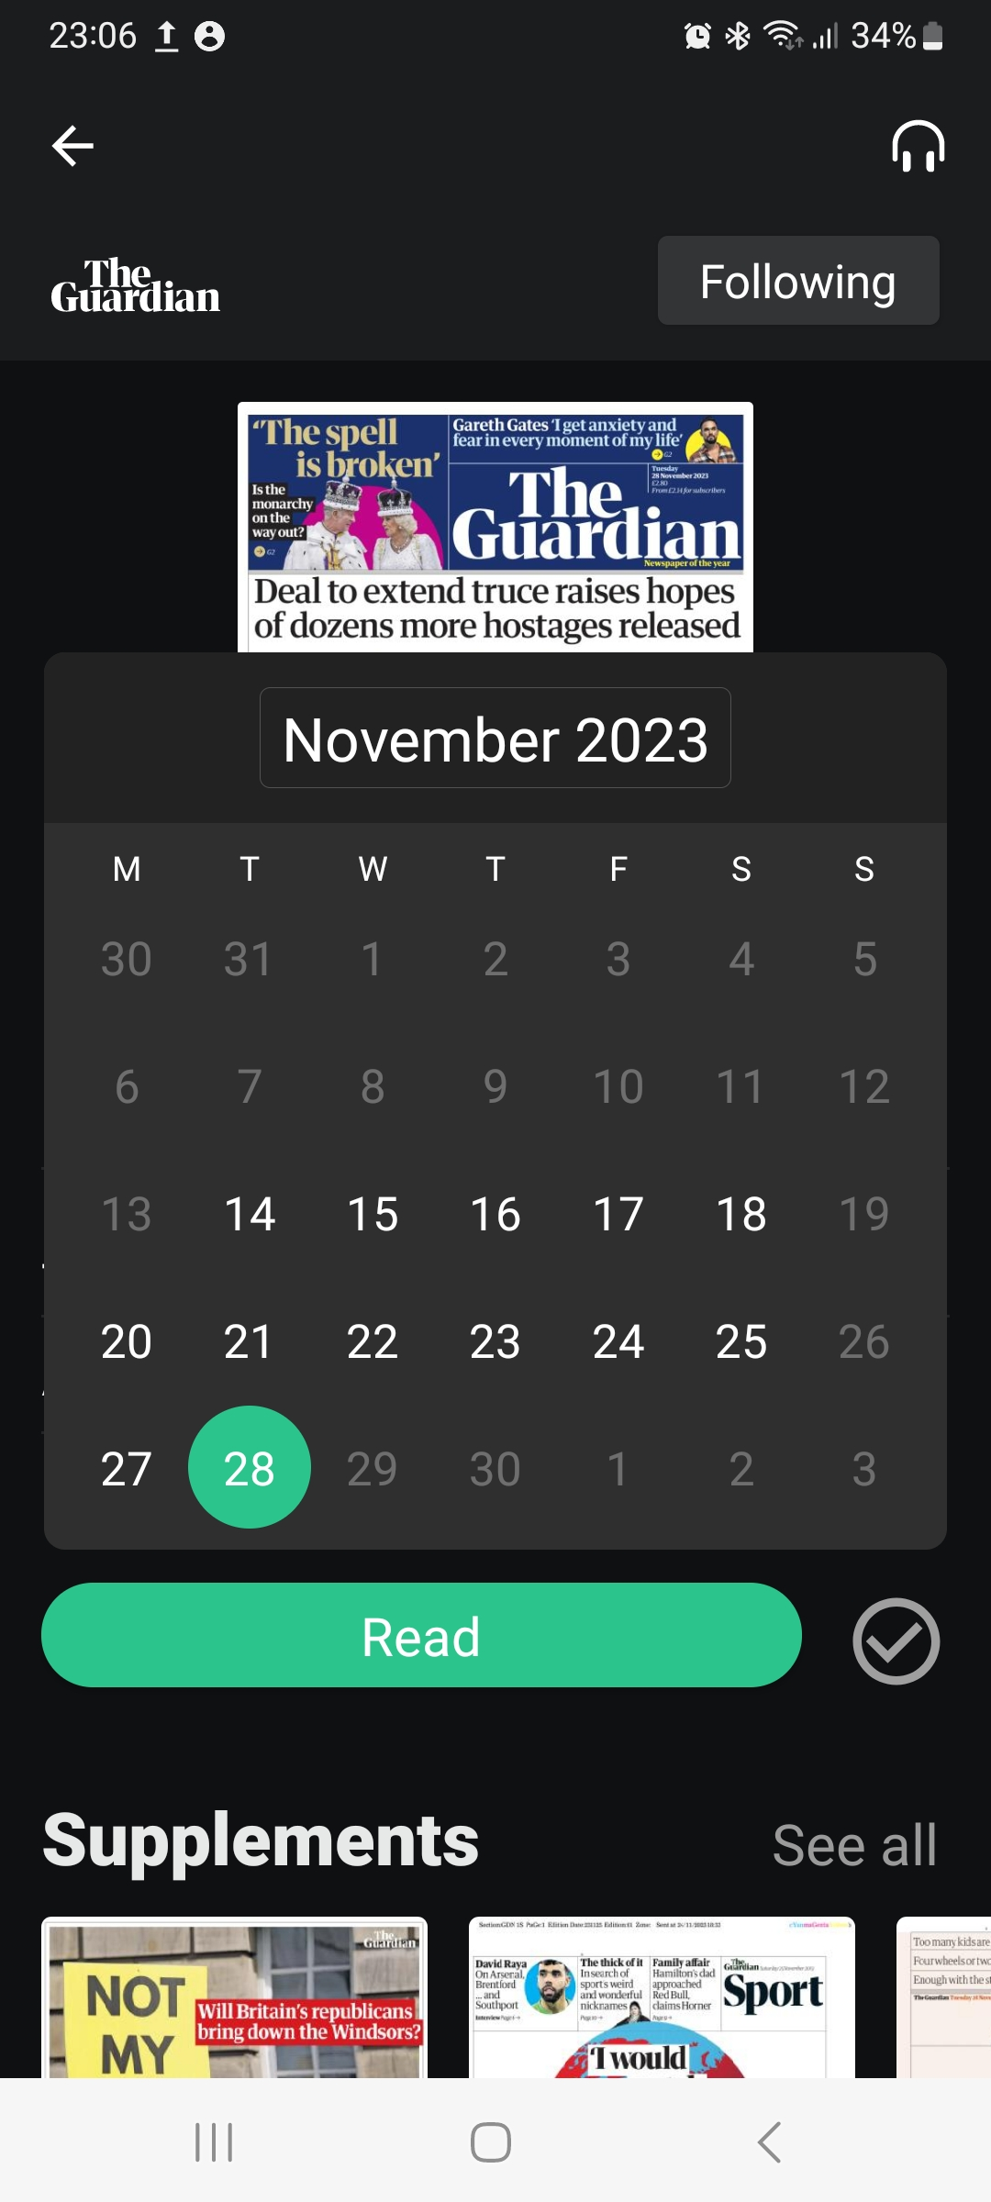
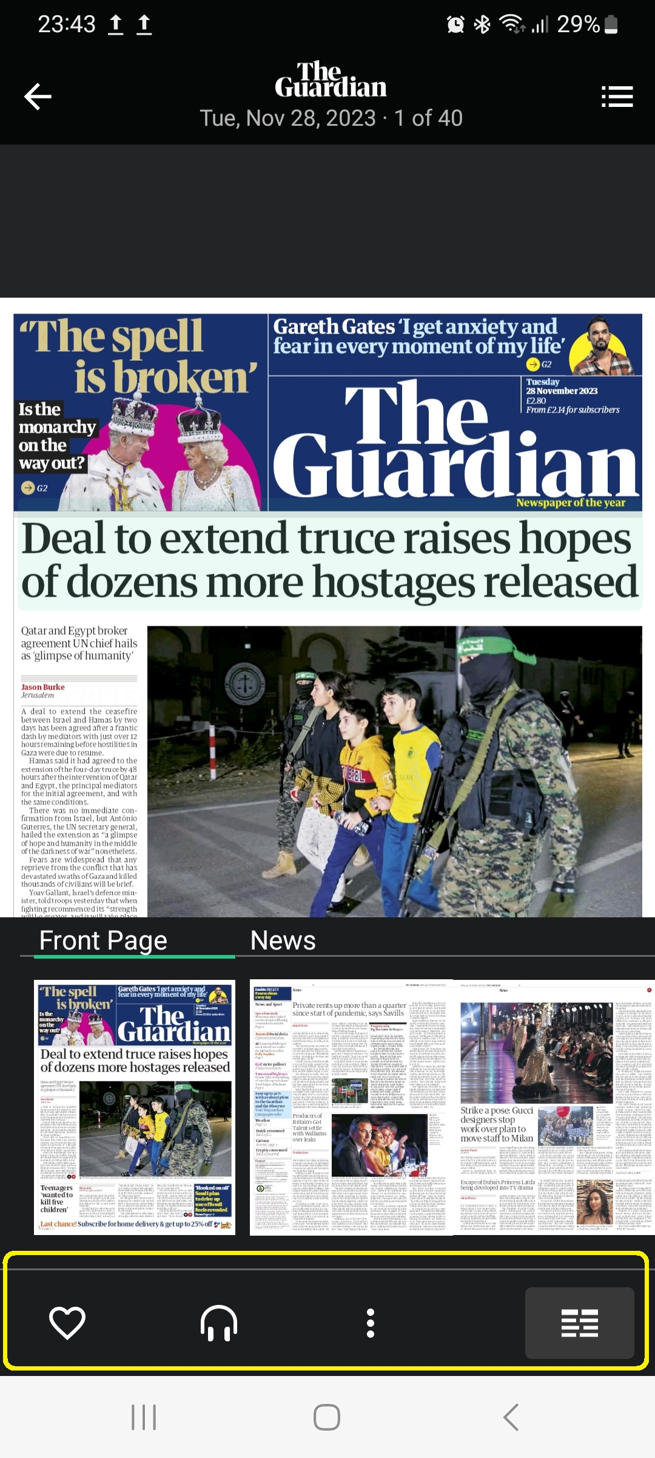
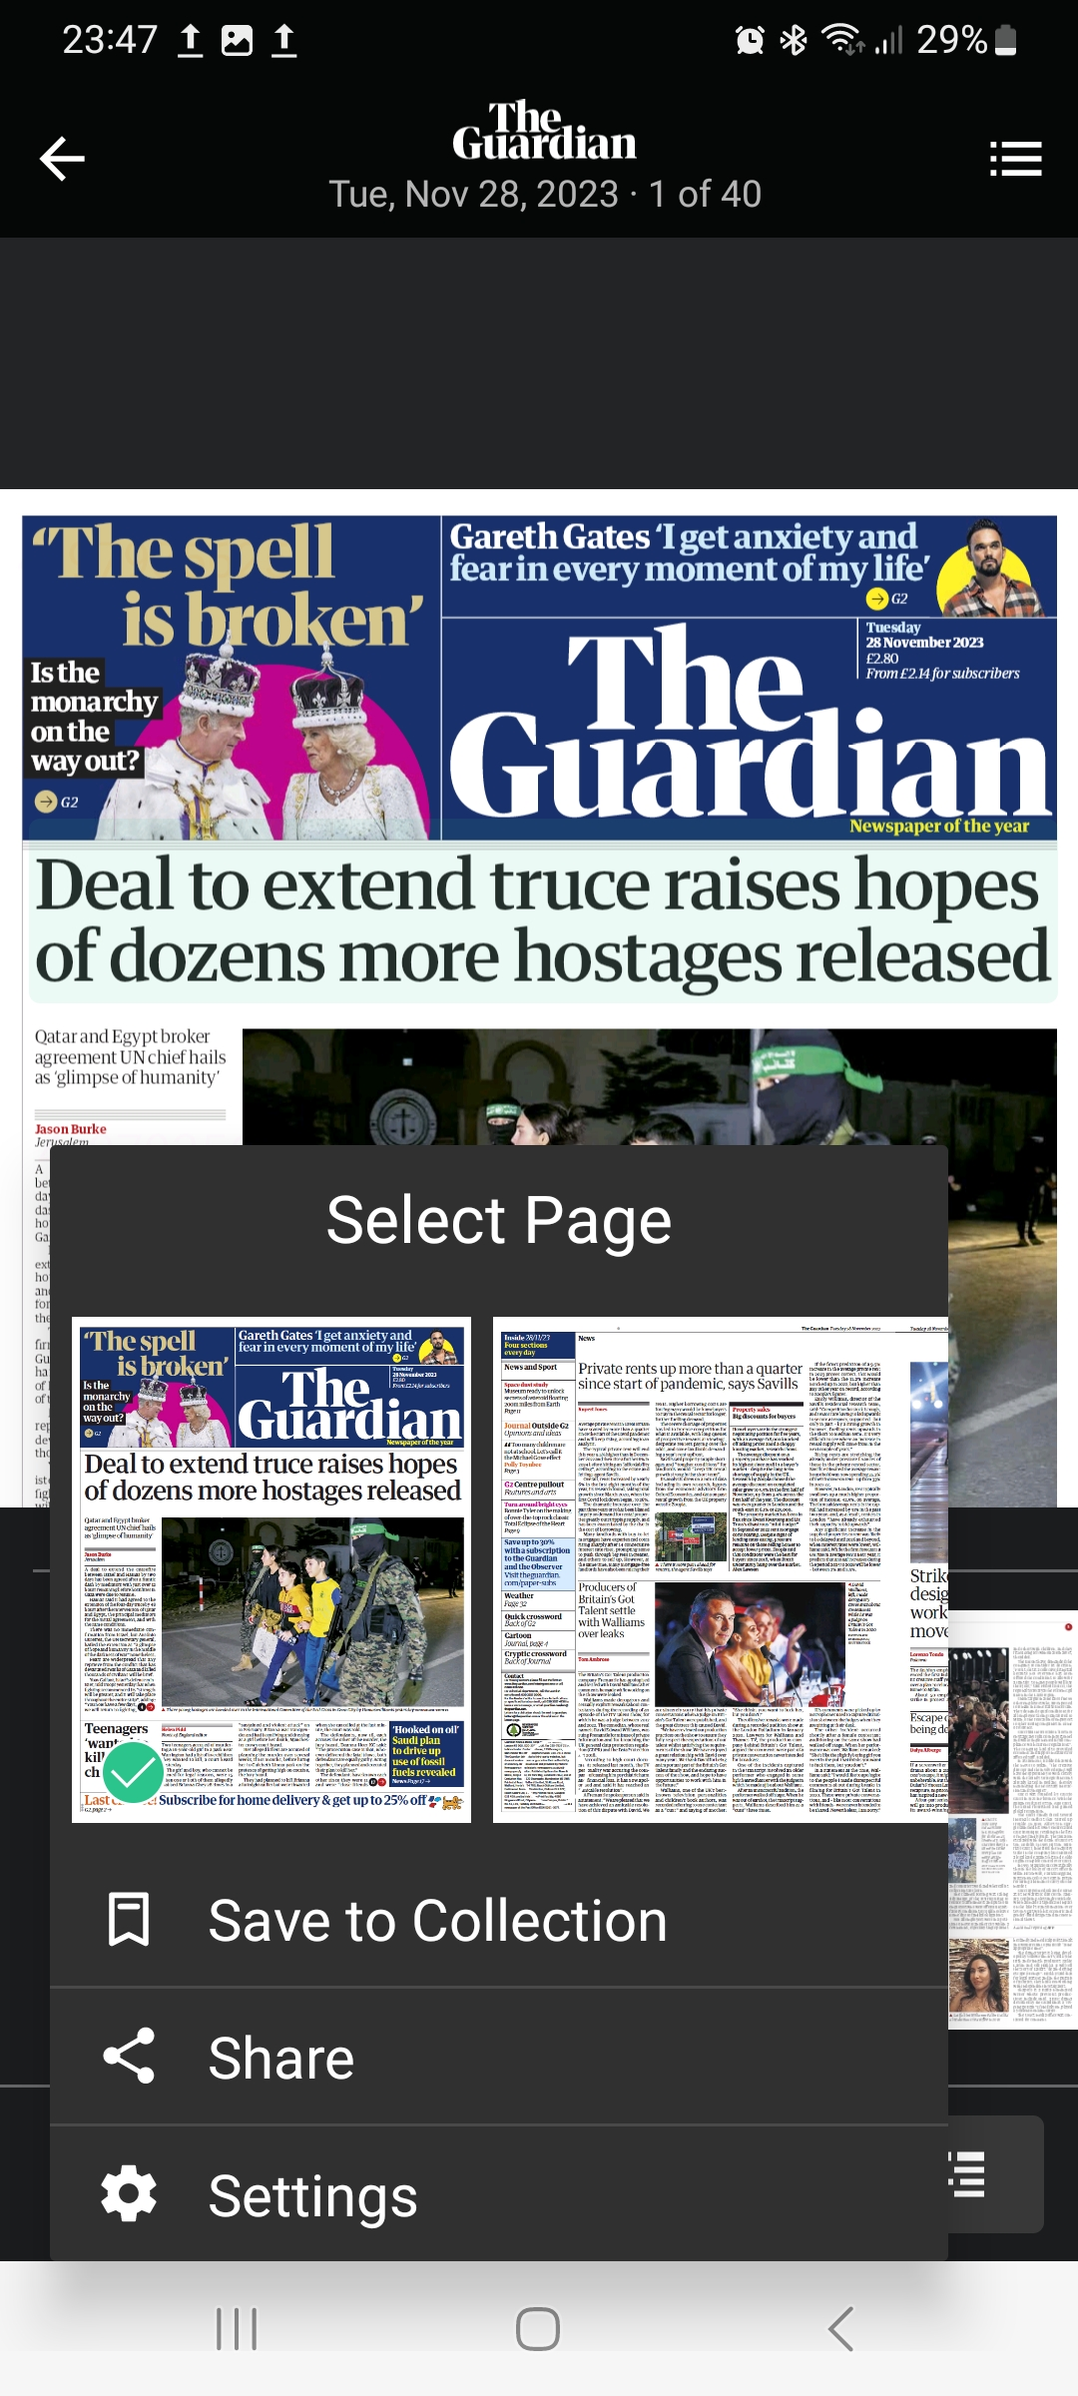
Main features
Notes:
Daily issue
Browse back the calendar to access previous issues, 90 days explained by Thomas
Enter an article
Zoom on it
Settings: Smart zoom, Full screen, highlights in full screen, Postpone sleep
Share: email, whatsApp, Instagram, Bluetooth...

Slide 26
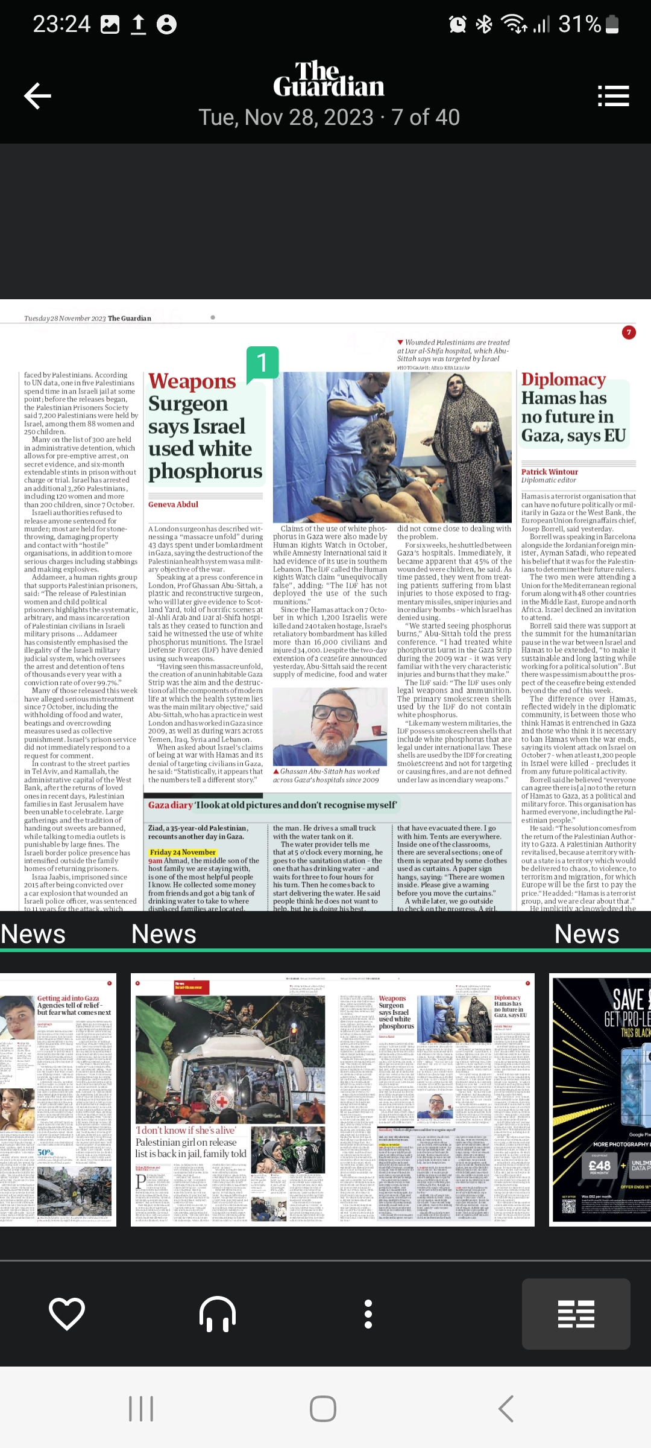
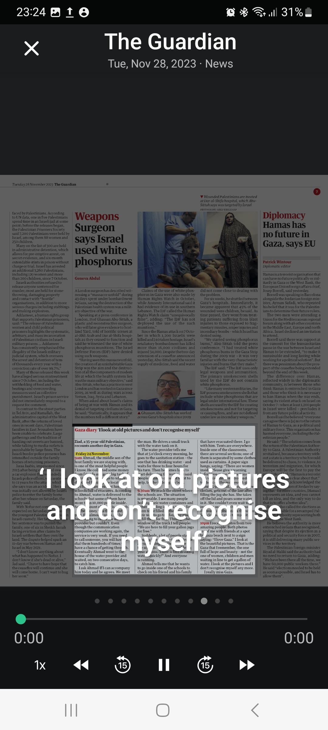
Main features
Text-to-Speech: https://care.pressreader.com/hc/en-us/articles/208726456-Enabling-Text-to-Speech
Notes:
A familiar voice. Less data.
PressReader now offers the option to use your own device's speech engine to read articles out loud. Just open the app, download your favorite newspaper or magazine, and enable Text-to-Speech. When you tap Listen to start your session, you'll be able to use the arrows to skip ahead in the issue, or back to the previous article at any time. The radio mode in PressReader will instantly acquire all of the audio preferences from your device.

Slide 27
Financial Times
Access FT via the Catalogue link
Create an account associated with your @eui.eu email
The first login to the App can be done from anywhere
This Photo by Unknown Author is licensed under CC BY-SA

Slide 28
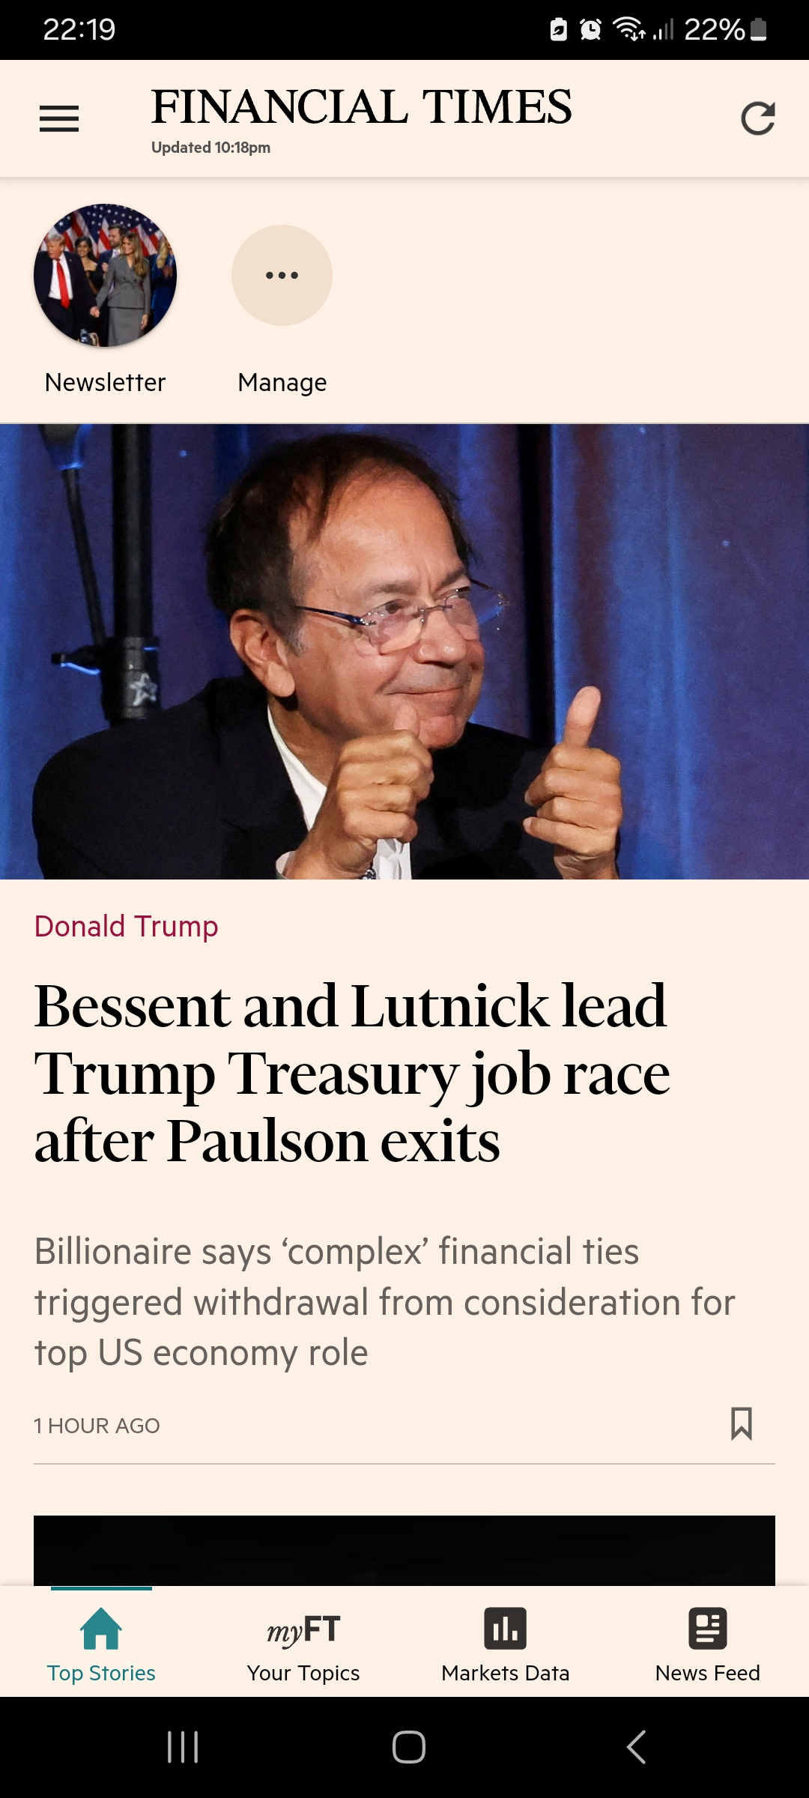
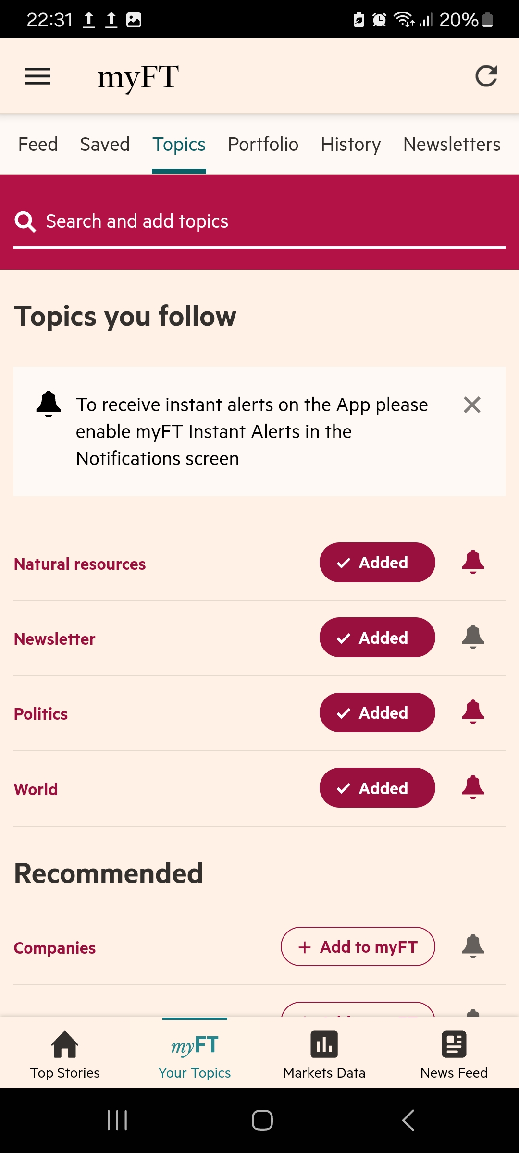
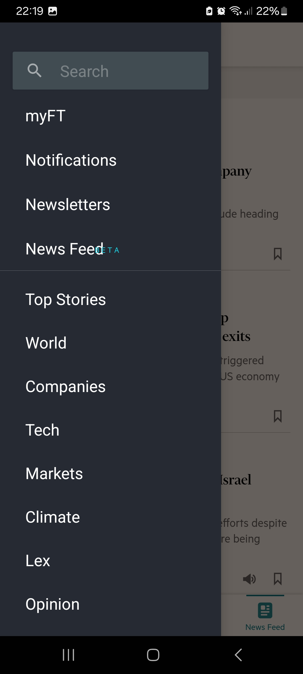
This Photo by Unknown Author is licensed under CC BY-SA

Slide 29
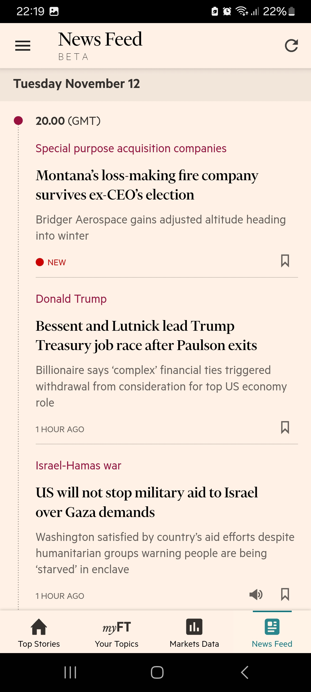
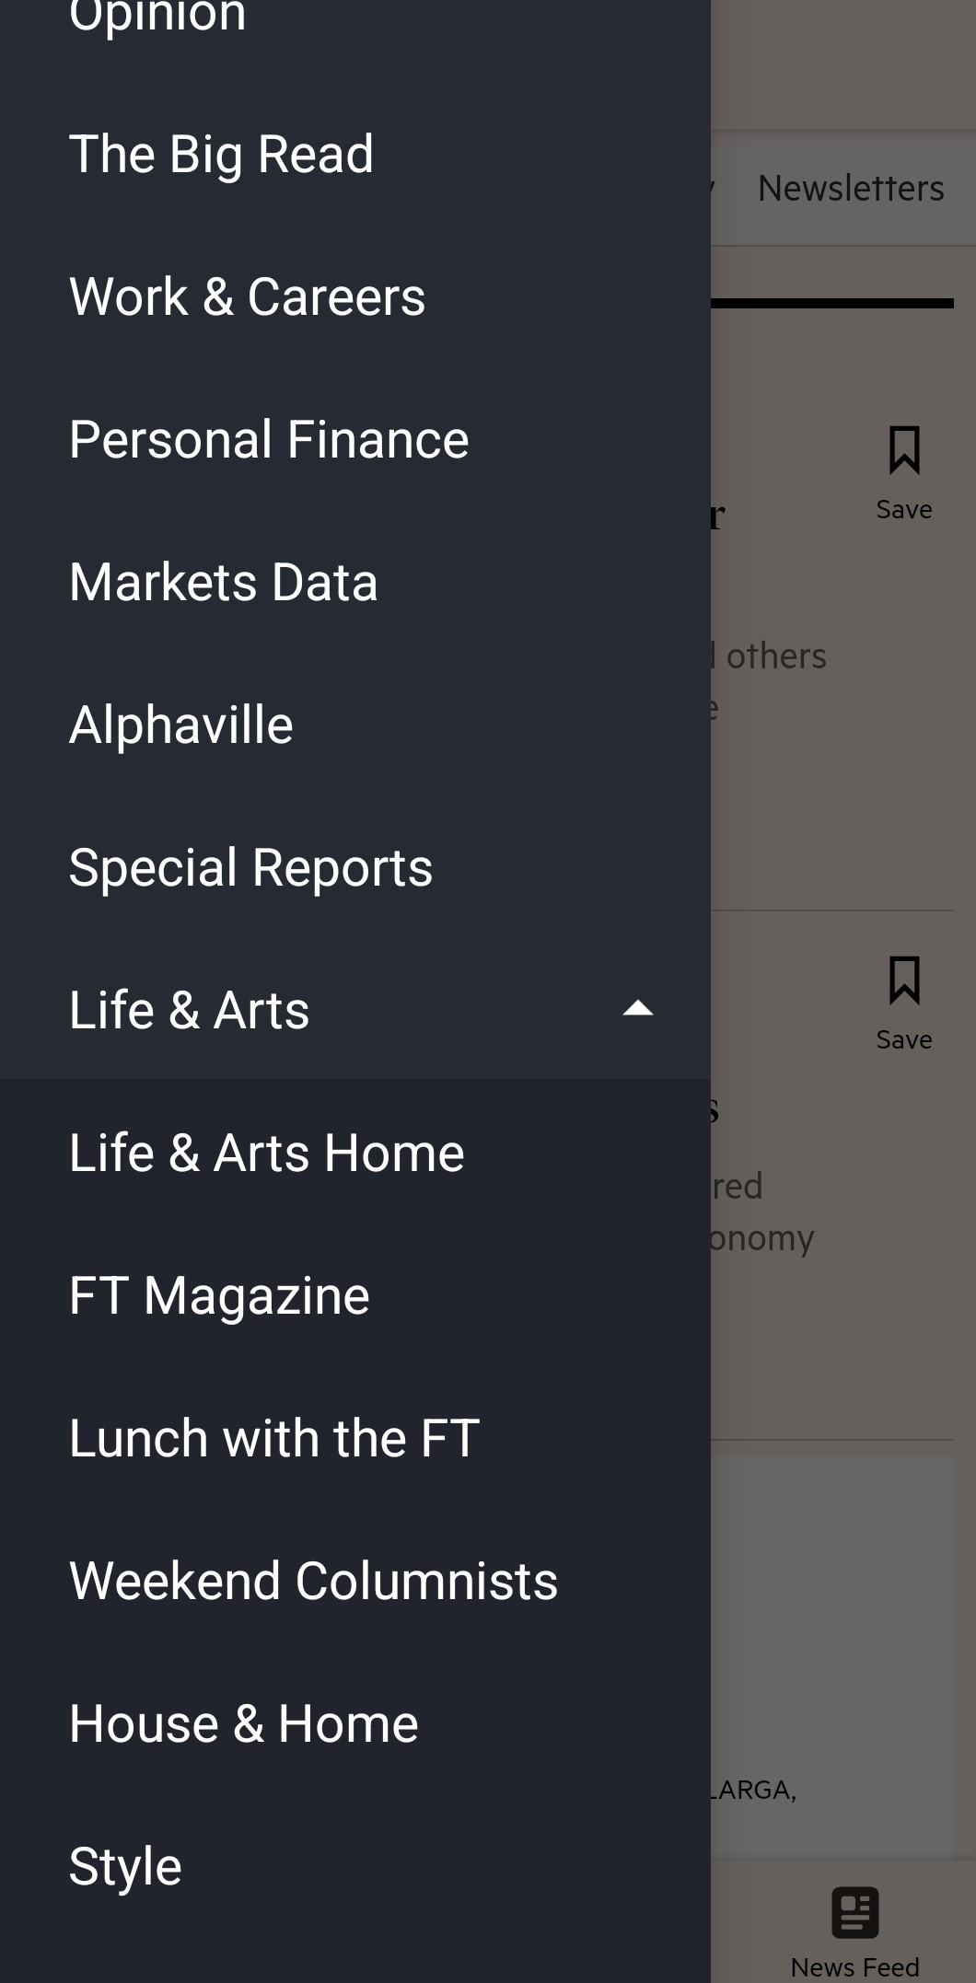
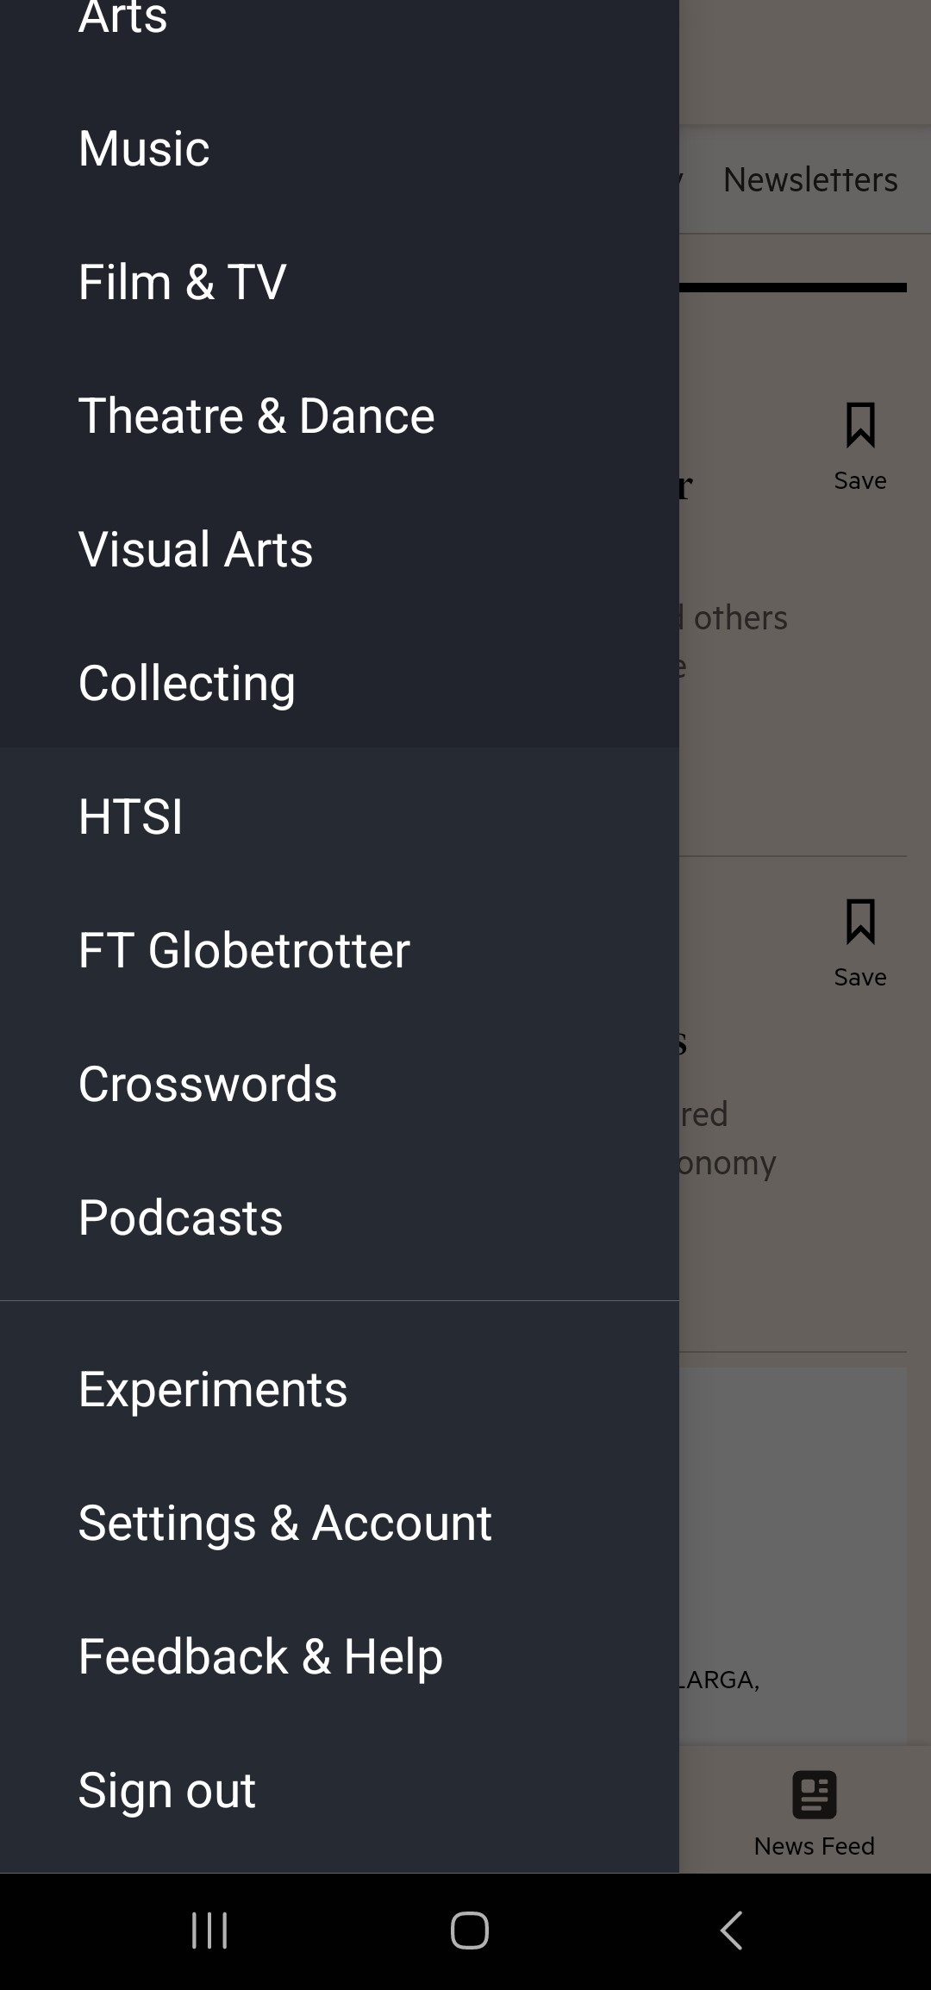
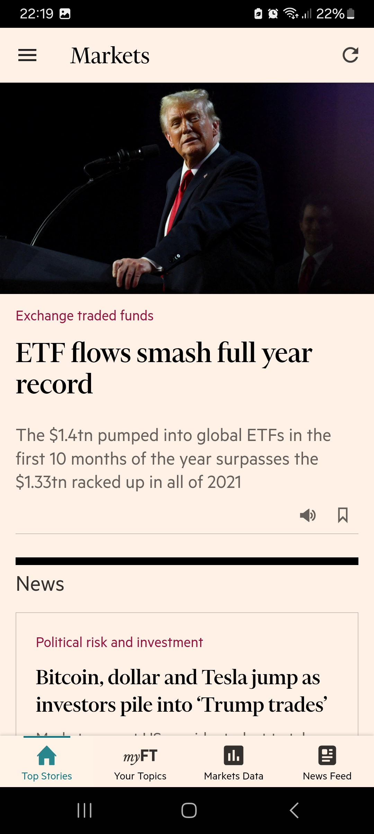
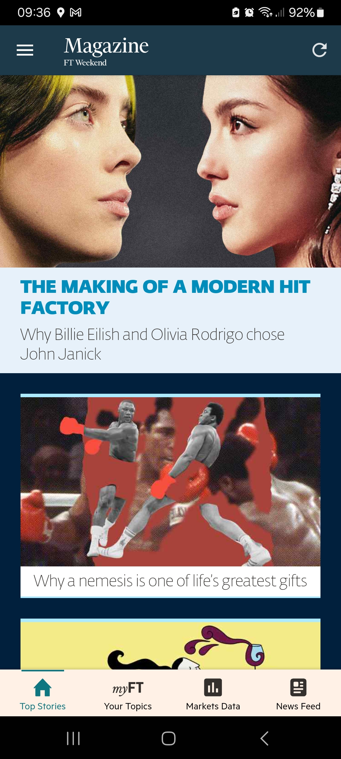
This Photo by Unknown Author is licensed under CC BY-SA

Slide 30
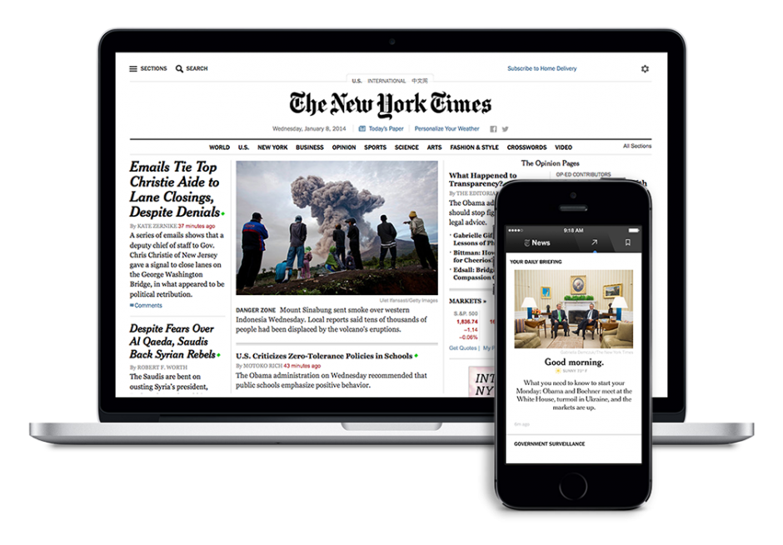
New York Times
Register to connect to NYT International (via Catalogue link)
With NYTimes.com Passes users have full access to the extensive breaking news, world news, and multimedia of The New York Times. On & off-campus access, plus smartphone/mobile and Tablet NYT Apps is provided.
Use the same credentials to set up the App
The first login to the App can be done from anywhere

Slide 31
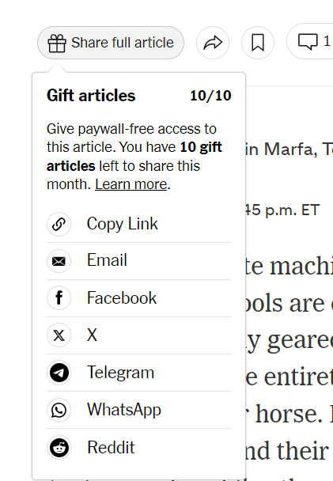
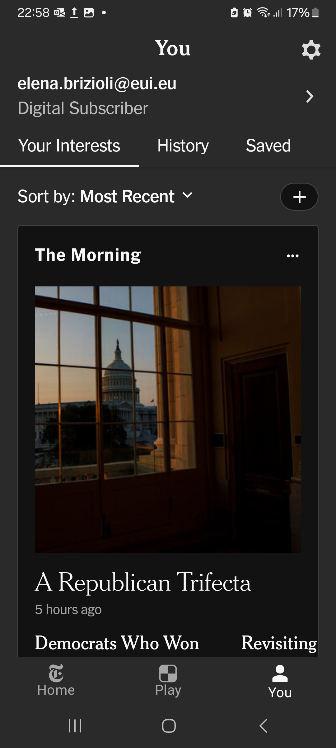
New York Times
Notes:
Very straight forward
Nice 10 gift articles option

Slide 32
To register to the Economist, follow carefully the instructions provided by the Catalogue
Use the Log in button on the top right corner
Enter your @eui.eu email account without entering any password
WAIT
You will be asked to authenticate with your EUI credentials (first time only)
Future access will automatically redirect you to the Economist homepage
Download the App on your phone or tablet and enter with your @eui.eu credentials
Notes:
The Economist is the only one which is using the SSO

Slide 33
Use the REPORT AN ACCESS PROBLEM link to contact us for any problems you may encounter accessing Library electronic resources
Any issues accessing eResources?

Slide 34
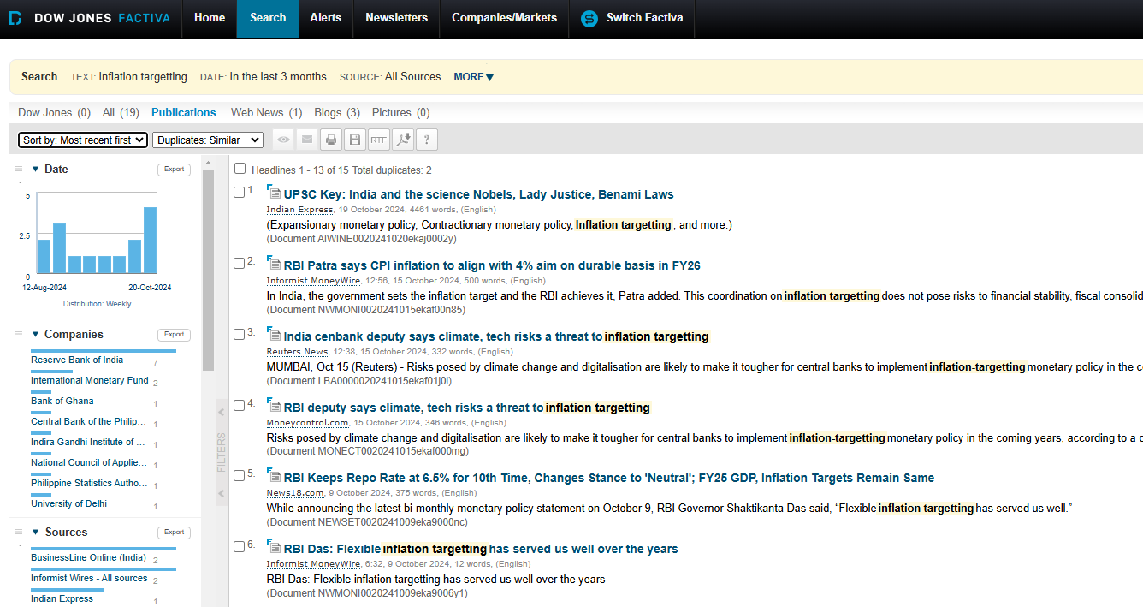

Slide 35
Factiva search operators
Simple search: Deforestation
All keywords present: Geneva Conventions (AND implied)
Phrase search: “European AI Act”
Any terms in article: Mercedes OR Daimler
Exclude terms: “fossil fuels” –coal
Headline search: hl: “COP29”

Slide 36
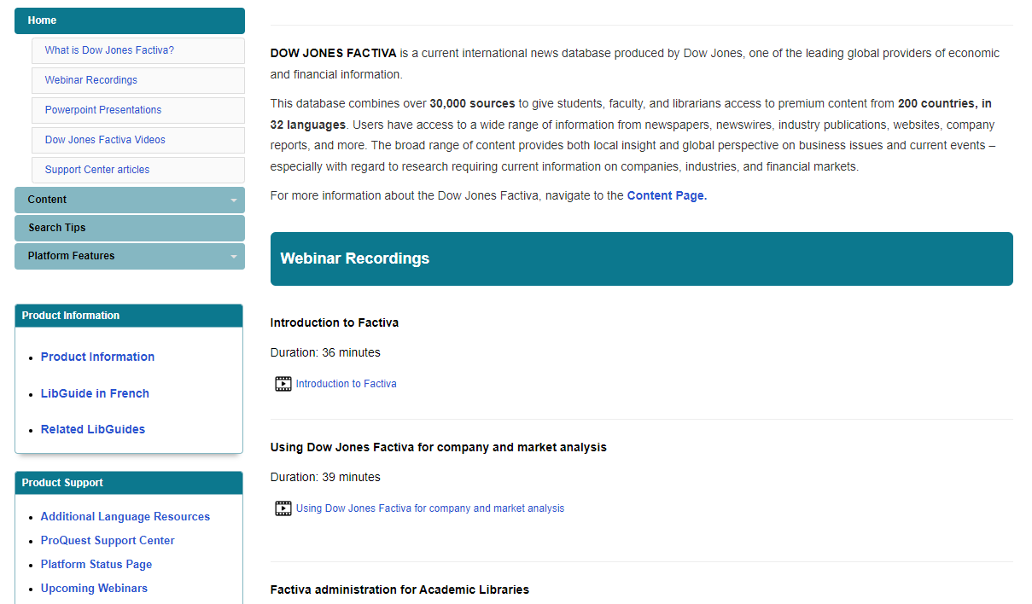
Factiva support

Slide 37
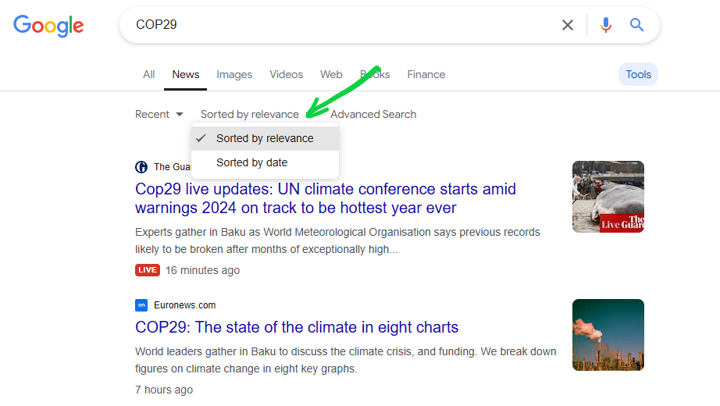

Slide 38
Annual ESR resource funding call

Slide 40
EUI Library News Resources
Thomas.Bourke@EUI.eu
Elena.Brizioli@EUI.eu
Federica.Signoriello@EUI.eu
13 November 2024

