Slide 1
Political & Social Sciences Collections and Services 4 September 2024

Slide 2
Research support
Homepage: Political & Social Sciences collection
thomas.bourke@eui.eu
Office: Library first floor, BF-085

Slide 3
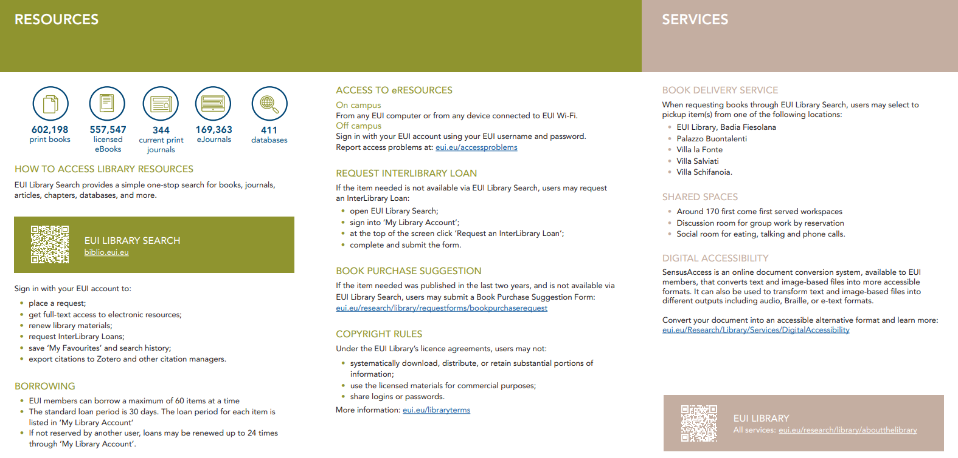
General information leaflet

Slide 4
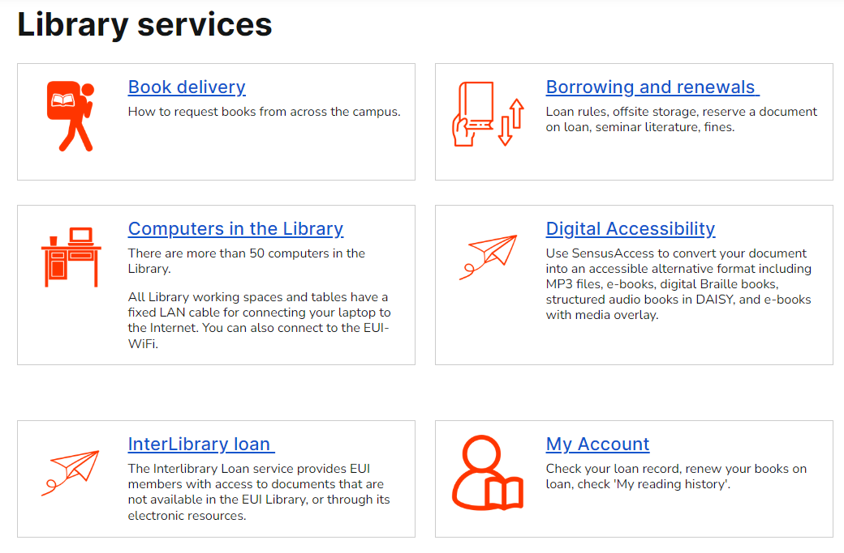

Slide 5
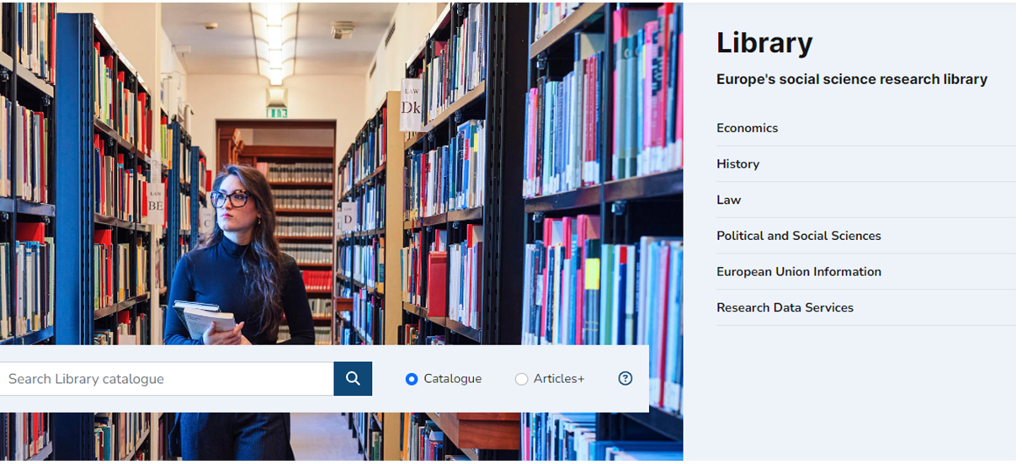

Slide 6
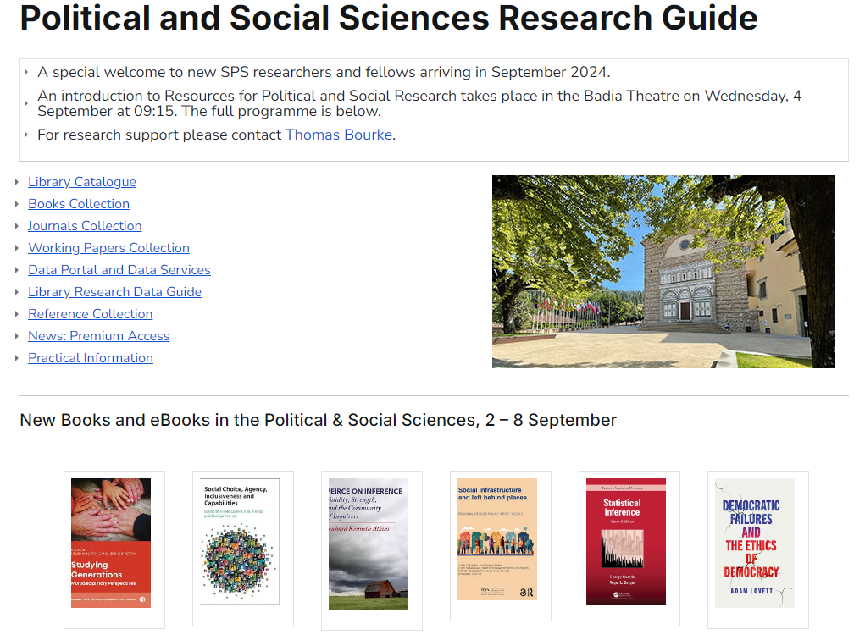

Slide 7
Collections
Books, eBooks & Manuals
Journals & eJournals
Data Portal
Working papers
Reference works
News resources

Slide 8
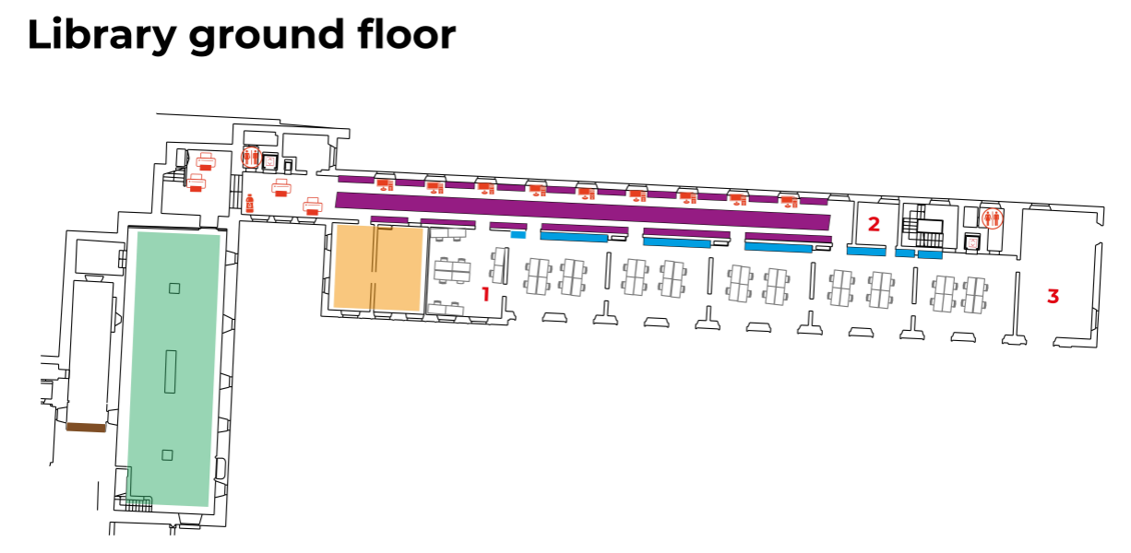

Slide 9
First floor

Slide 10
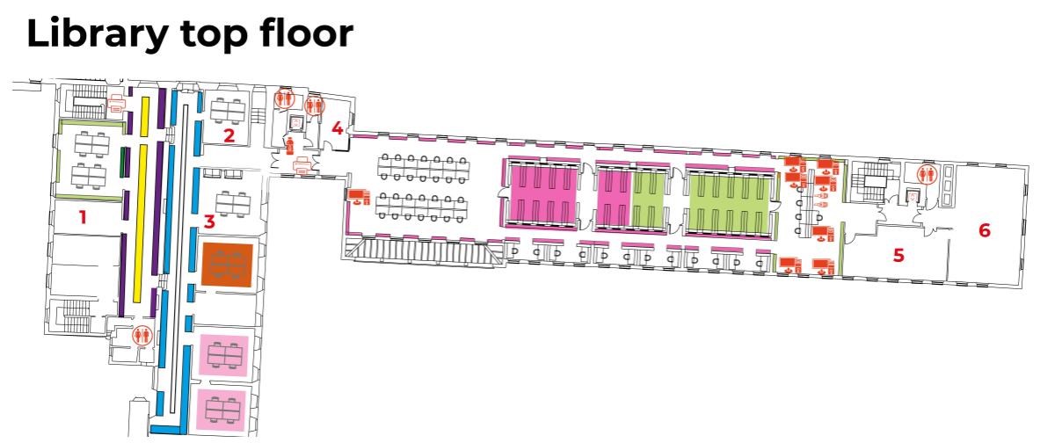

Slide 11
Shelfmarks
300 Social Sciences
301 Sociology & anthropology
302 Social interaction
303 Social processes
304 Factors affecting social behaviour
305 Social groups
306 Culture & institutions
307 Communities
320 Political science
321 Systems of governments & states
322 Relation of state to organised groups
323 Civil & political rights
324 The political process
325 International migration & colonisation
326 Slavery & emancipation
327 International relations
328 The legislative process

Slide 12
Inter-disciplinarity
Anthropology
Ethnography
Social psychology
Philology
Human geography
Culture and literature

Slide 13
Data and statistical science
Data science & software manuals: 001-005
Data methods for Social science: 300.72
Statistical science 519.5

Slide 14
The Catalogue
Title / author / keyword
Book shelfmarks
Full-text eBooks
Full-text ejournals
Patron account
Placing holds / picking up holds
Renewing loans

Slide 15
Suggestions Welcome
New books / ebooks / editions
Any language
New journals
New data and manuals
Older works not in Collection

Slide 16
SPS former faculty
Stefano Bartolini
Rainer Bauböck
Hans-Peter Blossfeld
Colin Crouch
Bernhard Giesen
Adrienne Héritier
Michael Keating
Martin Kohli
Steven Lukes
Peter Mair
Alessandro Pizzorno
Gianfranco Poggi
Christian Reus-Smit
Thomas Risse
Philippe C. Schmitter
Sven Steinmo
Susan Strange
Alexander H. Trechsel

Slide 17
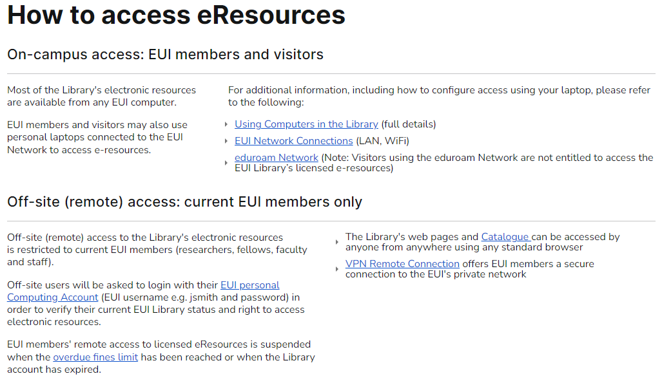

Slide 18
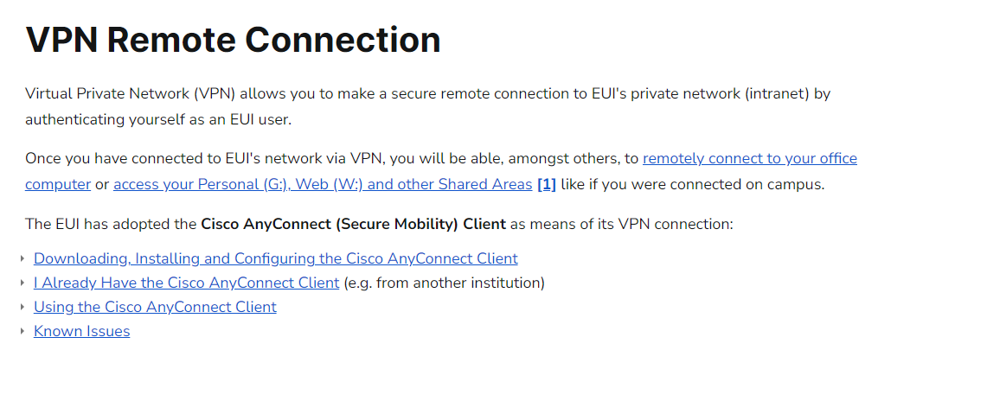
ICT Support

Slide 21
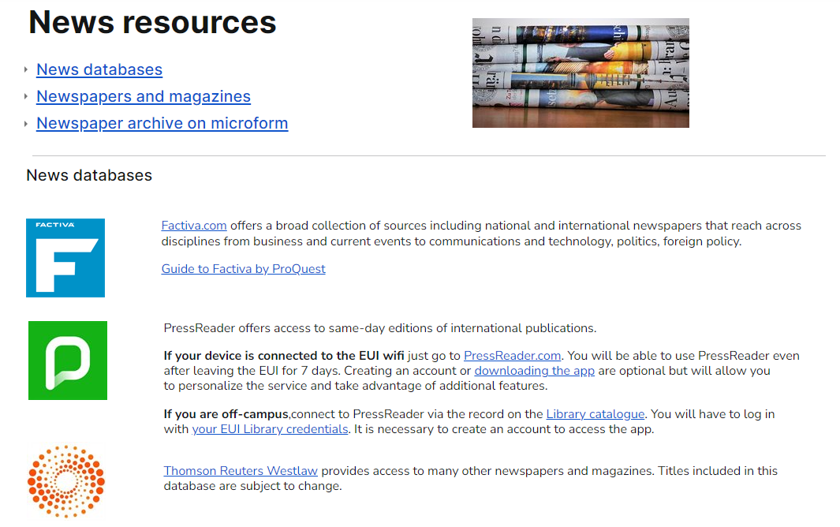
Suggestions Welcome
New books / ebooks / editions in any language
New journals
New data manuals
Extra copies for Departmental Library (VLF)
Older books not in Collection
econlibrary@eui.eu

Slide 22
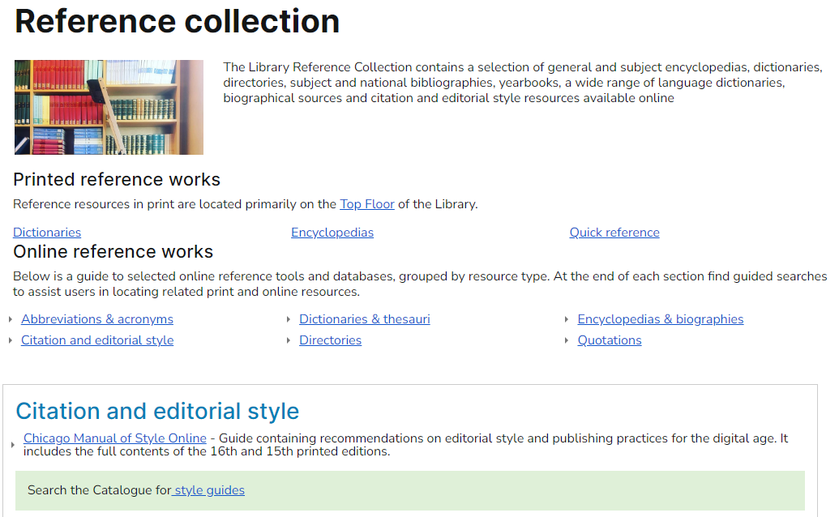

Slide 23
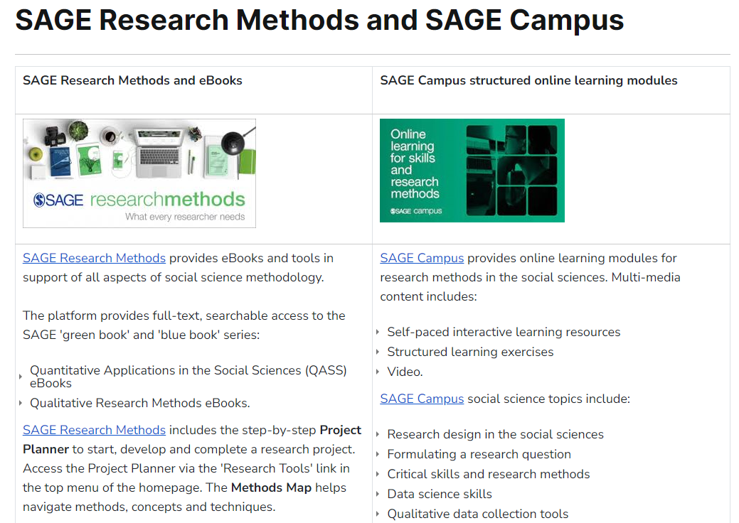

Slide 24
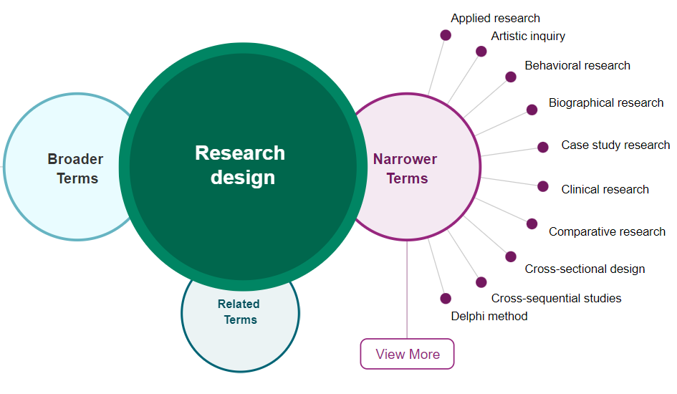

Slide 27
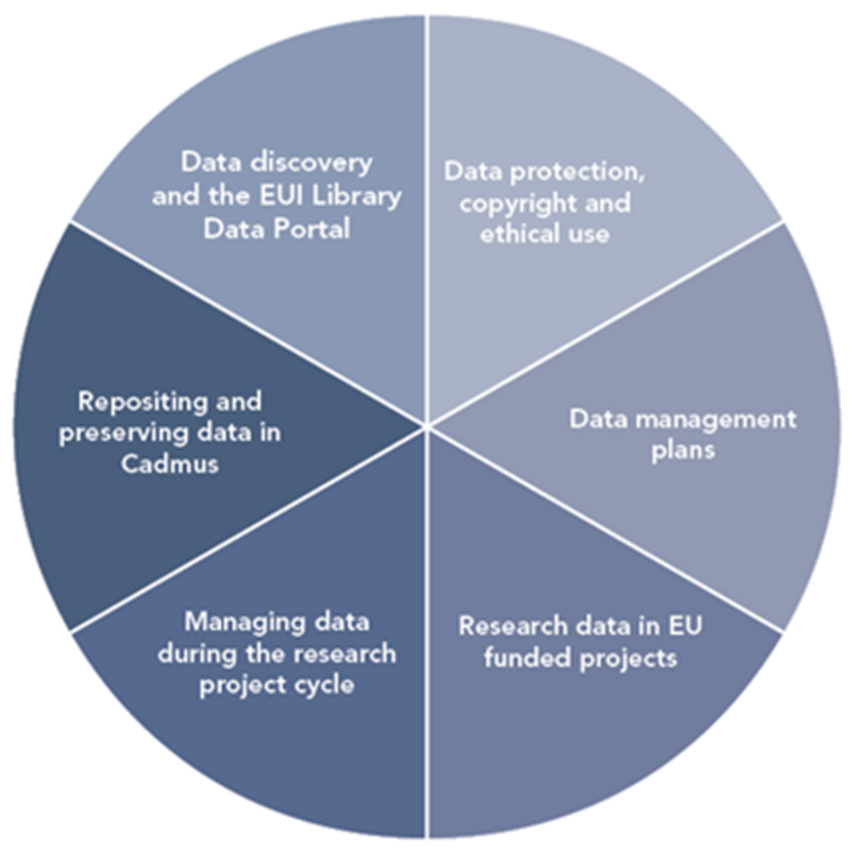
Research Data Lifecycle

Slide 28
Data discovery and generation
Data use
Data preservation and sharing

Slide 29
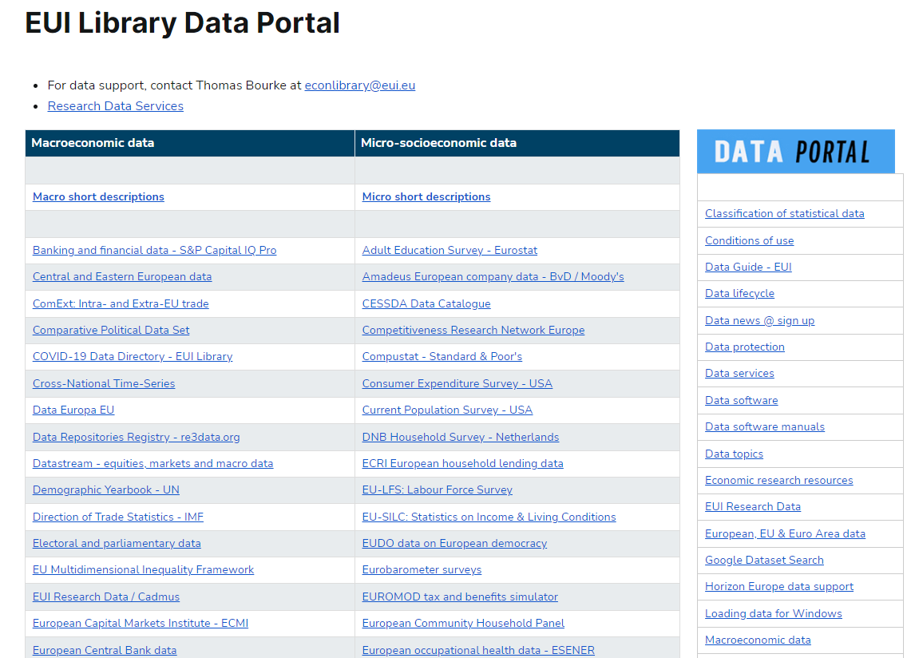

Slide 30
Micro socio-economic data Library restricted server
Special terms and conditions of access and use
Registration required
Library restricted server K:/

Slide 31
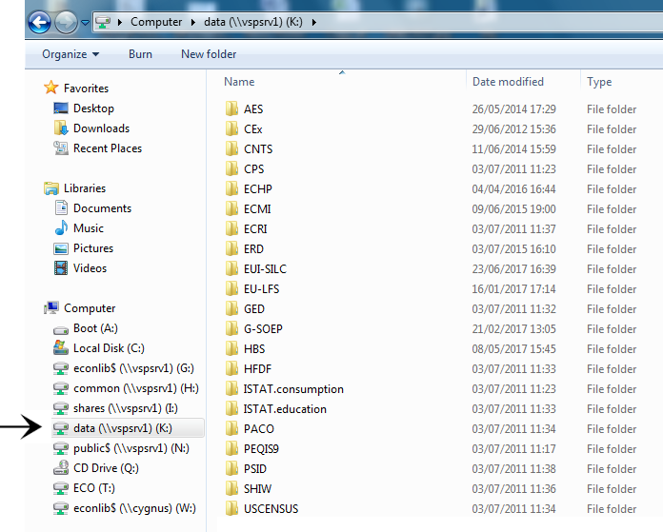
Restricted server K

Slide 32
Data archives

Slide 34
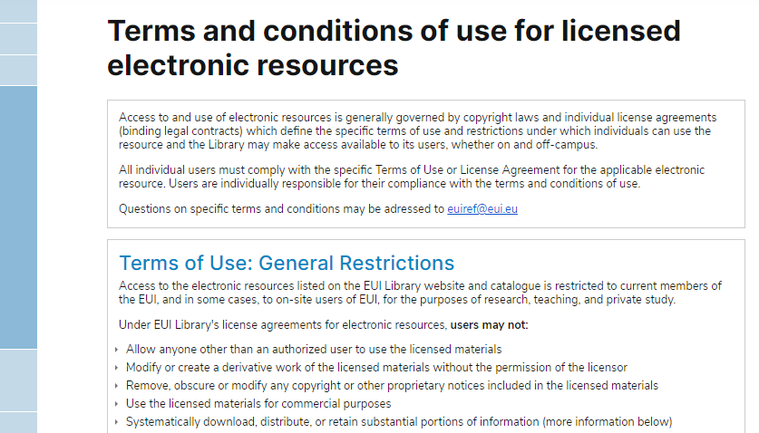

Slide 35
Data Protection: Collecting, generating and processing data
Special terms and conditions apply when collecting and processing micro-socioeconomic and qualitative data – reflecting the sensitive nature of data observations about persons, families and households
Persons, families and households cannot be identifiable in any dataset.

Slide 36
Structure, folders, files, variables, format and versioning
The structure of the research dataset should be carefully considered at the start of the project.
Dataset design varies by discipline, methodology, types of data and variables, medium of data, units of analysis, relationship between data elements, and whether or not the dataset is part of a series.
Clear and consistent metadata for folders, files, variables and versioning helps make research data findable, accessible, interoperable and re-usable; FAIR data principles.
File names should be standardised, eg: date, version
Variables (age, country &c.) should be clearly tagged, avoiding special characters and spaces
Temporary identifiers should be removed from the schema
Different file versions should be systematically named, using a standardised date system (YYYY-MM-DD) or version numbering.

Slide 37
Documentation and codebooks
Clear and accurate documentation should be provided about the purpose and context of the research project, and about the research data outputs
The sources of the data should be clearly indicated
Elaboration of pre-existing data
Data generation (surveys, interviews, experiments)
Documentation should include a description of folders, files, variables, versioning, and – where applicable – information about problematic values, missing observations and weightings
Codebooks, questionnaires and data dictionaries should be included. A concise note on methodology should be included
Good documentation makes datasets findable, accessible, interoperable and re-usable (FAIR data principles).

Slide 38
Security during research projects

Slide 39
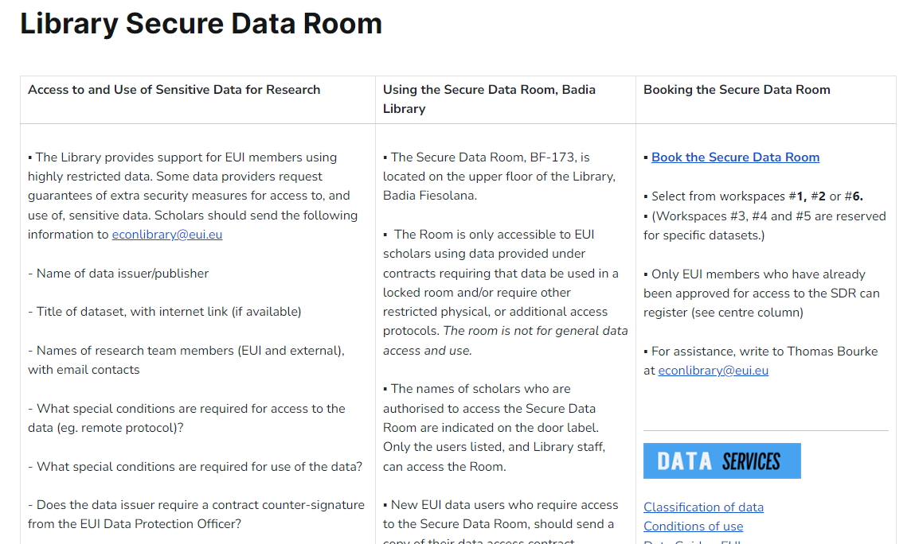

Slide 41
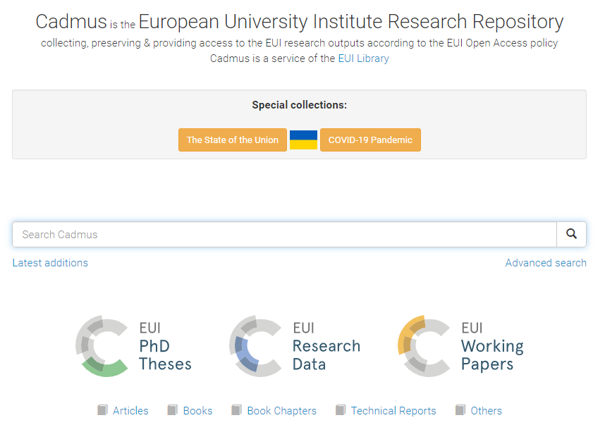

Slide 42
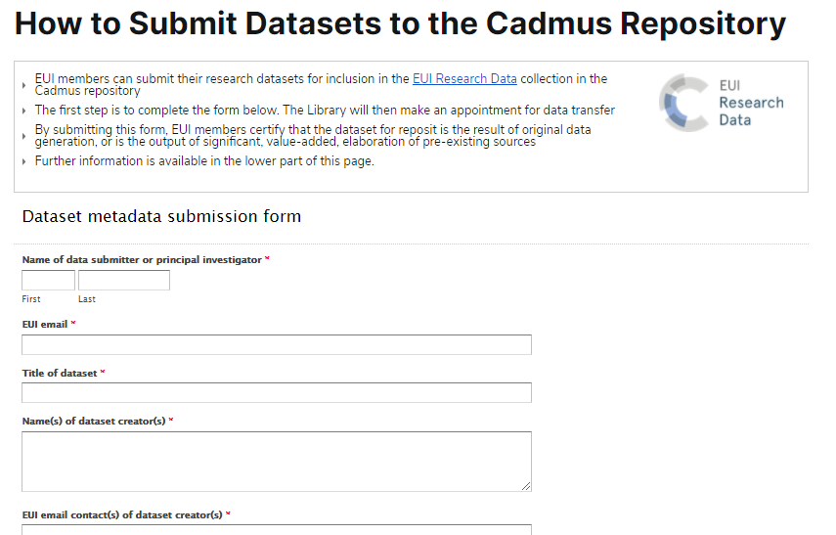

Slide 43
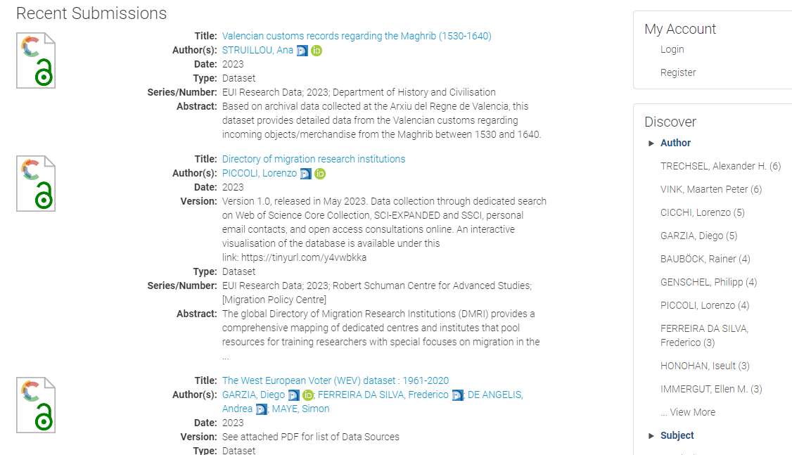

Slide 44
Data Management Plans
Overview and context of research project
How data are collected and generated
What data-related resources are required
How data are used, elaborated and organised during the research project
How data are secured, and how data subjects are protected
How data, code and ancillary elements are described and documented
What kind of data outputs are generated
How data are stored and secured, and how long data will be retained
How dataset authorship and credit are assigned
How data are preserved
How data outputs can be shared.

Slide 45
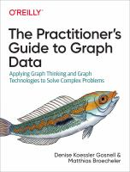
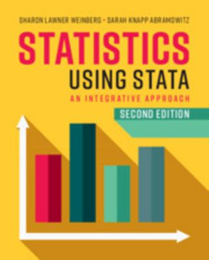
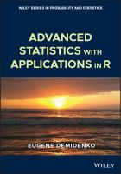
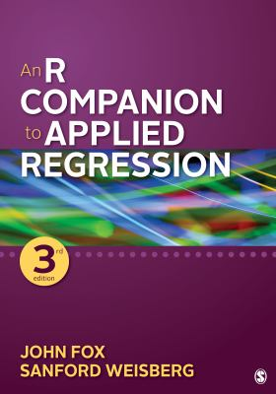
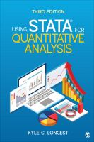
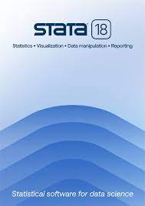
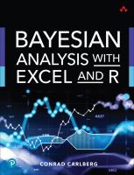
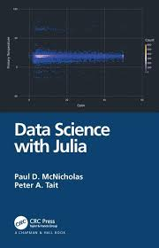
Manuals

Slide 46
Data and statistical science
Data science & software manuals: 001-005
Data methods for Social science: 300.72
Statistical science 519.5
eBooks / eManuals via Catalogue Online

Slide 47
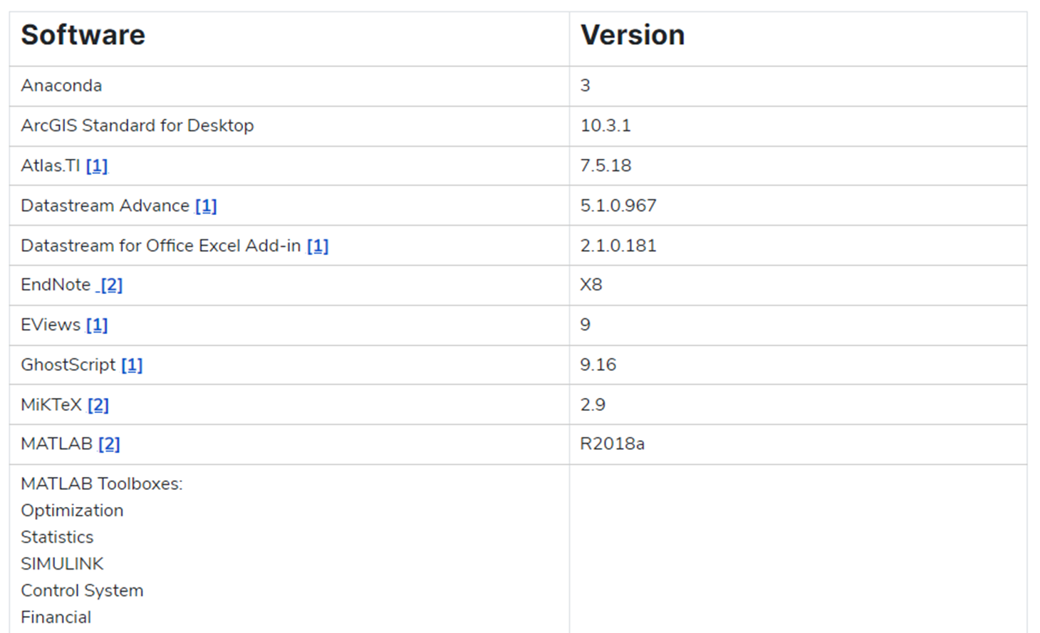
Research software - ICT

Slide 48
Data Resources and Services Wednesday, 11 September 16:30
Badia Fiesolana, Refectory

Slide 49
Weekly Bulletin
Fridays during term
The bulletin provides news about books, journals and data, and information on how to use Library databases and internet resources for social and political research.

Slide 50
Research support
thomas.bourke@eui.eu
Library first floor, BF-085
Political & Social Sciences Collection homepage

Slide 51
Political & Social Sciences Collections and Services 4 September 2024

